Slide 1
Reminders
Notes:
Please take a minute to ensure you are muted and any AI notetakers are turned off. Thank you!

Slide 2
Office Hour Sessions
Dr. Margaret Cage
Deputy Secretary
The Office of Special Education
December 17, 2024
Investing for tomorrow, delivering today.
Notes:
Good afternoon and welcome to Decembers Office Hour Session!
Today’s Office Hour Session will be providing updates, technical assistance, and professional development
A few housekeeping notes, we will have 10-15 minutes for questions at the end of the main presentation preceding the today’s training portion. Training questions will be answered on The Office of Special Education’s Q& A Booklet. This is a living document, and the link will be in the chat. The Office Hour Sessions Slide deck will be accessible on the PED website, in special education, under resources or may be found in the LEA Managed Booklet, under the resources tab.

Slide 3
Leadership/Duties of the Office
Dr. Margaret Cage
Deputy Secretary, OSE
Dr. Tyre Jenkins
Deputy Director, OSE
Charlene Marcotte
Deputy Director of Data & Finance
Ria Gill
Assistant Deputy Director, OSE
Vacancy
Assistant Deputy Director of Data & Finance
Develop, review, and propose updates to state special education statutes, rules, policies, and technical assistance
Consult and coordinate with other units of the Department, other state agencies, public post-secondary educational institutions, and key education and community stakeholders on varying special education topics and issues
Coordinate with school districts and public post-secondary education institutions to develop and provide training and professional development to licensed school employees
Provide technical assistance and recommendations to school districts and public schools to implement evidence- and research-based programs and services that are culturally and linguistically responsive
Conduct activities to promote the recruitment and retention of qualified special education practitioners
Solicit input regarding delivery of special education services in the State from various stakeholders
Oversee and enforce the compliance with the IDEA and any state law pertaining to special education
Collect statewide data on varying aspects of special education within the state
Monitor spending of state and federal funds for special education programs
Develop and annually update a state plan for students with disabilities
Notes:
To the right, please find The Office of Special Education priorities that align with the executive order per Governor Lujan-Grisham. To your left, you will find The Office of Special Education Leadership team.

Slide 4
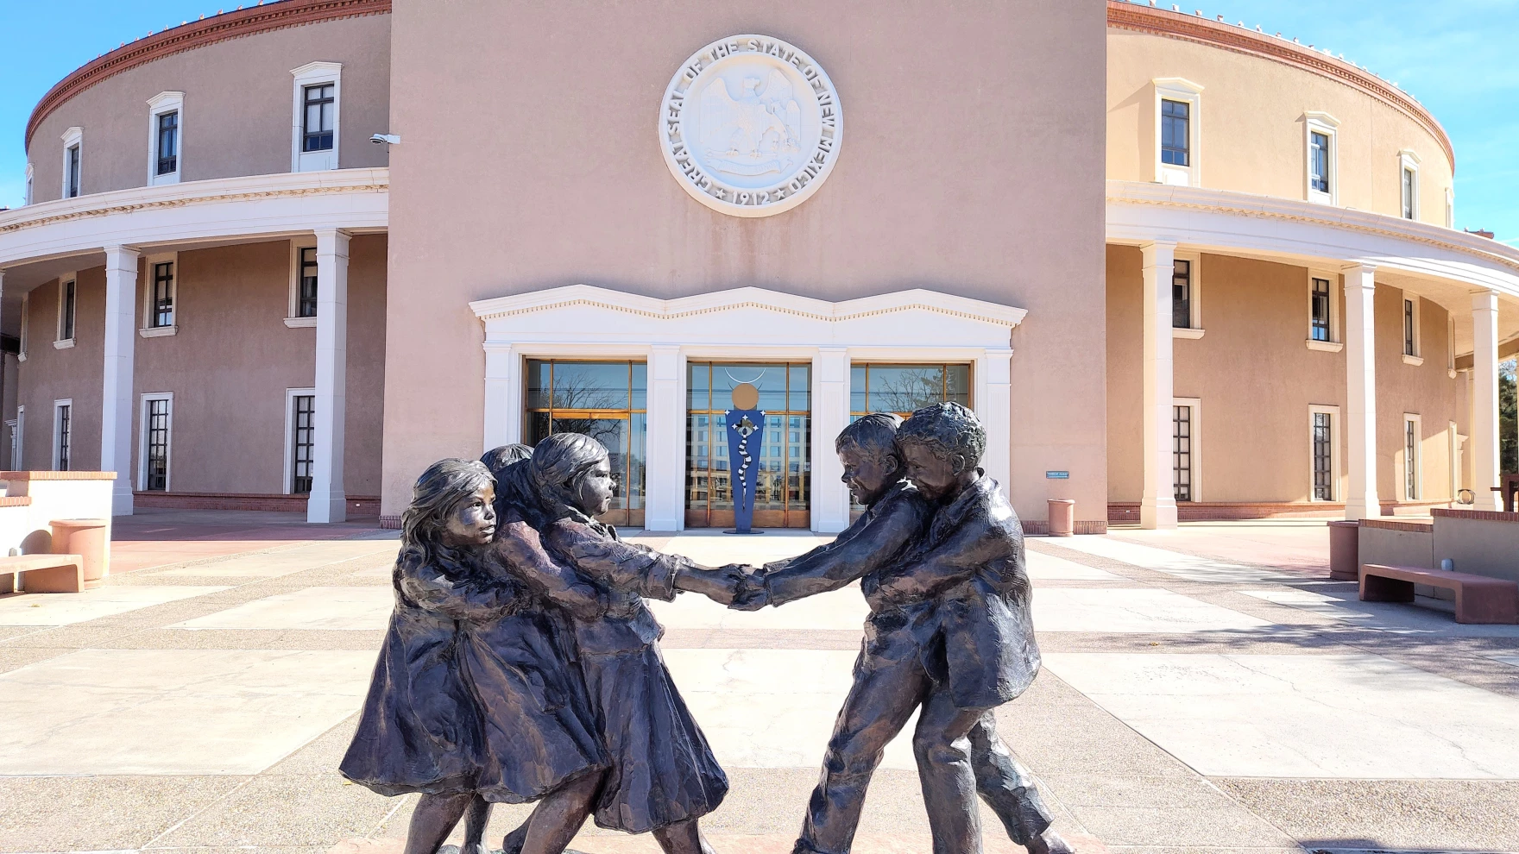
Hiring Updates
https://www.spo.state.nm.us/
Notes:
The OSE is steadily increasing capacity and staff to better serve you. Just a reminder, we are hiring! Please check the state personal office website for job openings.

Slide 5
2025 Special Education Academy

Slide 6
NMPED 1% Alternate Assessment Waiver Extension Request
State is Requesting a waiver of the 1% Cap on Student taking the Alternate Assessment (DLM)
This will be the second year for a waiver request
Based on feedback received, the NMPED's (State Level) 1% Alternate Assessment Waiver Extension Request has been reposted on the Alternate Assessment Monitoring site.
The period for Public Comment has been extended from December 9 - 20, 2024.
Please provide any comments to the 2024-25 Waiver Extension Request using the Google Form.
The window for Public Comment will close at the end of the day on December 20, 2024.

Slide 7
OSE Monthly Newsletter
Submissions to the OSE Newsletter are due by the third Monday of each month and should be sent to special.ednews@ped.nm.gov.
Please share great things happening in your LEA to special.ednews@ped.nm.gov.
The following form can be shared with colleagues who wish to receive the OSE Newsletter: OSE Signup Form.
Here is a linked newsletter submissions schedule through November 2025, as to when article submissions are due.
If you have questions about the newsletter email special.ednews@ped.nm.gov.
Notes:
Thank you, Miguel! Next up, Assistant Deputy Director of OSE, Ria Gill. Ria?

Slide 8
IDEA B Panel Meetings
Quadrants: Dates
Q1: September 5 & 6
(Española Public Schools)
Q2: November 7 & 8
(Virtual)
Q3: February 20 and 21
(Virtual, with the ICC joining on the 21st)
Q4: May 1 & 2
(Location to TBD)
Contact Kaity Ellis for questions
kaitlin.ellis@ped.nm.gov
505-709-7690
Notes:
Ria to present.

Slide 9
Special Education Ombud Flyers
Please direct all website staff, schools, and school personnel to take down the old flyers and post the new flyers in well trafficked areas.
If you would like information about our intake process, family presentations, or general information about our work, please contact:
Clare Gallegos (505) 841-3885
Jody Myers (682)554-6672
Michelle Tregembo (505)274-3885
Notes:
Ria to present.

Slide 10
Just Right Reader
Notes:
Ria to present.

Slide 11
Data & Finance
December 2024
Indicator 13 Review sample provided to LEAs
80-Day data reporting opens
Quarterly spending reports sent to LEAs
Puente Para Los Ninos High-Cost Fund applications released
Notes:
Thank you for that information, Ria! Deputy Director of Data & Finance, Charlene Marcotte is next on deck. Charlene?

Slide 12
80 Day Reminders
Subs and Caseloads
Substitute Teachers are not allowed to carry a caseload for students with disabilities.
See allowable case managers, student levels and codes.
Teachers’ Position Codes | Description of Position
95 | Special Education Speech Language Pathologist Acting as a Caseload Manager (6–21 year olds)
95S | Special Education Speech Language Pathologist Acting as a Caseload Manager (3–5 year olds)
96 | Special Education Preschool Teacher
97 | General Special Education Teacher (K–12)
Level of Student | Student Category | Nova Category Level | Amount of Special Education Services | Teacher Category | FTE
A or minimum level | Student with Disabilities | 1 | 10% or less of the school day | 96 / 97 | 1/35 or .029
A or minimum level | “Speech-Only” Student | 1 | 10% or less of the school day | 95 / 95S | 1/60 or .017
B or moderate level | Student with Disabilities | 2 | 11%–49% of the school day | 96 / 97 | 1/24 or .042
B or moderate level | “Speech-Only” Student | 2 | 11%–49% of the school day | 95 / 95S | 1/35 or .029
C or extensive level | Student with Disabilities | 3 | 50% or more of the school day | 96 / 97 | 1/15 or .067
D or maximum level | Student with Disabilities | 4 | Approaching 100% of the school day | 96 / 97 | 1/8 or .125

Slide 13
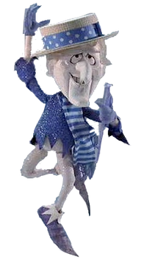
80 Day Reminders
Modified and Ability Graduation Options
Students who graduated on the modified and ability option but returned for a Free and Appropriate Public Education (FAPE) are still students of the LEA and must be reported as such for federal reporting purposes.
This includes students who are enrolled in Project Search or other postsecondary transition programs.
What is a FAPE?
The coursework necessary to earn a Standard Diploma.
Special education and related services.
Students are eligible for a FAPE until they:
Age out at 21 (or 22 if turn 22 after the school year has already started)
Earn a diploma through the Standard program of study.

Slide 14
80 Day Reminders
Indicator 8 Parent Information
The following data points are required for students:
Parent mailing address to send a paper survey mailing to the parent.
Parent email address to send an email with the link to the parent survey.
Parent cell phone number to send a text with the link to the parent survey.

Slide 15
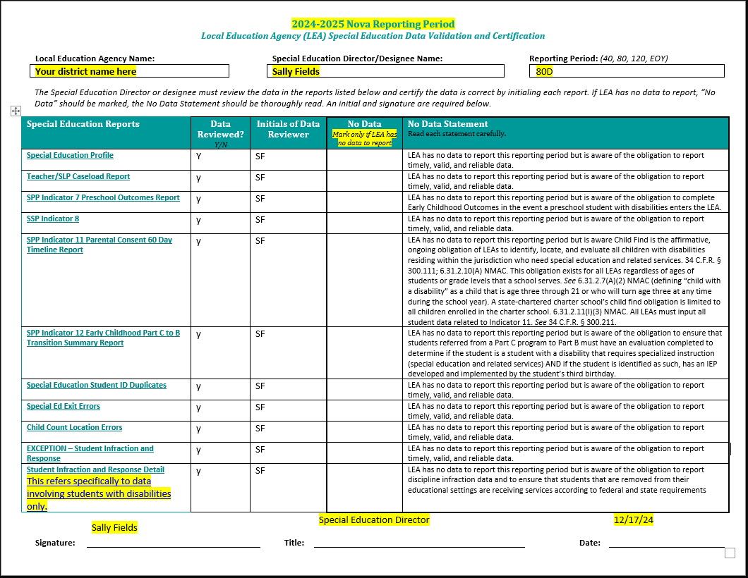
Data Validation Form
This form must be filled out once data in the Nova reports is completely accurate.
By signing, Special Education Director/Designee is indicating they have reviewed each report and confirm accuracy.
- This is done by marking yes/no in the "Data Reviewed"
box and initialing in the box next to it.
"No Data" should be marked with an "X" when an LEA does not have any of data to report for the specific reporting period.
- "No Data" is not the same as "No Errors."
The infraction reports referenced on this page are specific to the data involving students with disabilities only. If have no infraction data for students with disabilities, indicate no data on this form.
Membership count must either be included on this form or as a comment in the DTS.

Slide 16
Time and Effort Reporting – 200.430 (G)
In order to be allowable, personnel expenses must be documented.
Employees paid with federal funds, in whole or in part, must maintain documentation of time worked.
Includes: Full time and part time employees, Federal stipends that are considered salary expenses, Substitute teachers (if employees), etc.
Includes: Any employee whose salary is used to meet a match/cost share requirement (includes state, local, private funds)
Does not apply to contractors
Charges to federal awards for salaries and wages must be based on records that accurately reflect the work performed
Federal Fiscal Cross Cutting Rules & IDEA - September 10, 2024
THE BRUMAN GROUP, PLLC © 2024. ALL RIGHTS RESERVED.

Slide 17
Time and Effort Documentation Standards
Documentation must…
1. Be supported by a system of internal controls which provides reasonable assurance charges are accurate, allowable and allocable;
2. Be incorporated into official records;
3. Reasonably reflect total activity for which employee is compensated;
4. Encompass all activities (federal and non-federal);
5. Comply with established accounting polices and practices; and
6. Support distribution among specific activities or cost objectives.
Federal Fiscal Cross Cutting Rules & IDEA - September 10, 2024
THE BRUMAN GROUP, PLLC © 2024. ALL RIGHTS RESERVED.

Slide 18
Cost Objectives
Cost objective means a program, function, activity, award, organizational subdivision, contract, or work unit for which cost data are desired and for which provision is made to accumulate and measure the cost of processes, products, jobs, and capital projects. A cost objective may be a major function of the recipient or subrecipient, a particular service or project, a Federal award, or an indirect cost activity, as described in subpart E. (200.1)
Anything that requires separate cost accounting (ex. spending caps, mandatory minimums, etc.)
Federal Fiscal Cross Cutting Rules & IDEA - September 10, 2024
THE BRUMAN GROUP, PLLC © 2024. ALL RIGHTS RESERVED.

Slide 19
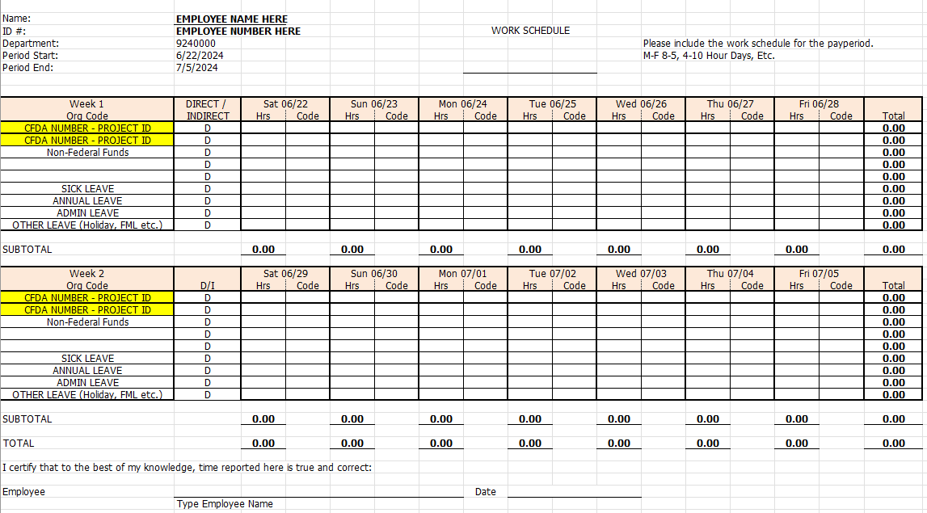
Cost Objectives Continued
Staff paid from more than one funding source must account for time daily and record which cost objective they worked on.

Slide 20
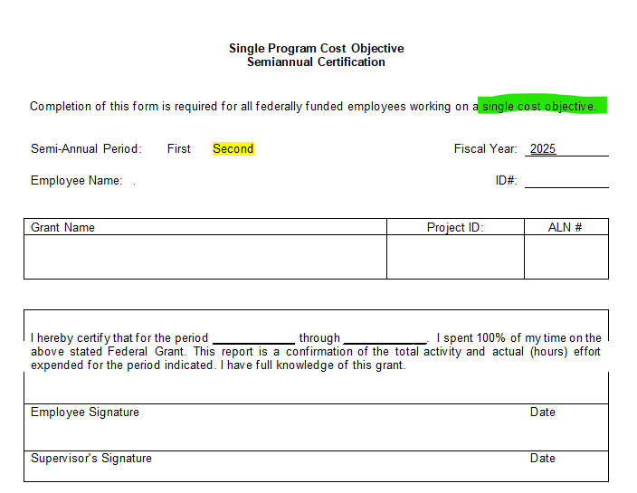
Cost Objectives Continued
Staff paid from one funding source are required to complete a semi-annual certification form.

Slide 21
LEA Time and Effort Submission
To meet federal requirements, LEAs will be required to begin submitting Time and Effort Documentation.
LEAs may use their own forms so long as it contains all information required.
Time and Effort forms to cover the first half of the fiscal year will be due:
January 31, 2024: Period of July 1, 2024 to December 31, 2024
July 31, 2025: Period of January 1, 2025 to June 30, 2025
More information to come on where to upload completed forms.

Slide 22
Finance Monitoring
OSE will begin finance monitoring of the IDEA B grant starting in March to April, 2025.
15 LEAs selected for desk-top monitoring
Letters sent out
Selected LEAs will submit documents in the Special Education Monitoring site
2024-2025
Finance Monitoring Folder
For access to the SE Monitoring site, contact Mahesh Reddy-Erri at mahesh.reddy-erri@ped.nm.gov
All LEAs will be monitored within a 5-Year cycle.

Slide 23
Deadline Reminders
The Puente High-Cost fund application form and guidelines:
https://webnew.ped.state.nm.us/bureaus/special-education/fiscal/
Application submission – the month of January 2025
Note: e-mail attachments, IEPs, must be redacted
Application deadline date – January 31, 2025
Puente High-Cost fund committee meeting – February 14, 2025

Slide 24
Data & Finance Calendar
Data Training: Purple
Finance Training: Blue
Training Key
October 2024
November 2024
December 2024
January 2025
Indicator 13 Annual Review Training for LEAs
Pre-finding Correction Training for LEAs
40-Day Reporting opens, data review begins
Excess cost compliance completion by LEAs
MOE compliance completion by LEAs
Determination Letters sent to LEAs
80-Day data reporting training
40-Day data review closes
Time and Effort Training for LEAs
High-Cost Fund Training
40-Day Pre-finding letter released
MOE Letters sent to LEAs
Indicator 13 Review sample provided to LEAs
80-Day data reporting opens, data review begins
Quarterly spending reports sent to LEAs
Puente Para Los Ninos High-Cost Fund applications released
120-Day data Reporting Training
80-Day data review closes
Indicator 13 Pre-finding notices sent to LEAs
80-Day Pre-finding letters released to LEAs
Time & Effort due from LEAs
Puente Para Los Ninos High-Cost Fund application submission deadline
February 2025
March 2025
April 2025
May 2025
120-Day data review opens, data review begins
Indicator 13-Prong 2 review completion
BOLO for NMASBO Spring Budget Conference Announcements
Advertisements for SPP/APR Stakeholder Meetings
SPP/APR Due to OSEP
MOE Eligibility Training for LEAs
Excess Cost Base trainings for LEAs
IDEA B Application Training
120-Day data review closes
120-Day Prefinding letter released
NMASBO School Budget Conference
SPP/APR Stakeholder Engagement meetings
Quarterly Spending Reports sent to LEAs
State IDEA B Application posted for public review
Puente Para Los Ninos High-Cost Fund awards issued
Indicator 8-Parent Surveys sent out to sampled parents.
MOE eligibility completion by LEAs
Excess Cost Base completion by LEAs
SPP/APR Stakeholder meetings
State Application-Public Comment opens
End of Year (EOY) data reporting training
DPR Training
Indicator 14-Post School Outcomes survey data collections begin
EOY reporting opens, reviews begin
IDEA B application open for LEA completion
SPP/APR Stakeholder engagement meeting
District Profile Report (DPR) data posted on DPR site
State Application-Public Comment closes
1 month to the end of state fiscal year
June 2025
July 2025
August 2025
September 2025
Budgets in OBMS due
Quarterly spending report sent to LEAs
IDEA B applications due from LEAs
Submit RfRs prior to end of Fiscal Year
All LEA IDEA B applications in “Approved by State” or “Substantially Approved” status
State Fiscal Year ends (6/30)
Start of New Fiscal Year (7/1)
Nova Conference
OBMS Deadlines-Reimbursement requests, accounts and payable invoices
Time & Effort for LEAs due
Encumber Funds expiring September 30
EOY Pre-finding letters released to LEAs
Federal Child Count DUE to USDE
Complete and submit Indicator 14 Data Collection
EOY Pre-finding notices sent to LEAs
Nova Conference
IDEA B applications must be fully approved
Board meeting agendas and minutes must be submitted on or before (8/30)
Encumber funds expiring in September
Complete Inventory of Supplies and Materials
40-Day data reporting training
Annual determination training
Excess cost compliance training
MOE Compliance training
Indicator 14 data due from LEAs
Quarterly spending reports sent to LEAs
OSE Law Conference
Federal Funding expires (9/30)
Notes:
Charlene

Slide 25
Data/Finance Team Contact List
Office of Special Education Data Team:
charlene.marcotte@ped.nm.gov
liz.schweiger@ped.nm.gov
tamara.burkett@ped.nm.gov
Office of Special Education Finance Team:
kaylock.sellers@ped.nm.gov
jingchao.jiang@ped.nm.gov
Indicator 14:
gdamian@nmhu.edu
NOVA Data:
alison.watt@ped.nm.gov
nicholas.keyes@ped.nm.gov
Notes:
Charlene

Slide 26
Questions???

Slide 27
TRAINING
Notes:
Switching gears into the training portion of Office Hour Sessions. Please ensure all questions are asked in the Q& A Training booklet. The link will be in the chat. Just a reminder, today’s presentation and slide deck will be on Ped’s website under, OSE, on the resources link to your right. (place Q&A link in chat).

Slide 28
Indicator 13 Secondary Transition for Students Update
OSE Office Hours
Lizana Schweiger, EA Secondary Transition Coordinator OSE
Charlene Marcotte Deputy Director Data and Finance (DDDF)
December 2024
Investing for tomorrow, delivering today.
Notes:
Liz Schweiger will now present on Indicator 13. Liz?

Slide 29
LEA Submission Process for Indicator 13 Review
You will have 2 weeks to submit IEP(s) into the Special Education Monitoring site
2024-2025
Indicator 13 Post Secondary Transition
Student 14-15 IEPs
Student 16+ IEPs
Where to find the Special Education Monitoring site go to:
PED Website New Mexico Public Education Department
PED Apps (IT) Information Technology – New Mexico Public Education Department
(IT) Applicator Information Technology Applications – New Mexico Public Education Department

Slide 30
IEP Upload
IEPs must be in PDF format
Upload the entire IEP
•Parent invitation
•Student invitation
•Signature page (Required)
Name IEP files as follows:
•Last 4 digits of the student ID number, underscore, then type of document.
•Do not use student names.
•Examples:
•1234_invitation
•1234_correction

Slide 31
OSE Indicator 13 Review
OSE will start reviewing IEPs in January 2025.
Your score will be available once all the reviews are complete in February 2025
You must check the Special Education Monitoring Site for LEA score.
You will not receive an email from OSE if your score is 100%. Please check the Special Education Monitoring Site for your score.

Slide 32
Indicator 13 Non-Compliance
Liz Schweiger will email LEAs who did not score 100% on the initial review.
Prong 1: Correction of Non-Compliance
LEAs must make whole the students whose IEPs did not meet all requirements (score less than 100%) by correcting the IEP.
A pre-finding correction notice will be issued, and the LEA must meet the established timelines and criteria outlined in the notice for correcting the IEP.

Slide 33
Indicator 13 Non-Compliance
Prong II
LEAs that did not meet 100% in the initial review are required to participate in a Prong 2 review.
LEAs must:
Demonstrate the systemic issues which caused the non-compliance are corrected.
Evidence must be provided
Submit additional IEPs for review.
Additional information will be provided

Slide 34
Access to Special Education Monitoring Site
Please check NOW to make sure all staff have access to the Special Education Monitoring Site.
Mahesh Reddy-Erri can grant access to the site. Please email him to request access at:
Mahesh.Reddy-Erri@ped.nm.gov

Slide 35
How is Indicator 13 related to Nova 40th day deadline?
Student IDs cannot be pulled until all the LEAs have been validated for 40th day.
If your LEA was not validated for 40th day on the deadline this delayed student IDs from being provided to the LEA.
Everything we do at OSE is dependent on other processes this is why it is important to meet deadlines.
Below is the link for your student IDs (I will put in the link) Use Prong I and Prong I (State)
https://eui.ped.state.nm.us/sites/stars/ProdNova/PublicFolders/District%20and%20School%20Reports/Special%20Education/SPED%20-%20SPP%20Indicator%2013%20Reports/2025%20-%20SPED%20-%20SPP%20Indicator%2013.rdl?d=waed1509b79fa464e8a59db20f9867082
Deadline to enter student IEPs in the SE Monitoring Site, January 13, 2025

Slide 36
Thank you for working with our students. You are the best!

Slide 37
Resources
December 2024 OSE Newsletter
Have Questions for OSE?
ose.support@ped.nm.gov
LEA Managed Booklet
OSE Parent Portal
OSE Resources
Notes:
Thanks Liz! Please find links to the OSE Parent portal, Newsletter, Resources, LEA Managed Booklet or if you have questions for OSE. Just a reminder, you can find Office Hours recordings and slide decks on the PED website, navigate to special education, under the resources tab.

Slide 38
Contact List
Cage, Margaret | margaret.cage@ped.nm.gov | Director of Special Education
Jenkins, Tyre’ | tyre.jenkins@ped.nm.gov | Deputy Director, Office of Special Education
Lozano, Miguel | miguel.lozano@ped.nm.gov | Chief Counsel
Marcotte, Charlene | charlene.marcotte@ped.nm.gov | Deputy Director of Finance and Data
Gill, Ria | ria.gill@ped.nm.gov | Assistant Deputy Director, OSE
Santistevan, Monica | monica.santistevan@ped.nm.gov | Program Support Specialist
Perea, Sharyn | sharyn.perea@ped.nm.gov | Dispute Resolution Coordinator
Cassel, Elizabeth | elizabeth.cassel@ped.nm.gov | Parent and Community Liaison, Complaints and CAPS
Pacheco, Lorie | lorie.pacheco@ped.nm.gov | General Supervision, Low Incidence, NIMAS/NIMAC
Schweiger, Liz | liz.schweiger@ped.nm.gov | Education Administrator, Data Analyst, Indicator 13
Sellers, Kaylock | kaylock.sellers@ped.nm.gov | Financial Coordinator
Quick, Catherine | catherine.Quick@ped.nm.gov | General Supervision, Early Childhood Ed
Notes:
Our newest employee, Monica Santistevan is added to our contact list. Monica is a Program & Supports Specialist.

Slide 39
Contact List
Gallegos, Katalina | katalina.gallegos@ped.nm.gov | Management Analyst
Cordova, Trudy | trudy.cordova@ped.nm.gov | Education Administrator, Professional Development
Dinsmore, Jessica | jessica.dinsmore@ped.nm.gov | Education Administrator, Program and Support Specialist
Burkett, Tammy | tamara.burkett@ped.nm.gov | Education Administrator Data Analyst
Hedrick, Yaling | yaling.hedrick@ped.nm.gov | Education Administrator Program & Support monitor
Gonzales, Kim | kimberly.gonzales1@ped.nm.gov | Education Administrator Program & Support Specialist
Ellis, Kaity | kaitlin.ellis@ped.nm.gov | Social & Community Coordinator
Campbell, Natalie | natalie.campbell@ped.nm.gov | Assistant General Counsel
Jiang, Jingchao | jingchao.jiang@ped.nm.gov | Financial Coordinator
Rodriguez, Jennifer | jennifer.rodriguez1@ped.nm.gov | Executive Secretary
Notes:
This is our continued list.

Slide 40
Mark Your Calendars!
January 21, 2025
Time: 3:30 – TBD
Location: Virtual, Microsoft Teams Click here to join the meeting
Click here to join the meeting
Meeting ID: 252 341 847 618 Passcode: 7tVTBm
Or call in (audio only)
+1 505-312-4308,,779020632#
Phone Conference ID: 779 020 632#
Office Hour Sessions is moving to a
NEW TIME!
Beginning March 18, 2025, OHS will be moving from 3:30 p.m. to 9:00 a.m.
Notes:
Next OHS is January 21, 2025 @ 3:30. Using feedback and analytics, Office Hour Sessions will change time from 3:30 to 9:00 am, every third Tuesday of the month beginning March 2025!!!!

