Slide 1
Unified Application
Pre-Application
January 14, 2024

Slide 2
Overview
IN THIS MEETING, LEAs WILL
AGENDA
Learn the process and next steps to gain access to the UA.
Discuss the UA Pre-Application Module, including key information for completing assurances and the General Education Provisions Act (GEPA) statement.
Review next steps for NOVA data validation.
Background & Context
LEA Access to the UA
Pre-Application Module: Assurances and GEPA Statement
Data Validation
Next Steps
Moving Forward

Slide 3
Background & Context
Today’s UA training call will focus on the initial actions that Local Education Agencies (LEAs) will take to prepare for the UA launch on March 3rd.
There are key activities LEAs need to complete prior to accessing the Unified Application on March 3. Completing these activities will ensure LEAs:
Have the right permissions to access the UA;
Have agreed to all necessary grant assurances;
Have uploaded a GEPA Statement; and
Have accurate data uploaded to their UA.

Slide 4
LEA Access to the UA
Notes:
Ken

Slide 5
Process for LEA Access to the UA
LEAs will access the UA through the OBMS system. One designated LEA individual will have administrative access with the ability to grant editing access to other LEA personnel.
The Planning Lead will be given access to the OBMS system. The Planning Lead is the only individual who can submit the Unified Application on behalf of their LEA.
The Planning Lead will grant UA access to the appropriate LEA personnel involved in completing the UA. Other personnel will have editing access but cannot submit.
Planning Leads will be granted access before the Pre-Application launches on February 17. They will also receive information about granting additional access within their LEA.
Next Step
LEAs participating in the pilot should review the current list of Planning Leads (based on previous surveys) and email Unified.App@ped.nm.gov to confirm or request a change by Friday, January 17.
Notes:
Ken

Slide 6
UA Pre-Application Module Overview
Notes:
Ken

Slide 7
The UA Pre-Application Module
Prior to accessing the UA, LEAs must provide federally required assurances in the Pre-Application module. Additionally, the Pre-Application module requires an upload of the LEA’s General Education Provisions Act (GEPA) statement.
Overview of Assurances and GEPA Statement:
Assurances — The Every Student Succeeds Act (ESEA) and Individuals with Disabilities Education Act (IDEA) require LEAs to confirm adherence to all applicable regulations for administering funds and implementing programs.
GEPA Statement — Section 427 of the General Education Provisions Act requires all applicants for funds to provide a statement that describes the steps the applicant will take to ensure equitable access to, and participation in, federally-assisted programs.
Each LEA must agree to the assurances and provide a GEPA statement to submit their application.
Notes:
Ken

Slide 8
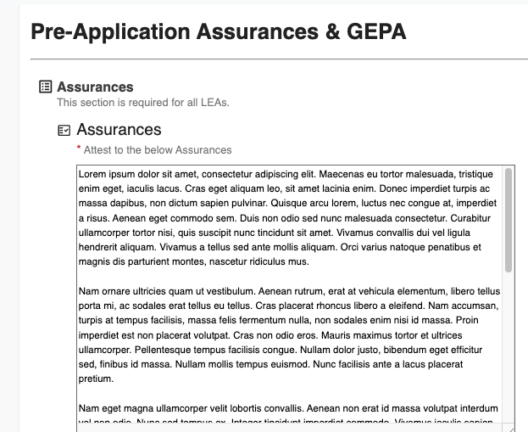
Consolidated Assurances
LEAs will complete assurances for ESEA and IDEA separately. LEAs can download the assurances prior to launch from the Unified Application Support Page.
Assurances will be uploaded on the UA Support page this week and Key Consolidated Assurances include:
Stakeholder engagement administration and compliance
Fiscal management
Reporting and documentation
Personnel requirements
Special populations services
Parent and family engagement
Private school services
Assessment and evaluation
Justice system-involved youth
Assurances for IDEA Part B 611 and 619 are currently under legal review and will be uploaded to the UA support page once finalized.

Slide 9
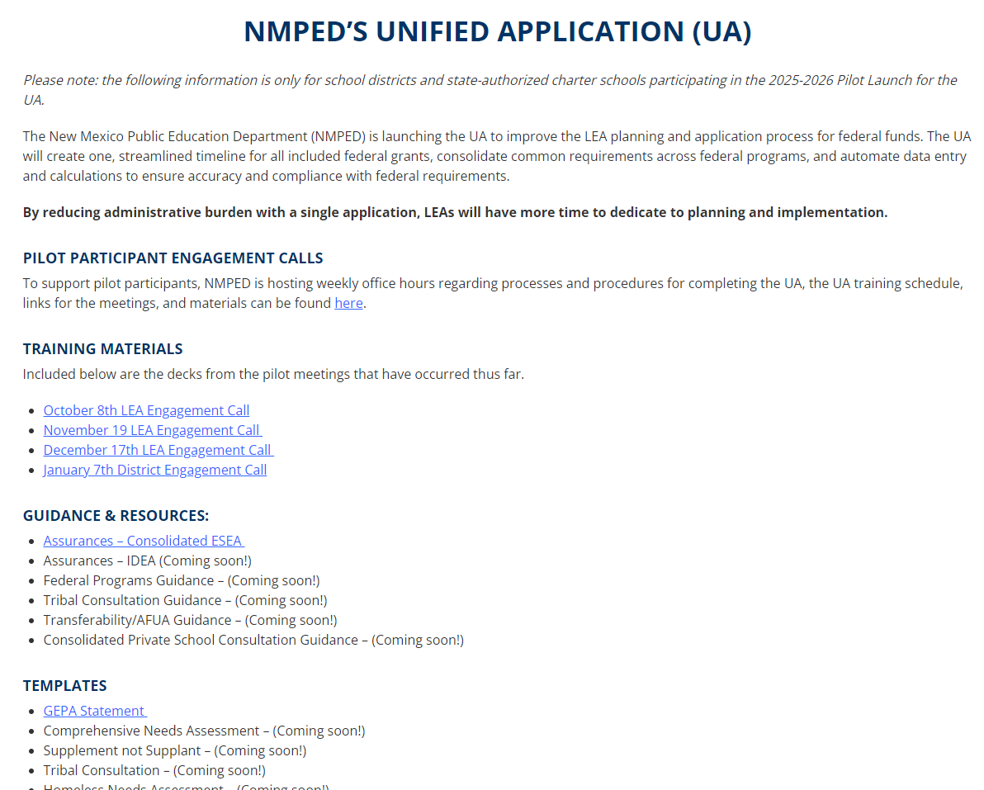
Unified Application Website
Steps to access:
Go to https://webnew.ped.state.nm.us/
Click “Offices and Programs” in the top green menu
Click “Unified Application”
Notes:
Ken

Slide 10
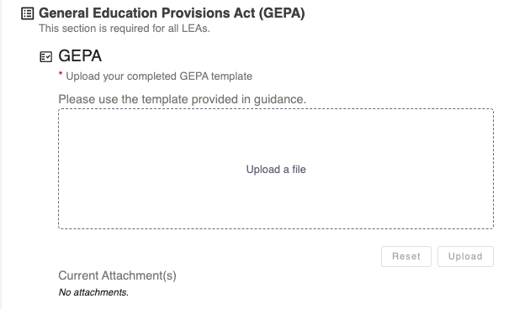
GEPA Statement
LEAs must upload a GEPA statement to access the Unified Application. A template for the GEPA statement is available on the Unified Application Support Page that districts can download, complete, and upload.
GEPA Statement
Grant applicants for federally-assisted education awards must provide a statement that:
Describes how the LEA will ensure equitable access to, and equitable participation in, grant-funded projects and activities;
Identifies potential barriers to equitable access and participation;
Identifies steps the LEA will take to address barriers to equitable access and participation; and
Provides a timeline and targeted milestones for addressing identified barriers.
Notes:
Ken

Slide 11
Planning for the Pre-Application Module
Application Completion Step: LEA’s complete the GEPA Statement
Pre-Application Completion | Description
When | Starting Friday, January 17th, LEAs can access the assurances and GEPA statement from the UA support page. Starting February 17, Planning Leads will access the Pre-Application Module to complete assurances and upload the GEPA statement on behalf of the LEA.
Who | All LEAs will be required to include a GEPA Statement and complete assurances for the UA. ,
Additional Details | These Pre-Application tasks must be complete in order to access the UA when it launches. LEA Planning Leads can access the GEPA statement template on the Unified Application Support Page.
Notes:
Ken

Slide 12
NOVA Data Validation
Notes:
Kirsi

Slide 13
NOVA Data Validation
Five data descriptors are used in various configurations for several purposes (e.g., Title I rank and serve and final allocations). LEAs should ensure all data is accurate and complete.
Key NOVA Data*
1 = SNAP Direct Cert Eligibility, as identified in the Direct Certification report.
2 = Other Direct Cert Eligibility, Homeless, Food Distribution Program on Indian Reservations (FDPIR), Foster, Migrant, and Head Start.
3 = Extended Direct Cert Eligibility, a student who is part of the same household as a student directly matched for Human Services Department (HSD) benefits, but is not themselves matched for those benefits. A list of these students must be manually sent to the Student Success and Wellness Bureau to be updated and verified.
4 = Medicaid - REDUCED Direct Cert Eligibility
5 = Medicaid - FREE Direct Cert Eligibility
*Title I rank and serve will use 80-day counts from SY 2024-2025.
Notes:
Kirsi

Slide 14
Moving Forward

Slide 15
Key Milestones for the UA
The Unified Application will launch in three stages: the Pre-Application Module, ESEA, and IDEA. Unified Application submissions will be due April 16.
Date | UA Milestone
February 17th | Pre-Application Module opens.
March 3rd | Unified Application opens – all modules (except IDEA-specific submodules) available.
March 17th | IDEA-specific submodules released.
April 16th | UA submissions due.
Notes:
Kirsi

Slide 16
Weekly Federal Programs Team Calls Schedule (1/2)
Further training on the Unified Application components will take place until applications are due. Planning leads should ensure personnel attend sessions relevant to their LEAs; not all sessions will be applicable to all LEAs.
Date | Phase | Audience *denotes mandatory | Description
January 7 | Pre-Application | Federal Programs Directors* All LEA Roles | Overview of Unified Application Structure (including budget) and pre-application modules (consolidated assurances, district contacts, etc.)
January 14 | Pre-Application | Federal Programs Directors* All LEA Roles | Overview of Pre-Application Activities (Assurances, , NOVA data validation, LEA Access, etc.).
January 21 | Pre-Application | Federal Programs Directors* All LEA Roles | Comprehensive Needs Assessments, Tribal Consultation, Homeless Needs Assessment
January 28 | Pre-Application | Chief Academic Officers* All LEA Roles | Priorities module overview: Academics for All, Priority Student Groups, Educator Workforce
February 4 | Pre-Application | Private School Equitable Services Captains (Geographical LEAs only)* All LEA Roles | ESSA Equitable Services
February 11 | Pre-Application | Geographical LEA Title I Directors* All LEA Roles | Title I-A: Reservations and Rank & Serve
February 17th | Pre-Application Module Opens
February 18 | Pre-Application | Federal Programs Directors* All LEA Roles | TItle IV & Title III
February 25 | Pre-Application | Federal Programs Directors* All LEA Roles | Expenditure Detail Module & Guidance
March 3 | UA Opens (ESEA)

Slide 17
Planned Topics for Weekly Federal Programs Team Calls (2/2)
Further training on the Unified Application components will take place until applications are due. Planning leads should ensure personnel attend sessions relevant to their LEAs; not all sessions will be applicable to all LEAs.
Date | Phase | Audience *denotes mandatory | Description Tentative & Subject to Change
March 4 | Application Completion | Federal Programs Directors* All LEA Roles | Launching and Transferability/AFUA
March 11 | Application Completion | Federal Programs Directors* All LEA Roles | IDEA Compliance & Proportionate Share
March 17th | UA Opens (IDEA)
March 18 | Application Completion | All LEA Roles | Submitting the Application & Overview of approval process
March 25 | Application Completion | Federal Programs Directors* All LEA Roles | Overview of finance processes that will stay the same and any differences
April 1 | Application Completion | Chief Financial Officers/Business Managers* All LEA Roles | Outstanding Questions
April 8 | Application Completion | All LEA Roles | Outstanding Questions
April 15 | Application Completion | Federal Programs Directors* All LEA Roles | Outstanding Questions
April 16 | UA Submissions Due

Slide 18
Next Steps

Slide 19
Next Steps
LEAs validate their NOVA 80-day data by January 17th.
LEAs confirm (or communicate updates) to their Planning Lead to Unified.App@nmped.gov by January 17th.
LEAs complete the assurances and upload the GEPA statement in this module by March 3rd.

Slide 20
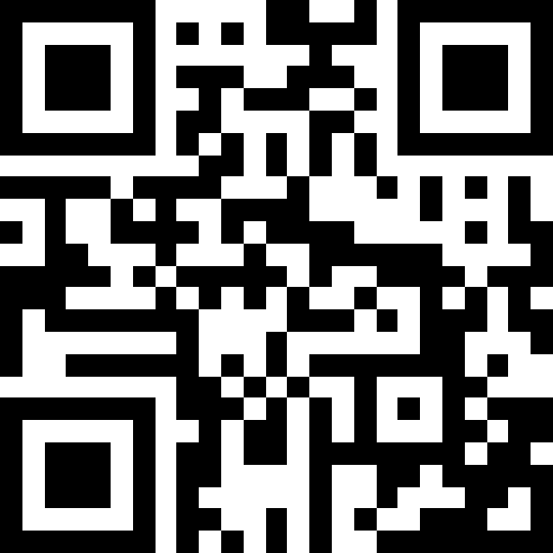
Exit Survey: Questions & Feedback
Link to exit survey
Also available at https://tinyurl.com/NMUAJan14
Please send any questions regarding the Unified Application to:
Unified.App@ped.nm.gov

