Slide 1
Unified Application
ESEA Documentation & Priorities Module
January 28, 2025
Notes:
Ken

Slide 2
Overview
IN THIS MEETING, LEAs WILL
AGENDA
Review the templates, forms, and criteria for completing ESEA documentation for the following:
the Homeless Needs Assessment;
tribal consultation;
supplement not supplant compliance; and
the Comprehensive Needs Assessment.
Understand next steps for completing the ESEA supporting documentation for the UA.
Understand the questions and response guidance for the three domains of the Priorities module:
Academics for All,
Priority Student Groups, and
Educator Workforce.
Background & Context for Supporting Documents
The Homeless Needs Assessment
Tribal Consultation
Supplement not Supplant - Title I Part A
The Comprehensive Needs Assessment
Priorities Module Overview
Academics for All
Priority Student Groups
Educator Workforce
OBMS Module Walkthrough
Notes:
Ken

Slide 3
ESEA Supporting Documentation
Notes:
Ken

Slide 4
Background & Context for Supporting Documents
There are several requirements for Unified Application submission that districts can begin working on prior to application launch.
The Unified Application will require LEAs to upload the following documents:
Homeless Needs Assessment
Tribal Consultation
Supplement Not Supplant form
Comprehensive Needs Assessment (CNA)
Notes:
Ken

Slide 5
Homeless Needs Assessment
Notes:
Daniela

Slide 6
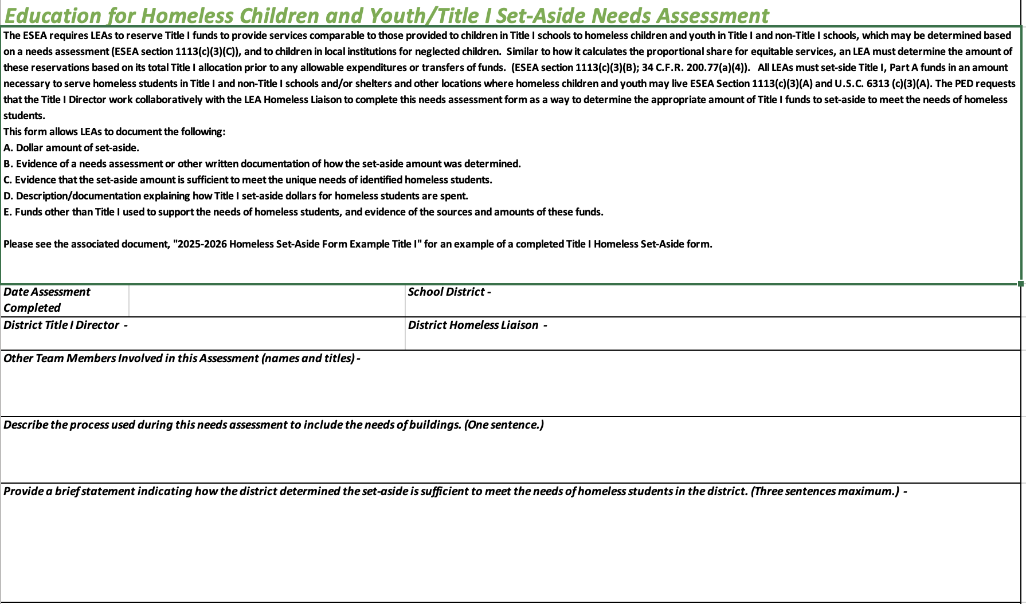
Homeless Needs Assessment Overview
All LEAs must complete the Homeless Needs Assessment, regardless of whether or not they set aside funds. This form is available on the Unified Application Support Page.
The Homeless Needs Assessment
Key information collected in the homeless needs assessment includes:
Dollar amount of set-aside.
Evidence of a needs assessment or other written documentation of how the set-aside amount was determined.
Evidence that the set-aside amount is sufficient to meet the unique needs of identified homeless students.
Description/documentation explaining how Title I set-aside dollars for homeless students are spent.
Funds other than Title I used to support the needs of homeless students, and evidence of the sources and amounts of these funds.
Notes:
Daniela

Slide 7
Tribal Consultation
Notes:
Kirsi

Slide 8
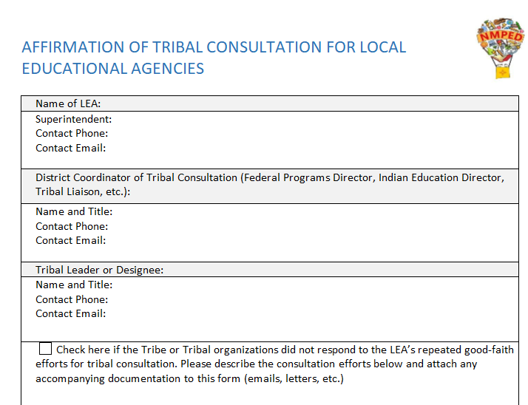
Tribal Consultation Overview
Tribal consultation is required in section 8538 of the ESEA, as amended, for ‘affected’ LEAs prior to submitting an application under ESEA programs. The Affirmation of Tribal Consultation form can be found on the Unified Application Support Page.
The term ‘affected LEA’ means an LEA that has
50% or more of its student enrollment comprised of American Indian (AI) or Alaskan Native (AN) students; or
received an Indian education formula grant under Title VI part A subpart 1 in the previous year that exceeded $40,000.
The Affirmation of Tribal Consultation document can be found on the NMPED’s Indian Education website here.
Please upload the document with all applicable signatures to the UA.
Notes:
Kirsi

Slide 9
Supplement Not Supplant - Title I Part A
Notes:
Kirsi

Slide 10
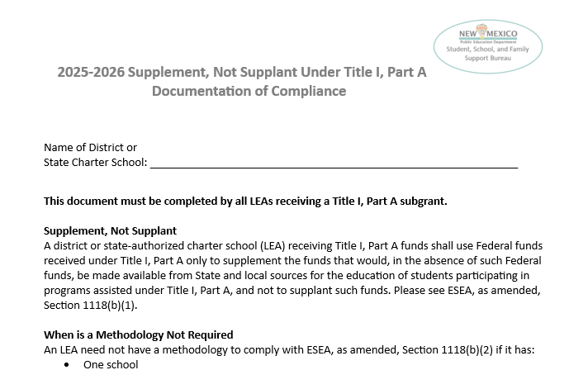
Supplement Not Supplant Overview
The Supplement, Not Supplant Under Title I Part A Documentation of Compliance must be completed by all LEAs applying for a Title I Part A subgrant to ensure compliance with all provisions of ESEA, as amended, section 1118(b). The Supplement Not Supplant form is available on the Unified Application Support Page.
To demonstrate compliance with the supplement not supplant requirement, an LEA’s methodology to allocate State and local funds to schools must result in each Title I school in the LEA receiving all the State and local funds it would otherwise receive if it were not receiving Title I, Part A funds.
Select methodology & provide description
If methodology is not required, select the reason from the listed options
Include LEA name under the Assurance section
Notes:
Kirsi

Slide 11
The Comprehensive Needs Assessment
Notes:
Emily

Slide 12
Comprehensive Needs Assessment (CNA) Overview
The needs assessment is the first step in a continuous improvement cycle. With the UA, there will be key updates to this process.
Purpose:
Identify, understand, and prioritize the needs that districts/charters must address to improve student achievement.
Examination of the current reality (strengths and challenges)
Assess what is needed to get to desired outcomes.
Goals:
Meet compliance regulations
Planning the spending of federal funds
Consider connections between funds
Notes:
Emily

Slide 13
CNA Requirements
 | Title I Part C | Title II Part A | Title III | Title IV Part A
Which districts are required to complete a needs assessment? | All who support migratory students due to qualifying work in agriculture or fishery | All | All, intent to apply available for new Districts/Charters in the fall | Districts/Charters with an award of $30,000 more more.
How often? | annual/27 months | annual/27 months | annual/27 months | Every three years
What areas of improvement must the needs assessment address? | State Comprehensive Needs Assessment | Professional Development (HQ) | English Learner Student Identification | Well-rounded education for all students
 | State Service Delivery Plan | Recruitment of HQ Educators | Immigrant Student Identification and Services | Healthy and safe learning environment
 | Priority for Services | Retention of HQ Educators | Providing EL programs with At-risk and Bilingual funds in the SEG | Effective use of technology for personalized learning and PD.
 |  | Mentorship
Notes:
Emily

Slide 14
Process for CNA with the Unified Application
NMPED recognizes that LEAs are continually looking at data and have several established teams and processes to support school improvement (ex: DASH plans, Strategic Plans, MLSS, Equity Council, etc.)
During at least this first year with the Unified Application, these internal tools will still be accepted.
LEAs will either upload their internal tool/process or upload the provided template.
Although the template is not required to use for LEAs to conduct their CNAs, specific criteria must be met for the process.
Notes:
Emily

Slide 15
The CNA criteria
Notes:
Emily

Slide 16
Comprehensive Needs Assessment Criteria
Upload provided template or LEA tool that is used. If using your own process, your upload must include the following elements:
Who: Identify the members of your stakeholder team
When: Include the date of plan, survey, etc.
What: Identify what data sources were used and your analysis. Summarize your findings and reflections. What needs were identified?
How: Identify desired outcomes that ESEA funds will be used to help address
Upload documentation of two meetings with stakeholder team (agendas and/or meeting notes)
Notes:
Emily

Slide 17
The CNA template
Notes:
Emily

Slide 18
Comprehensive Needs Assessment Template
The CNA Template can be used by LEAs as a tool to guide their assessment process. The CNA Template is available on the Unified Application Support Page.
Identify Stakeholder Team
Stakeholder Team Meeting Dates and Process for Consultations
Identify Multiple Sources of Data
Data Analysis
Identify Priorities
Reflection on Needs as Per ESEA Fund Content/Focus Areas
Make Decisions
Notes:
parents,
teachers,
principals,
other school leaders,
specialized instructional support personnel,
students,
community based organizations,
local government representatives (which may include a local law enforcement agency, local juvenile court, local child welfare agency, or local public housing agency),
Indian tribes or tribal organizations that may be located in the region served by the local educational agency (where applicable),
*charter school teachers, principals, and other school leaders (if such agency or consortium of such agencies supports charter schools)
others with relevant and demonstrated expertise in programs and activities designed to meet the purpose of this subpart.

Slide 19
ESEA Supporting Documentation in the UA
Notes:
Ken

Slide 20
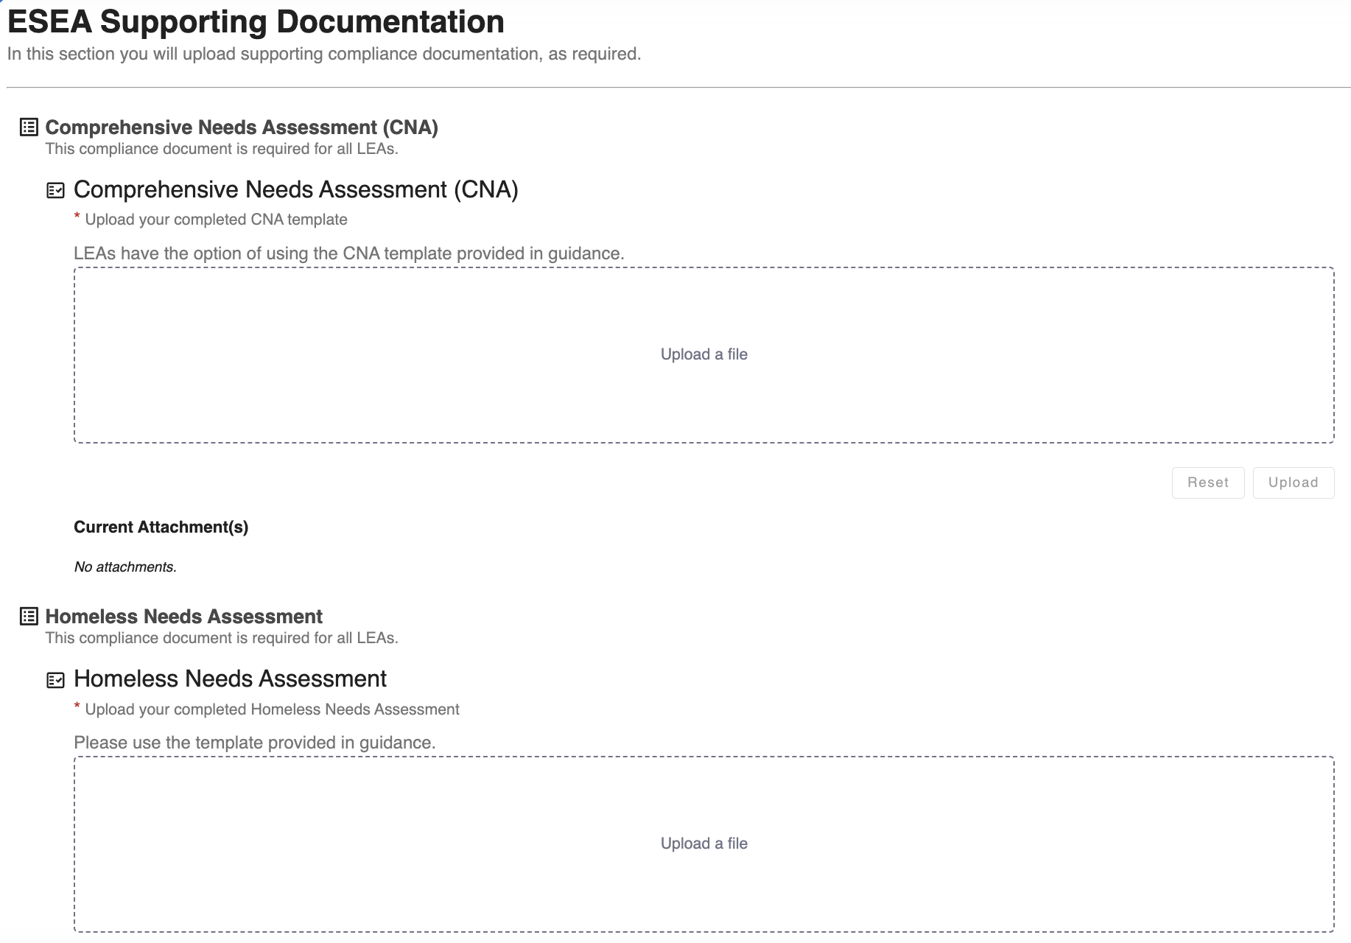
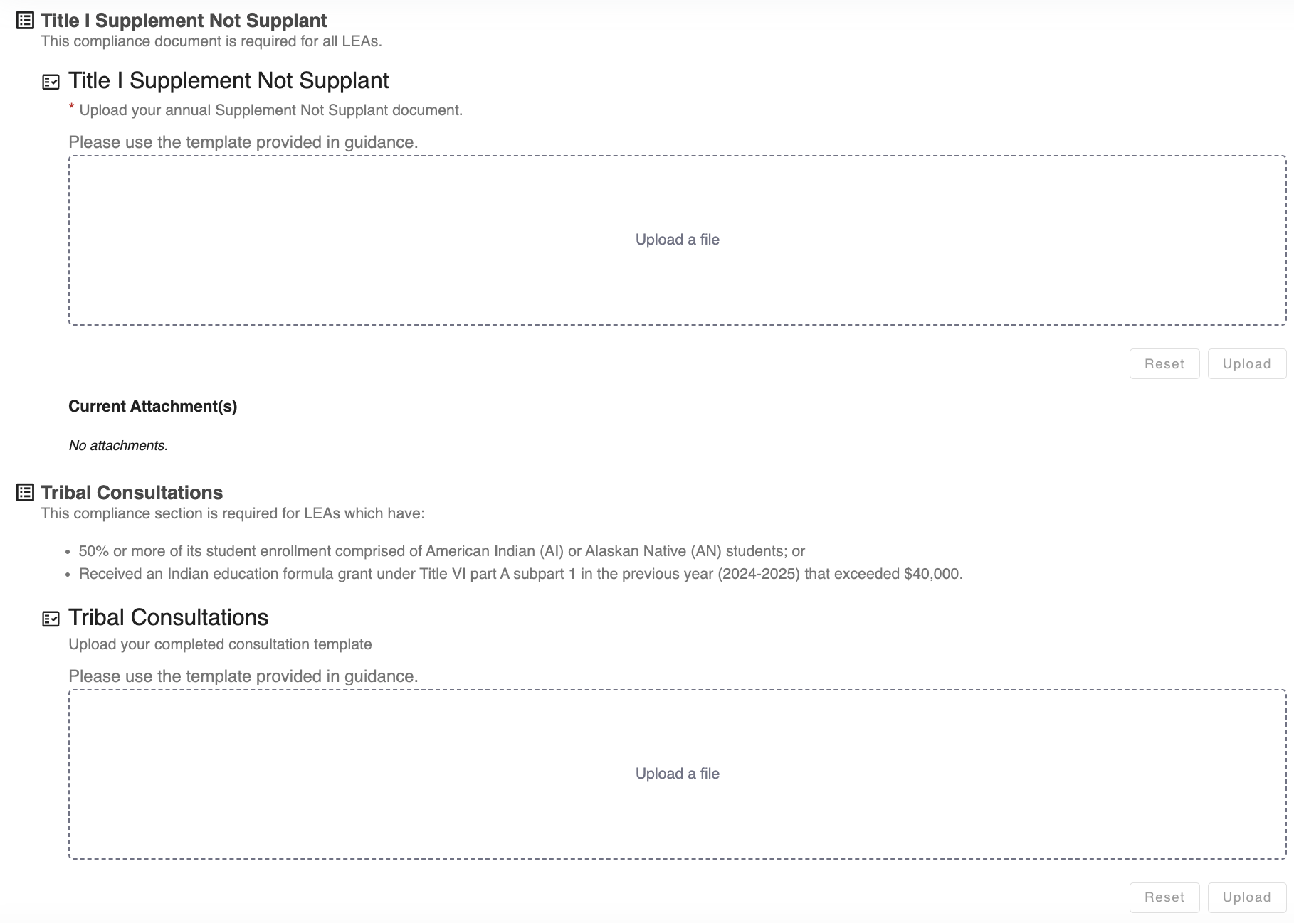
ESEA Documentation in the UA
The ESEA documentation uploads will be a submodule in the Compliance Module of the UA in OBMS. LEAs will upload one or more files with the necessary documents for each requirement as needed.
Notes:
Ken

Slide 21
Priorities Module
Notes:
Ken

Slide 22
Priorities Module Overview
The Priorities module contains three domains where LEAs will identify priorities to improve student achievement. Responses should guide decisions for spending federal funds.
Structure of the UA
Three Domains in the Priorities Module:
Academics for All
Priority Student Groups
Educator Workforce
Module 1
Module 2
Module 3
LEA Priorities
LEA Compliance Decisions
LEA Expenditure Detail
Notes:
Ken

Slide 23
The Academics for All Domain
Notes:
Jacque & Kirsi

Slide 24
Academics for All Overview
The Academics for All domain collects information about education programs to ensure all students meet state academic standards.
The Academics for All domain focuses on:
Core High-Quality Instructional Materials (HQIM) – LEAs will identify the instructional materials planned for use during core instruction in English Language Arts (ELA), math, science, and social studies.
High Quality Professional Learning (HQPL) – LEAs will identify the partners that will provide professional learning for educators on implementing instructional materials.
Title V RLIS – LEAs applying for Title V RLIS funds will summarize how funds have improved student achievement in prior years.
Notes:
Jacque

Slide 25
Academics for All Questions (1/3)
The Priorities module questions are available on the Unified Application Support Page. LEAs can use response guidance for planning and completing the application.
Priority 1A | Question | Response Guidance
Core High-Quality Instructional Materials | Which ELA high-quality instructional materials reviewed by educators from across NM and adopted by the state will be used across each grade band? | LEAs identify which HQIM they use from the state's approved list for each grade band from a drop down menu. If an LEA is not using a HQIM from the adopted list, they should select the 'Other non-approved curriculum product’' option, list the material they are using in the “Name of Curriculum” field, and provide a written explanation of how the material was identified and how the material has been evaluated for rigor as well as cultural and linguistic relevance. (150 character limit)
 | Which math high-quality instructional materials reviewed by educators from across NM and adopted by the state will be used across each grade band?
 | Which science high-quality instructional materials reviewed by educators from across NM and adopted by the state will be used across each grade band?
 | Which social studies high-quality instructional materials reviewed by educators from across NM and adopted by the state will be used across each grade band?
Notes:
Jacque

Slide 26
Academics for All Questions (2/3)
The Priorities module questions are available on the Unified Application Support Page. LEAs can use response guidance for planning and completing the application.
Priority 2A | Question | Response Guidance
High Quality Curriculum- Based Professional Learning | Which partner(s) will provide curriculum-based professional learning on the installation and ongoing implementation of ELA high quality instructional materials by grade band? | LEAs identify the professional learning vendor from a drop down menu. If an LEA is using a vendor not on the list, they should select the ‘Other vendor not in State Marketplace list’ option. LEAs should then list the partner as well as how the professional learning will be sustained, intensive, collaborative, job-embedded, data-driven, classroom-focused, and evidence-based. (150 character limit)
 | Which partner(s) will provide curriculum-based professional learning on the installation and ongoing implementation of math high-quality instructional materials by grade band?
 | Which partner(s) will provide curriculum-based professional learning on the installation and ongoing implementation of science high-quality instructional materials by grade band?
 | Which partner(s) will provide curriculum-based professional learning on the installation and ongoing implementation of social studies high-quality instructional materials by grade band?
Notes:
Jacque

Slide 27
Academics for All Questions (3/3)
The Priorities module questions are available on the Unified Application Support Page. LEAs can use response guidance for planning and completing the application.
Priority 3A | Question | Response Guidance
Title V RLIS – applicable only to LEAs that are eligible for Title V Rural and Low-Income School (RLIS) funds | Is your LEA applying for RLIS? | LEAs indicate “Yes”/”No” to apply for Title V RLIS funds. If “Yes”, LEAs must answer the following: Summarize how Rural and Low-Income School (RLIS) program subgrant awards have impacted student outcomes. The description should include outcomes from at least the most recent RLIS award. The information contained here should help to justify plans for use of funds during this grant year. (250 word count)
Notes:
Kirsi

Slide 28
Priority Student Groups Domain
Notes:
Ken

Slide 29
Priority Student Groups
The Priority Student Groups domain collects information about education programs that will support students with disabilities and English Learners.
The Priority Student Groups domain focuses on:
Students with Disabilities – LEAs will identify plans to support students with disabilities, including: (1) instructional materials (core and supplemental) and professional learning for educators, (2) early and accurate identification, (3) specialized supports and related services, and (4) transitions.
English Learners – LEAs will identify the instructional materials that will support English learners.
Notes:
Ken

Slide 30
Priority Student Groups – Students with Disabilities Questions (1/3)
The Priorities module questions are available on the Unified Application Support Page. LEAs can use response guidance for planning and completing the application.
Priority 1S | Question | Response Guidance
High Quality Instruction for Students with Disabilities | Will the high-quality instructional materials indicated in the Core High-Quality Instructional Materials section be used to support students with disabilities taking the Measures of Student Success and Achievement (MSSA)? | LEAs select "Yes" if the curricula identified in the "Academics for All" section will be used to support students with disabilities. If “No”, LEAs should specify grade bands and partners that differ from those used for all students.
 | Will the professional development partner(s) indicated in the High Quality Professional Learning section be used to train all teachers on how to implement high quality instructional materials that support students with disabilities? | LEAs select "Yes" if the PL vendor identified in "Academics for All" will be used to train teachers on the curriculum being implemented. If “yes”, LEAs will indicate how many Special Education staff will participate in this training. If “No”, LEAs should specify grade bands and partners that differ from those used for all students.
 | Will your LEA provide supplemental materials and training beyond HQIM to support student specific needs in accessing grade level instruction? | LEAs indicate “Yes/No/Not Applicable”. If Yes, LEAs should list the supplemental materials and training they are using via the provided text box.
Notes:
Charlene

Slide 31
Priority Student Groups – Students with Disabilities Questions (2/3)
The Priorities module questions are available on the Unified Application Support Page. LEAs can use response guidance for planning and completing the application.
Priority 2S & 3S | Question | Response Guidance
Early and Accurate Identification for Students with Disabilities | How will the LEA identify students who have disabilities early and accurately? In your response, please list what screening tools will be used and any community partners your LEA will work with to screen students ages 3-5. | LEAs should identify which screening instrument(s) is/are used for children ages 3-5. Please describe how LEA staff coordinate with partners to increase the number of students screened.
Specialized Supports and Related Services for Students with Disabilities | What areas of specialized support (for example, executive functioning skills, communication skills, functional skills, social and behavioral skills) will the LEA address and what strategies will be used for students with disabilities? | LEAs should identify the areas of specialized support they plan to address and the specific strategies they will use to provide this support. (250 word count)
Notes:
Charlene

Slide 32
Priority Student Groups – Students with Disabilities Questions (3/3)
The Priorities module questions are available on the Unified Application Support Page. LEAs can use response guidance for planning and completing the application.
Priority 4S & 5S | Question | Response Guidance
Transitions for Students with Disabilities | Describe your LEA’s transition strategies for students. Please write “Not Applicable” if a transition does not apply to your LEA. | LEAs should identify their process for coordinating supports at key transition points throughout pre-K to grade 12 and for preparing students with disabilities for success in post-secondary education, employment, and adult life. (100 word limit) Each of the following transition points should have a response (even if N/A): pre-K to Kindergarten, Elementary to Middle School, Middle School to High School, and High School to postsecondary, career, and/or military.
Improvements for Students with Disabilities | Targeted individualized plans for high school students | LEAs should describe their plans in the following areas (100 word limit for each section): -Improving dropout rates for students with disabilities -Improving the cohort graduation rate for students with disabilities
Notes:
Charlene

Slide 33
Priority Student Groups – English Learners
The Priorities module questions are available on the Unified Application Support Page. LEAs can use response guidance for planning and completing the application.
Priority 6S | Question | Response Guidance
High Quality Instruction for English Learners | What HQIM are you using for English Language development? | LEAs identify which HQIM they use for English Language Development from the state's approved list for each grade band from a drop down menu. If an LEA is not using an HQIM from the adopted list, they should select the 'Other not-adopted core curriculum' option and list which curriculum the LEA is using for that grade band.
Notes:
Kirsi

Slide 34
Educator Workforce
Notes:
Birgit

Slide 35
Educator Workforce Overview & Questions
The Priorities module questions are available on the Unified Application Support Page. LEAs can use response guidance for planning and completing the application.
Priority 1W & 2W | Question | Response Guidance
Recruitment and Retention | Will the LEA offer recruitment or retention incentives/stipends for hard-to-fill placements? | LEAs identify "Y/N" and provide a list of the placement type for which incentives/stipends will be used and the amount of incentive/stipend.
Mentorship | Will the LEA partner with a vendor to provide a teacher mentorship program? | LEAs select "Yes/No”, If “Yes”, provide the vendor name.
 | Will the LEA use Title II Funds to pay for mentor stipends or for a vendor to provide a teacher mentorship program? | LEAs select "Yes/No”, If “Yes”, upload the LEA's 2024-2025 80D Nova Mentorship Report.
Notes:
Birgit

Slide 36
OBMS Priority Module Walkthrough
Notes:
Ken via Loom

Slide 37
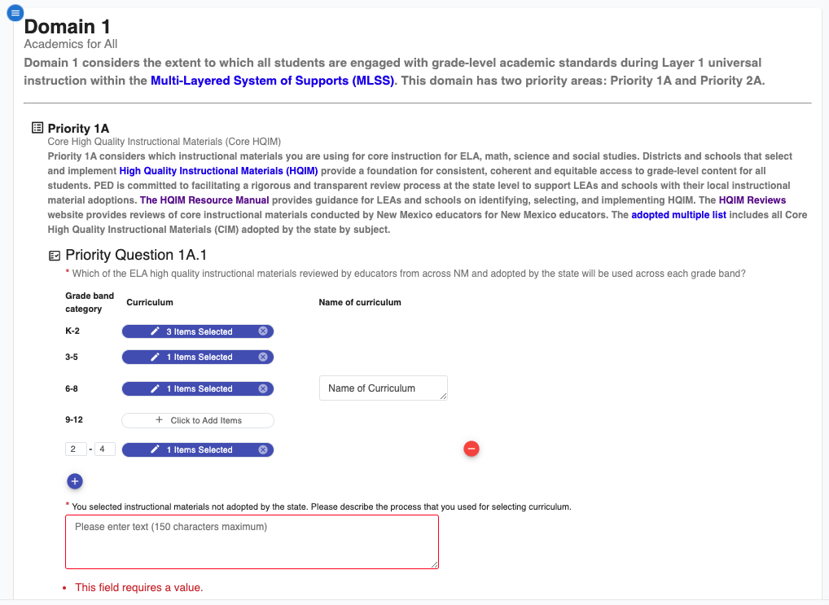
Priorities Module in OBMS
The Priorities module in the UA in OBMS is designed to streamline the priorities planning process for LEAs.
Notes:
Ken

Slide 38
Moving Forward
Notes:
Ken

Slide 39
Key Milestones for the UA
The Unified Application will launch in three stages: the Pre-Application module, ESEA, and IDEA. Unified Application will be due April 16.
Date | UA Milestone
February 17th | Pre-Application module opens.
March 3rd | Unified Application opens – all modules (except IDEA submodules) available.
March 17th | IDEA submodules released.
April 16th | UA due.
Notes:
Ken

Slide 40
Weekly Federal Programs Team Calls Schedule (1/2)
Further training on the Unified Application components will take place until applications are due. Planning leads should ensure personnel attend sessions relevant to their LEAs; not all sessions will be applicable to all LEAs.
Date | Phase | Audience *denotes mandatory | Description
January 7 | Pre-Application | Federal Programs Directors* All LEA Roles | Overview of Unified Application Structure (including budget) and pre-application modules (consolidated assurances, district contacts, etc.)
January 14 | Pre-Application | Federal Programs Directors* All LEA Roles | Overview of Pre-Application Activities (Assurances, , NOVA data validation, LEA Access, etc.).
January 21 | Pre-Application | Federal Programs Directors* All LEA Roles | Comprehensive Needs Assessments, Tribal Consultation, Homeless Needs Assessment
January 28 | Pre-Application | Chief Academic Officers* All LEA Roles | Priorities module overview: Academics for All, Priority Student Groups, Educator Workforce
February 4 | Pre-Application | Private School Equitable Services Captains (Geographical LEAs only)* All LEA Roles | ESEA Equitable Services
February 11 | Pre-Application | Geographical LEA Title I Directors* All LEA Roles | Title I-A: Reservations and Rank & Serve
February 17th | Pre-Application Module Opens
February 18 | Pre-Application | Federal Programs Directors* All LEA Roles | TItle IV & Title III
February 25 | Pre-Application | Federal Programs Directors* All LEA Roles | Expenditure Detail Module & Guidance
March 3 | UA Opens (ESEA)
Notes:
Ken

Slide 41
Planned Topics for Weekly Federal Programs Team Calls (2/2)
Further training on the Unified Application components will take place until applications are due. Planning leads should ensure personnel attend sessions relevant to their LEAs; not all sessions will be applicable to all LEAs.
Date | Phase | Audience *denotes mandatory | Description Tentative & Subject to Change
March 4 | Application Completion | Federal Programs Directors* All LEA Roles | Launching and Transferability/AFUA
March 11 | Application Completion | Federal Programs Directors* All LEA Roles | IDEA Compliance & Proportionate Share
March 17th | UA Opens (IDEA)
March 18 | Application Completion | All LEA Roles | Submitting the Application & Overview of approval process
March 25 | Application Completion | Federal Programs Directors* All LEA Roles | Overview of finance processes that will stay the same and any differences
April 1 | Application Completion | Chief Financial Officers/Business Managers* All LEA Roles | Outstanding Questions
April 8 | Application Completion | All LEA Roles | Outstanding Questions
April 15 | Application Completion | Federal Programs Directors* All LEA Roles | Outstanding Questions
April 16 | UA Submissions Due
Notes:
Ken

Slide 42
Key Notes Regarding Upcoming Sessions
Upcoming sessions will be more specific; LEA Planning Leads can invite additional team members as necessary.
February 4 will focus on equitable services and will be most relevant to districts that administer funds to private schools. Equitable services may be handled independently for each federal program, however the Unified Application will make it easy to appoint a “captain” for equitable share.
February 11 will focus on Title I and the time will be extended. The first 30 minutes will be relevant to all LEAs. The second 60 minutes will cover Title I Rank & Serve and be most relevant to districts with multiple sites and more than 1,000 students (next slide).
Notes:
Ken

Slide 43
Pilot LEAs that will Rank and Serve
NMPED anticipates that 15 LEAs participating in the UA pilot listed below will be required to complete the rank and serve process through the Unified Application for the 2025-2026 Grant Applications .
DRAFT LIST – LEAs that must complete the Rank and Serve Process
Albuquerque Public Schools | Espanola Public School District | Moriarty Public Schools
Aztec Municipal Schools | Gallup-McKinley County Schools | Roswell Independent School District
Belen Consolidated Schools | Grants Cibola County School District | Socorro Consolidated Schools
Central Consolidated Schools | Hatch Valley Public School District | Truth or Consequences Municipal Schools
Deming Public Schools | Lovington Municipal Schools | Zuni Public School District
LEAs not on the list that believe they will need to complete Rank & Serve should email Unified.App@ped.nm.gov.
Notes:
Ken

Slide 44
Next Steps
Notes:
Ken

Slide 45
Next Steps
Identify the LEA lead for the Comprehensive Needs Assessment, Homeless Needs Assessment, Tribal Consultation, and Supplement Not Supplant process.
Plan to ensure all relevant documents are uploaded by the Unified Application submission deadline (April 16, 2025).
Make a plan for which LEA personnel should attend next week’s session focused on the Priorities module.
LEA Planning Leads should convene the planning team to align on answers before the application opens on March 3.
Notes:
Ken

Slide 46
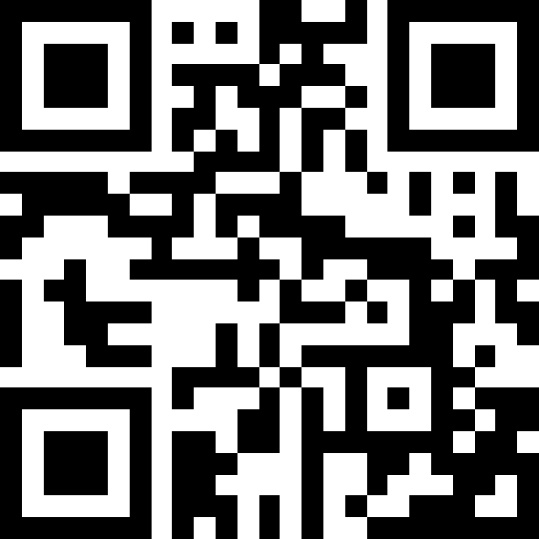
Exit Survey: Questions & Feedback
Link to exit survey
Also available at https://tinyurl.com/NMUAJan28
Please send any questions regarding the Unified Application to:
Unified.App@ped.nm.gov
Notes:
Ken

