Slide 1
Reminders
Notes:
Please take a minute to ensure you are muted and any AI notetakers are turned off. Thank you!

Slide 2
Office Hour Sessions
Dr. Margaret Cage
Deputy Secretary
The Office of Special Education
January 21, 2025
Investing for tomorrow, delivering today.
Notes:
Good afternoon and welcome to January’s Office Hour Session!
Today’s Office Hour Session will be providing updates, technical assistance, and professional development
A few housekeeping notes, we will have 10-15 minutes for questions at the end of the main presentation preceding the today’s training portion. Training questions will be answered on The Office of Special Education’s Q& A Booklet. This is a living document, and the link will be in the chat. The Office Hour Sessions Slide deck will be accessible on the PED website, in special education, under resources or may be found in the LEA Managed Booklet, under the resources tab.

Slide 3
Leadership/Duties of the Office
Dr. Margaret Cage
Deputy Secretary, OSE
Dr. Tyre Jenkins
Deputy Director, OSE
Charlene Marcotte
Deputy Director of Data & Finance
Ria Gill
Assistant Deputy Director, OSE
Vacancy
Assistant Deputy Director of Data & Finance
Develop, review, and propose updates to state special education statutes, rules, policies, and technical assistance
Consult and coordinate with other units of the Department, other state agencies, public post-secondary educational institutions, and key education and community stakeholders on varying special education topics and issues
Coordinate with school districts and public post-secondary education institutions to develop and provide training and professional development to licensed school employees
Provide technical assistance and recommendations to school districts and public schools to implement evidence- and research-based programs and services that are culturally and linguistically responsive
Conduct activities to promote the recruitment and retention of qualified special education practitioners
Solicit input regarding delivery of special education services in the State from various stakeholders
Oversee and enforce the compliance with the IDEA and any state law pertaining to special education
Collect statewide data on varying aspects of special education within the state
Monitor spending of state and federal funds for special education programs
Develop and annually update a state plan for students with disabilities
Notes:
To the right, please find The Office of Special Education priorities that align with the executive order per Governor Lujan-Grisham. To your left, you will find The Office of Special Education Leadership team.

Slide 4
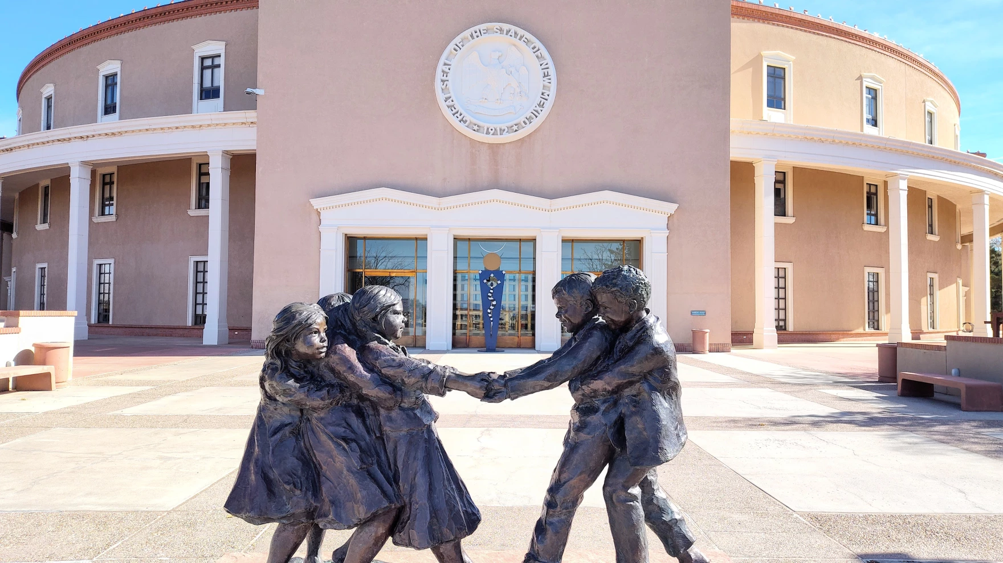
Hiring Updates
https://www.spo.state.nm.us/
Notes:
OSE is steadily increasing capacity and staff to better serve you. Just a reminder, we are hiring! Please check the state personal office website for job openings.

Slide 5
Data & Finance Calendar
Data Training: Purple
Finance Training: Blue
Training Key
October 2024
November 2024
December 2024
January 2025
Indicator 13 Annual Review Training for LEAs
Pre-finding Correction Training for LEAs
40-Day Reporting opens, data review begins
Excess cost compliance completion by LEAs
MOE compliance completion by LEAs
Determination Letters sent to LEAs
80-Day data reporting training
40-Day data review closes
Time and Effort Training for LEAs
High-Cost Fund Training
40-Day Pre-finding letter released
MOE Letters sent to LEAs
Indicator 13 Review sample provided to LEAs
80-Day data reporting opens, data review begins
Quarterly spending reports sent to LEAs
Puente Para Los Ninos High-Cost Fund applications released
120-Day data Reporting Training
80-Day data review closes
Indicator 13 Pre-finding notices sent to LEAs
80-Day Pre-finding letters released to LEAs
Time & Effort due from LEAs
Puente Para Los Ninos High-Cost Fund application submission deadline
February 2025
March 2025
April 2025
May 2025
120-Day data review opens, data review begins
Indicator 13-Prong 2 review completion
BOLO for NMASBO Spring Budget Conference Announcements
Advertisements for SPP/APR Stakeholder Meetings
SPP/APR Due to OSEP
MOE Eligibility Training for LEAs
Excess Cost Base trainings for LEAs
IDEA B Application Training
120-Day data review closes
120-Day Prefinding letter released
NMASBO School Budget Conference
SPP/APR Stakeholder Engagement meetings
Quarterly Spending Reports sent to LEAs
State IDEA B Application posted for public review
Puente Para Los Ninos High-Cost Fund awards issued
Indicator 8-Parent Surveys sent out to sampled parents.
MOE eligibility completion by LEAs
Excess Cost Base completion by LEAs
SPP/APR Stakeholder meetings
State Application-Public Comment opens
End of Year (EOY) data reporting training
DPR Training
Indicator 14-Post School Outcomes survey data collections begin
EOY reporting opens, reviews begin
IDEA B application open for LEA completion
SPP/APR Stakeholder engagement meeting
District Profile Report (DPR) data posted on DPR site
State Application-Public Comment closes
1 month to the end of state fiscal year
June 2025
July 2025
August 2025
September 2025
Budgets in OBMS due
Quarterly spending report sent to LEAs
IDEA B applications due from LEAs
Submit RfRs prior to end of Fiscal Year
All LEA IDEA B applications in “Approved by State” or “Substantially Approved” status
State Fiscal Year ends (6/30)
Start of New Fiscal Year (7/1)
Nova Conference
OBMS Deadlines-Reimbursement requests, accounts and payable invoices
Time & Effort for LEAs due
Encumber Funds expiring September 30
EOY Pre-finding letters released to LEAs
Federal Child Count DUE to USDE
Complete and submit Indicator 14 Data Collection
EOY Pre-finding notices sent to LEAs
Nova Conference
IDEA B applications must be fully approved
Board meeting agendas and minutes must be submitted on or before (8/30)
Encumber funds expiring in September
Complete Inventory of Supplies and Materials
40-Day data reporting training
Annual determination training
Excess cost compliance training
MOE Compliance training
Indicator 14 data due from LEAs
Quarterly spending reports sent to LEAs
OSE Law Conference
Federal Funding expires (9/30)
Notes:
Deputy Director of Data & Finance, Charlene Marcotte will kick us off today. Charlene?

Slide 6
Data & Finance
January 2025
120-Day data Reporting Training
80-Day data review closes
80-Day Pre-finding letters released to LEAs
Excess cost due from LEAs
Puente Para Los Ninos High-Cost Fund application submission deadline
Notes:
Charlene

Slide 7
Discipline Data Submission
Deadline to submit manual data files for school year 2023-2024 is tomorrow, Wednesday, 1/22/2025
This only applies to LEAs who received an email from Charlene Marcotte, Deputy Director of Data and Finance on Tuesday, 1/14/2025

Slide 8
LEA Time and Effort Submission
To meet federal requirements, LEAs will be required to begin submitting Time and Effort Documentation.
LEAs may use their own forms so long as it contains all information required.
Time and Effort form due dates:
February 28, 2025: Period of July 1, 2024 to December 31, 2024
Timeline extended.
July 31, 2025: Period of January 1, 2025 to June 30, 2025

Slide 9
LEA Time and Effort Submission
Time and effort (T&E) forms will be uploaded to the Special Education Monitoring site.
Folders:
Finance Folder
Time and Effort Folder
2024-2025 Folder
Upload T&E forms in this folder.
For access to the SE Monitoring site, contact Mahesh Reddy-Erri at mahesh.reddy-erri@ped.nm.gov

Slide 10
Finance Monitoring
LEAs selected for monitoring will upload documents to the Special Education Monitoring site
Folders:
Finance Folder
Finance Monitoring Folder
2024-2025 Folder
Upload monitoring documents in this folder
For access to the SE Monitoring site, contact Mahesh Reddy-Erri at mahesh.reddy-erri@ped.nm.gov
All LEAs will be monitored within a 5-Year cycle.

Slide 11
Monitoring Overview
PED/OSE is responsible for monitoring programmatic and financial activities of its IDEA Part B subrecipients - LEAs, to ensure:
proper stewardship of the funds received from the U.S. Department of Education.
grants are used for authorized purposes and that activities are following federal statutes, regulations, and the terms and conditions of the subaward.
the subaward performance goals are achieved.

Slide 12
Fiscal Accountability & Compliance Requirements
The following are federal regulatory provisions under which the PED/OSE must monitor for fiscal accountability and compliance:
34 CFR Parts 75, 76, and 77—Education Department General Administrative Regulations (EDGAR)
2 CFR Part 200—Uniform Administrative Requirements, Cost Principles, and Audit Requirements for Federal Awards
2 CFR Part 180—Office of Management and Budget (OMB) Guidelines to Agencies on Governmentwide Debarment and Suspension (Non-procurement)
34 CFR Part 300—Assistance to States for the Education of Children with Disabilities
The OMB’s Uniform Administrative Requirements, Cost Principles, and Audit Requirements for Federal Awards, commonly known as the Uniform Grant Guidance, and other applicable regulations establish fiscal requirements for nonfederal agencies and other entities that are recipients of federal funds.

Slide 13
Desk Review
Desk reviews verify that each LEA has internal controls in place to ensure LEA compliance with federal and state statutes.
The desk reviews include:
a review of the files submitted by the LEA, may include but are not limited to, the following:
budget and/or expenditure reports
time and effort documentation
documentation related to program-specific areas (where applicable)
board-approved fiscal policies and procedures
additional fiscal data submitted at the request of the NMPED
grant award letters, contracts, files, documents, and related correspondence
audit reports (as necessary)

Slide 14
Monitoring Tool
The fiscal monitoring tool to be used can be found here:
NMPED Fiscal Monitoring Tool.docx - Google Docs
LEAs selected for monitoring - start reviewing the tool and preparing documents which will be requested.
LEAs not undergoing monitoring this round should also begin reviewing the protocol to ensure all requirements are being met.

Slide 15
American Rescue Plan Act (ARPA) Funds
OSE is seeking a late liquidation request for ARPA funds
LEAs with unspent ARPA funds will be receiving an email soon
Complete google form and submit information requested.
The following documents will be required:
Purchase orders
Contracts
Dated invoices, bills of lading or other billing documents
Descriptions and clear explanations will be needed

Slide 16
Puente High-Cost Fund Deadline Reminders
The Puente High-Cost fund application form and guidelines:
https://webnew.ped.state.nm.us/bureaus/special-education/fiscal/
Application submission – the month of January 2025
Note: e-mail attachments, IEPs, must be redacted
Application deadline date – January 31, 2025
Puente High-Cost fund committee meeting – February 14, 2025

Slide 17
Direct Costs - CFR 200.413
Direct Costs: those costs that can be identified specifically with a particular final cost
objective, such as a federal award, or other internally or externally funded activity,
or that can be directly assigned to such activities relatively easily with a high degree
of accuracy.
• Typically incurred specifically to benefit an award
•The federal award is the Individuals with Disabilities Education Act (IDEA) Part B.
Slides taken from EDGAR Academy, The
Bruman Group, PLLC

Slide 18
Indirect Costs - CFR 200.414
For costs that cannot be directly charged to the grant, grantees have an indirect cost rate
Salaries of administrative and clerical staff should be treated as “indirect” unless all of the following are met
Such services are integral to the activity
Individuals can be specifically identified with the activity
Costs not also recovered as indirect
Pass-through entities must accept all federally negotiated indirect cost rates for subrecipients
Object Code 53713
Slides taken from EDGAR Academy, The
Bruman Group, PLLC

Slide 19
Determining Cost Type
Is this a direct or indirect cost?
Considerations:
Such services are integral to the activity
Individuals can be specifically identified with the activity
Costs not also recovered as indirect

Slide 20
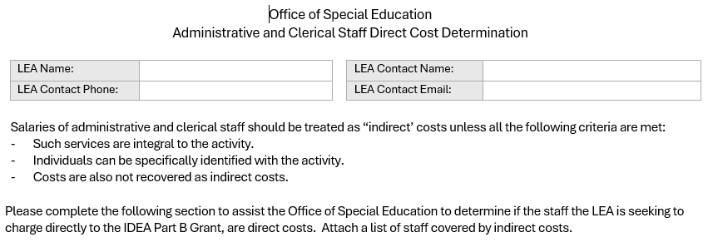
Administrative and Clerical Staff Direct Cost Determination Form
Notes:
Katalina

Slide 21
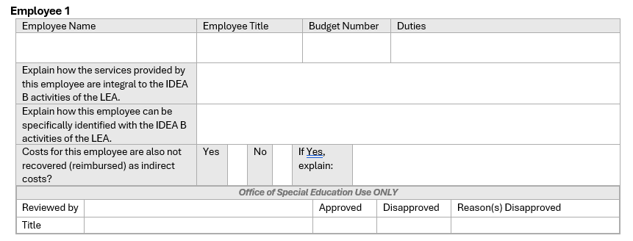
Administrative and Clerical Staff Direct Cost Determination Form

Slide 22
Substitutes
Substitutes can only cover for special education staff and not for general education staff.
Considerations:
Substitutions for special education professional development
Proportionality
Substitution for special education classroom or caseload
Entirely allowable
Substitutions for a regular education classroom
Not allowable

Slide 23
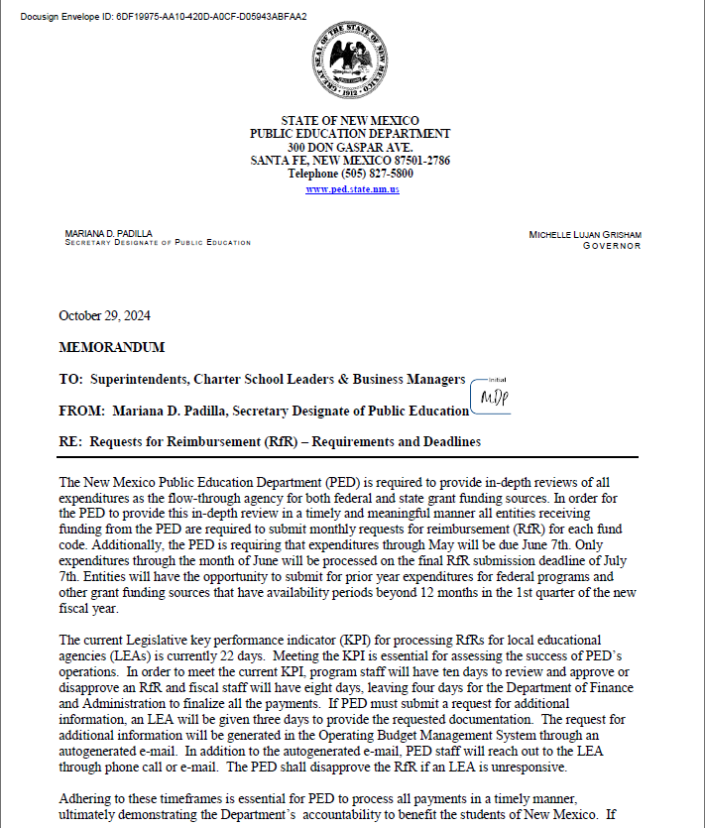
RfR Timelines
LEAs must reply to info requests entered into OBMS.
After 2 days of no LEA response, phone calls and emails will be sent out.
RfR disapprovals:
If RfR reaches 10 days pending with OSE:
The entire RfR may be disapproved; or
Line item disapproved for the item(s) in question.
The weekend and holidays are included in the 10 days.

Slide 24
RfR Tips
To avoid the need for info requests and delays in approval, please ensure that:
Backup documentation is provided for all expenses
For example:
Purchase orders
Invoices
Administrative Staff Consideration Form
All expenses are:
An excess cost of providing special education and related services
Allocable – only correct share of cost is charged
Reasonable – costs meet the prudent person test
Necessary – needed to provide special education and related services

Slide 25
Data/Finance Team Contact List
Office of Special Education Data Team:
charlene.marcotte@ped.nm.gov
liz.schweiger@ped.nm.gov
tamara.burkett@ped.nm.gov
trudy.cordova@ped.nm.gov
Office of Special Education Finance Team:
kaylock.sellers@ped.nm.gov
jingchao.jiang@ped.nm.gov
NOVA Data:
alison.watt@ped.nm.gov
nicholas.keyes@ped.nm.gov
Indicator 14:
gdamian@nmhu.edu
Notes:
Thank you, Kaylock! Trudy

Slide 26
Spring Special Education Law Conference
Tentatively Scheduled
Tuesday April 15, 2025, and Wednesday April 16, 2025
Times: TBD
Location: TBD
Save the Date! Registration will be available soon!!!
Conference will cover same topics as 2024 Fall Law Conference, excluding finance training.
LEAs are encouraged to send Superintendents, School and District Administrators, and Teachers that did not attend Fall conference
Notes:
Thank you! Chief Counsel Miguel Lozano has some exiting news to share. Miguel?

Slide 27
OSE Monthly Newsletter
Submissions to the OSE Newsletter are due by the second Monday of each month and should be sent to special.ednews@ped.nm.gov.
Please share great things happening in your LEA to special.ednews@ped.nm.gov.
The following form can be shared with colleagues who wish to receive the OSE Newsletter: OSE Signup Form.
Here is a linked newsletter submissions schedule through November 2025, as to when article submissions are due.
If you have questions about the newsletter email special.ednews@ped.nm.gov.
Notes:
Thank you, Miguel! Next up, Assistant Deputy Director of OSE, Ria Gill. Ria?

Slide 28
IDEA B Panel Meetings
Quadrants: Dates
Q1: September 5 & 6
(Española Public Schools)
Q2: November 7 & 8
(Virtual)
Q3: February 20 and 21
(Virtual, with the ICC joining on the 21st)
Q4: May 1 & 2
(Location to TBD)
Contact Kaity Ellis for questions
kaitlin.ellis@ped.nm.gov
505-709-7690
Notes:
Ria to present.

Slide 29
Connections! - OSE Parent Newsletter
Our new monthly OSE parent newsletter, Connections!, released its inaugural issue last week for parents.
Our goal is to continue building strong, supportive, collaborative relationships with families of students with disabilities, school districts, and leaders from our state’s cradle to career initiative set for the by the education Secretaries and our Governor, Michelle Lujan Grisham.
Connections! will play an important role in this effort. Through this newsletter, our goal is to keep parents informed and engaged in the educational journey of their children, while also aligning with specific special education initiatives within the State Plan.
connections.news@ped.nm.gov
Parent Resource Spotlight
Notes:
Thank you, Ria! Dr. Elizabeth Cassel will now introduce a new OSE initiative-Connections. Dr. Cassel?

Slide 30
Special Education Ombud Flyers
Please direct all website staff, schools, and school personnel to take down the old flyers and post the new flyers in well trafficked areas.
If you would like information about our intake process, family presentations, or general information about our work, please contact:
Clare Gallegos (505) 841-3885
Jody Myers (682)554-6672
Michelle Tregembo (505)274-3885
Notes:
Thank you, Dr. Cassel. Next up, Ombud.

Slide 31
Contact List
Cage, Margaret | margaret.cage@ped.nm.gov | Director of Special Education
Jenkins, Tyre’ | tyre.jenkins@ped.nm.gov | Deputy Director, Office of Special Education
Lozano, Miguel | miguel.lozano@ped.nm.gov | Chief Counsel
Marcotte, Charlene | charlene.marcotte@ped.nm.gov | Deputy Director of Finance and Data
Gill, Ria | ria.gill@ped.nm.gov | Assistant Deputy Director, OSE
Santistevan, Monica | monica.santistevan@ped.nm.gov | Program Support Specialist
Perea, Sharyn | sharyn.perea@ped.nm.gov | Dispute Resolution Coordinator
Cassel, Elizabeth | elizabeth.cassel@ped.nm.gov | Parent and Community Liaison, Complaints and CAPS
Pacheco, Lorie | lorie.pacheco@ped.nm.gov | General Supervision, Low Incidence, NIMAS/NIMAC
Schweiger, Liz | liz.schweiger@ped.nm.gov | Education Administrator, Data Analyst, Indicator 13
Sellers, Kaylock | kaylock.sellers@ped.nm.gov | Financial Coordinator
Quick, Catherine | catherine.Quick@ped.nm.gov | General Supervision, Early Childhood Ed

Slide 32
Contact List
Gallegos, Katalina | katalina.gallegos@ped.nm.gov | Management Analyst
Cordova, Trudy | trudy.cordova@ped.nm.gov | Education Administrator, Professional Development
Dinsmore, Jessica | jessica.dinsmore@ped.nm.gov | Education Administrator, Program and Support Specialist
Burkett, Tammy | tamara.burkett@ped.nm.gov | Education Administrator Data Analyst
Hedrick, Yaling | yaling.hedrick@ped.nm.gov | Education Administrator Program & Support monitor
Gonzales, Kim | kimberly.gonzales1@ped.nm.gov | Education Administrator Program & Support Specialist
Ellis, Kaity | kaitlin.ellis@ped.nm.gov | Social & Community Coordinator
Campbell, Natalie | natalie.campbell@ped.nm.gov | Assistant General Counsel
Jiang, Jingchao | jingchao.jiang@ped.nm.gov | Financial Coordinator
Rodriguez, Jennifer | jennifer.rodriguez1@ped.nm.gov | Executive Secretary
Notes:
This is our continued list.

Slide 33
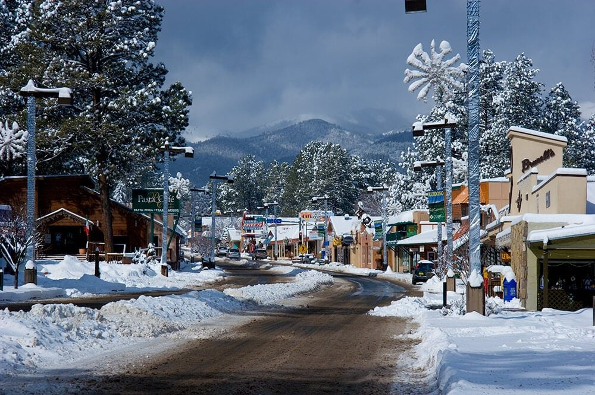
Mark Your Calendars!
February 18, 2025
Time: 3:30 – TBD
Location: Virtual, Microsoft Teams Click here to join the meeting
Click here to join the meeting
Meeting ID: 252 341 847 618 Passcode: 7tVTBm
Or call in (audio only)
+1 505-312-4308,,779020632#
Phone Conference ID: 779 020 632#
Office Hour Sessions is moving to a
NEW TIME!
Beginning March 18, 2025, OHS will be moving from 3:30 p.m. to 9:00 a.m.
Notes:
Next OHS is February 18, 2025 @ 3:30. Using feedback and analytics, Office Hour Sessions will change time from 3:30 to 9:00 am, every third Tuesday of the month beginning March 2025!!!!

Slide 34
Questions???

Slide 35
TRAINING
Notes:
Switching gears into the training portion of Office Hour Sessions. Please ensure all questions are asked in the Q& A Training booklet. The link will be in the chat. Just a reminder, today’s presentation and slide deck will be on Ped’s website under, OSE, on the resources link to your right. (place Q&A link in chat).

Slide 36
Indicator 13 Secondary Transition for Students & 120-Day Data Training
OSE Office Hours
Lizana Schweiger, EA Secondary Transition Coordinator OSE
January 21, 2025
Investing for tomorrow, delivering today.
Notes:
Liz Schweiger will now present on Indicator 13 and 120-day Data Training. Liz?

Slide 37
I-13 Submission
Deadline for I-13 was Monday 1.13.25
If you had an extension, it expired yesterday Monday 1.20.25
If I-13 IEPs are not submitted, they will be considered late.
Reviews will start tomorrow Wednesday 1.22.25
Tentative Completion date is Monday 3.10.25

Slide 38
Indicator 13 Non-Compliance
Liz Schweiger will email LEAs who did not score 100% on the initial review.
Prong 1: Correction of Non-Compliance
LEAs have 10 days to make whole the students whose IEPs did not meet all requirements (score less than 100%) by correcting the IEP.
A pre-finding correction notice will be issued, and the LEA must meet the established timelines and criteria outlined in the notice for correcting the IEP.

Slide 39
OSE Indicator 13 Review Recap
LEA scores will be available once all the reviews are complete in March 2025
Check the Special Education Monitoring Site for LEAs score.
You will not receive an email from OSE if your score is 100%. Please check the Special Education Monitoring Site for your score.

Slide 40
120 Day Reminders 2-12-2025
Subs and Caseloads
Substitute Teachers are not allowed to carry a caseload for students with disabilities.
See allowable case managers, student levels and codes.
Teachers’ Position Codes | Description of Position
95 | Special Education Speech Language Pathologist Acting as a Caseload Manager (6–21 year olds)
95S | Special Education Speech Language Pathologist Acting as a Caseload Manager (3–5 year olds)
96 | Special Education Preschool Teacher
97 | General Special Education Teacher (K–12)
Level of Student | Student Category | Nova Category Level | Amount of Special Education Services | Teacher Category | FTE
A or minimum level | Student with Disabilities | 1 | 10% or less of the school day | 96 / 97 | 1/35 or .029
A or minimum level | “Speech-Only” Student | 1 | 10% or less of the school day | 95 / 95S | 1/60 or .017
B or moderate level | Student with Disabilities | 2 | 11%–49% of the school day | 96 / 97 | 1/24 or .042
B or moderate level | “Speech-Only” Student | 2 | 11%–49% of the school day | 95 / 95S | 1/35 or .029
C or extensive level | Student with Disabilities | 3 | 50% or more of the school day | 96 / 97 | 1/15 or .067
D or maximum level | Student with Disabilities | 4 | Approaching 100% of the school day | 96 / 97 | 1/8 or .125

Slide 41
120 Day Reminders
Modified and Ability Graduation Options
Students who graduated on the modified and ability option but returned for a Free and Appropriate Public Education (FAPE) are still students of the LEA and must be reported as such for federal reporting purposes.
This includes students who are enrolled in Project Search or other postsecondary transition programs.
What is a FAPE?
The coursework necessary to earn a Standard Diploma.
Special education and related services.
Students are eligible for a FAPE until they:
Age out at 21 (or 22 if turn 22 after the school year has already started)
Earn a diploma through the Standard program of study.

Slide 42
120 Day Reminders
Indicator 8 Parent Information
The following data points are required for students:
Parent mailing address to send a paper survey mailing to the parent.
Parent email address to send an email with the link to the parent survey.
Parent cell phone number to send a text with the link to the parent survey.
This data will be collected manually for LEAs having SIS difficulties.

Slide 43
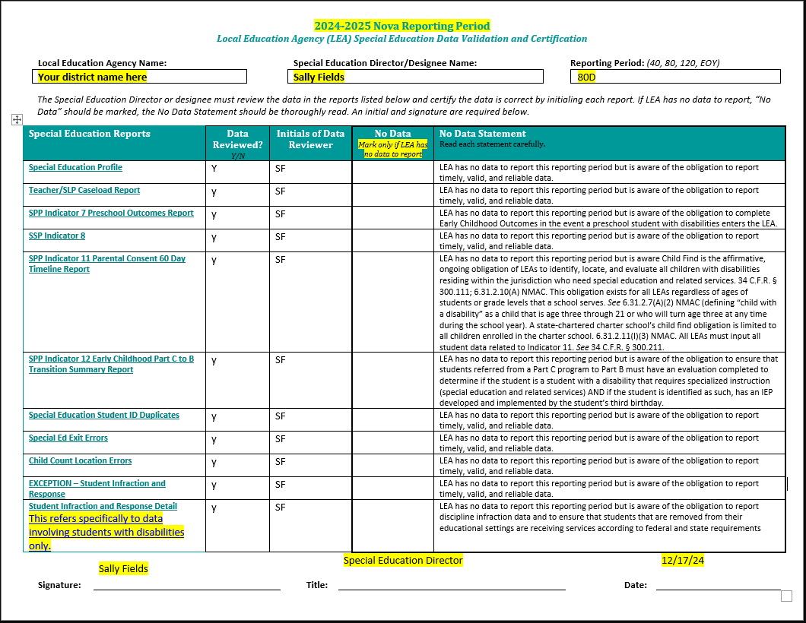
Data Validation Form
This form must be filled out once data in the Nova reports is completely accurate.
By signing, Special Education Director/Designee is indicating they have reviewed each report and confirm accuracy.
- This is done by marking yes/no in the "Data Reviewed"
box and initialing in the box next to it.
"No Data" should be marked with an "X" when an LEA does not have any of data to report for the specific reporting period.
- "No Data" is not the same as "No Errors."
The infraction reports referenced on this page are specific to the data involving students with disabilities only. If have no infraction data for students with disabilities, indicate no data on this form.
Membership count must either be included on this form or as a comment in the DTS.

Slide 44
Resources
December 2024 OSE Newsletter
Have Questions for OSE?
ose.support@ped.nm.gov
LEA Managed Booklet
OSE Parent Portal
OSE Resources
Notes:
Thanks Liz! Please find links to the OSE Parent portal, Newsletter, Resources, LEA Managed Booklet or if you have questions for OSE. Just a reminder, you can find Office Hours recordings and slide decks on the PED website, navigate to special education, under the resources tab.

Slide 45
Thank you for working with our students. You are the best!

