Slide 1
Special Education Monitoring
An Overview of IDEA and NMAC Requirements
February 5, 2025

Slide 2
Welcome!
Thank you for all you do for children and youth with disabilities.

Slide 3
Housekeeping
This session is being recorded.
Artificial Intelligence (AI) tools, such as notetakers are not permitted and will be removed from the Zoom room.
Please be mindful of FERPA and confidentiality requirements. Refrain from sharing personally identifiable information. For questions regarding specific needs beyond the scope of systems monitoring, contact OSE.

Slide 4
Disclaimer
TAESE does not provide legal advice.
Check with your legal counsel or the New Mexico Public Education Department (PED) staff if you have specific questions or issues.
The Office of Special Education Programs (OSEP) has the final authority regarding IDEA.
Notes:
Poll for attendees

Slide 5
Introductions
Frank Podobnik, Associate Director
Kristen Perez-Rickels, TA Specialist
Alex Langevin, TA Specialist

Slide 6
TAESE Major Centers and Projects

Slide 7
Purpose
Provide districts and their staff an overview of the General Supervision requirements of IDEA and the LEA responsibilities.
Participants can ask questions and share concerns about their district’s special education procedures.
Notes:
Note: within Zoom, participants can use the Q&A function to ask a question at any time.

Slide 8
Objectives
Participants will:
Understand the eight components of General Supervision.
Better understand their roles and responsibilities in carrying out IDEA.

Slide 9
Special education requirements
Individuals with Disabilities Education Act (IDEA) of 2004.
Implementing regulations initially issued in 2006 but revised many times.
Litigation.
New Mexico Administrative Code (NMAC).
OSE Policy and Procedure Guides for Special Education.
District Policy and Procedural Guidance.
Both the SEA and the local district may enact policies and procedures that exceed the requirements of the IDEA.
No policy or procedure can reduce the protections of the IDEA.
Notes:
Requirements funnel down from federal to state to district. At each point of the funnel, requirements can become more rigorous, but never less.

Slide 10
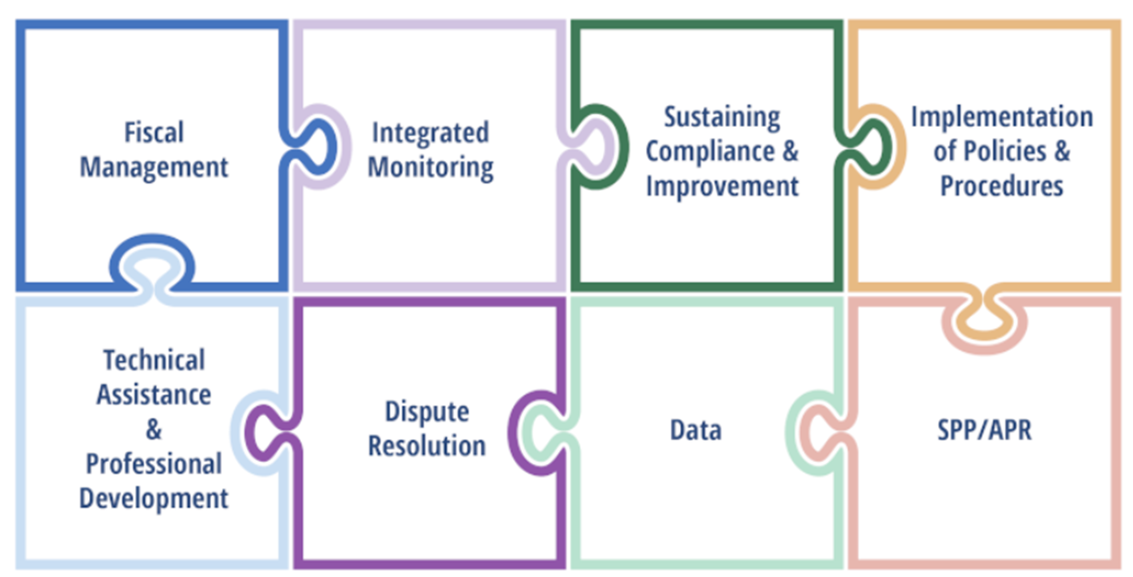
General Supervision
Notes:
Mention here the role monitoring plays in continuous improvement within the puzzle pieces of sustaining compliance and improvement and implementation of policies and procedures. Remind LEAs to leverage monitoring information to support prioritization and design of technical assistance and professional development plans.
Discussion Question:
What current systems are in place for internal LEA monitoring? How do these processes inform district PD systems or school improvement mechanisms?

Slide 11
Fiscal Management
2 CFR § 200.303 Internal controls.
The recipient and subrecipient must:
Establish, document, and maintain effective internal control over the Federal award that provides reasonable assurance that the recipient or subrecipient is managing the Federal award in compliance with Federal statutes, regulations, and the terms and conditions of the Federal award.
Allowable Costs
Maintenance of Effort
Time and Effort Tracking
Notes:
LEAs are the subrecipient of the federal award, and as such must have internal controls in place to ensure they are in compliance with all IDEA statutes and regulations and make corrections when noncompliance is found.

Slide 12
Policies and Procedures
34 CFR § 300.149 SEA responsibility for general supervision
(b) The State must have in effect policies and procedures to ensure that it complies with the monitoring and enforcement requirements in §§300.600 through 300.602 and §§300.606 through 300.608.
34 CFR § 300.201 Consistency with State policies.
The LEA, in providing for the education of children with disabilities within its jurisdiction, must have in effect policies, procedures, and programs that are consistent with the State policies and procedures established under §§300.101 through 300.163, and §§300.165 through 300.174.
Notes:
Kristen
LEAs must have policies, procedures, and programs in place. Again, LEAs can put in place more specific and rigorous policies and procedures but can not enact less stringent requirements.
Discussion Question:
Do you have an LEA procedures guide? How are new staff trained on LEA policies and procedures? How often are they reviewed and who reviews them? How do staff and families provide feedback and input?

Slide 13
Data
34 CFR § 300.211 Information for SEA.
The LEA must provide the SEA with information necessary to enable the SEA to carry out its duties under Part B of the Act, including, with respect to §§300.157 and 300.160, information relating to the performance of children with disabilities participating in programs carried out under Part B of the Act
This includes the data used for SPP/APR, EDFacts Reports, and Annual Determinations.
The LEA must ensure the data provided are valid and reliable.

Slide 14
State Performance Plan
The State Performance Plan (SPP) is the six year plan each state is required to develop. The SPP contains 18 indicators which the SEA is required to report on annually (APR).
In New Mexico, the SPP data are used for:
Annual Determinations – State Performance Plan (SPP) Indicator data reviewed for each LEA.
Identification of LEAs with noncompliance related to Indicators 4 (discipline), 9 (identification rates), 10 (identification by disability), 11 (initial evaluation timeline), 12 (Part C to Part B transition), and 13 (post-secondary transition).

Slide 15
Dispute Resolution
The SEA must maintain a system for implementing the Procedural Safeguards available to parents and students under the IDEA.
These procedures include:
Written State Complaints
Due Process Requests
Mediation
Notes:
Alex

Slide 16
Sustaining Compliance and Improvement
Each LEA in New Mexico is assigned to a 5-year monitoring cycle that identifies in which school year the LEA will be visited by the OSE staff.
The nature of the type of visit the LEA will receive is determined by the OSE staff based on certain risk factors.
Monitoring can occur through:
Self-monitoring activities
Virtual monitoring by OSE staff
On-site monitoring by OSE staff
Compliance record reviews are conducted using the protocol developed by the OSE.
Notes:
Kristen

Slide 17
Monitoring follow-up
Following the monitoring action, the LEA must make improvement efforts.
All instances of student noncompliance are corrected.
LEAs determine the root cause of any systemic noncompliance.
Corrective actions are defined and implemented (e.g., new staff training, revisions to policy, etc.).
Monitoring actions are a crucial component of program improvement and should be considered as an opportunity for growth. If there are not instances of technical noncompliance, consider where are there opportunities for best practice improvement.
Notes:
Kristen

Slide 18
Integrated Monitoring
The integrated monitoring system in New Mexico has several components:
Annual Determinations – State Performance Plan (SPP) Indicator data reviewed for each LEA.
Identification of LEAs with noncompliance related to Indicators 4 (discipline), 9 (identification rates), 10 (identification by disability), 11 (initial evaluation timeline), 12 (Part C to Part B transition), and 13 (post-secondary transition).
Written State Complaints and Due Process Requests.
Compliance record reviews.

Slide 19
Technical Assistance
In addition to written guidance and procedures, the SEA is required to make available to LEAs, parents and other agencies, technical assistance and professional development to support the improvement of services and outcomes for children with disabilities.
Technical Assistance is support intended to assist in addressing a specific issue.
Professional Development is support that is broader in nature and is intended to improve skills that are not necessarily to address a specific issue.
Notes:
Kristen

Slide 20
Record Review Process
The OSE has developed an electronic protocol for documenting the review of special education records.
Please consider joining us for a deeper dive of this tool:
February 18th virtually
February 19th in-person
Notes:
Kristen
This protocol can be found at:
Virtual: https://usu.co1.qualtrics.com/jfe/form/SV_dcELzeRWgyEyNLw
In-Person: https://usu.co1.qualtrics.com/jfe/form/SV_5BGohxNsgt7oRiS

Slide 21
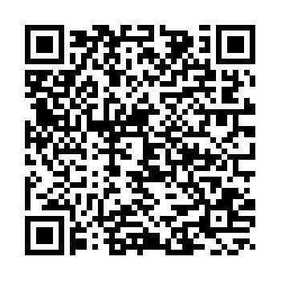
Session Evaluation
Evaluation Link
Notes:
https://docs.google.com/forms/d/e/1FAIpQLScyw2dFxmRod4E5CLUaJAeEK9Ii_MMr9V9eDShajpig_NlzLw/viewform?usp=sharing

Slide 22
Questions

Slide 23
Thank you!

