Slide 1
NMPED Unified Application
ESEA Equitable Services
February 4, 2025
Notes:
Ken

Slide 2
Overview
IN THIS MEETING, LEAs WILL
AGENDA
Understand the purpose and process of ESEA Equitable Services compliance.
Preview the ESEA Equitable Services in the Unified Application.
ESEA Equitable Services Overview
Equitable Services Consultation
Equitable Services Requirements
Equitable Services in the Unified Application (UA)
OBMS Module Walkthrough
Notes:
Ken

Slide 3
Overview
Notes:
Daniela

Slide 4
Purpose and Overview of Equitable Services
The purpose of ESEA (amended by ESSA) is to provide ALL children opportunity to receive a fair, equitable, and high-quality education and to close educational achievement gaps.
Each LEA that receives ESEA funds must make funds available for education support authorized by each title to qualified students in compliance with Federal law and regulations.
Programs Eligible for Equitable Services –
Title I, Part A-Improving Basic Programs Operated by Local Educational Agencies (LEAs)
Title I, Part C - Education of Migratory Children
Title II, Part A- Supporting Effective Instruction
Title III, Part A- Language Instruction for English Learners and Immigrant Students
Title IV, Part A- Student Support and Academic Enrichment

Slide 5
ESEA Eligibility for Title Programs
Each federal program utilizes a different student count to identify private school eligibility for equitable services.
 | Title I-A | Title I-C | Title II-A | Title III | Title IV-A
Student Eligibility | Must live in a Title I funded school within the LEA Must be academically at-risk based on two agreed upon criteria | Must meet statutory and regulatory definitions of a migratory child Must be recorded by the State on the National Certificate of Eligibility | Must be used school-wide May include private school instructional staff, principals and/or other school leaders | Must be identified as an English Learner (EL) student | May be used school-wide May be used for private school students, instructional staff, principals and/or other school leaders
Teacher/Parent Eligibility | Must be a teacher or parent of an eligible Title I-A student | N/A | N/A | Must be a teacher or parent of an eligible Title III-A student | N/A

Slide 6
Equitable Services Eligibility and Determination
Who is eligible for Equitable Services under Title I Part A?
Under section 1117 of the ESEA:
School districts are required to provide services for eligible private school students, teachers and their families that are equitable to those of eligible public-school students.
A private school student generates Title funds if he/she resides within an attendance area of a participating Title I public school and meets the established low-income criteria.
A private school student who can participate in Title I services resides within an attendance area of a participating Title I public school and is failing or at risk of failing state student academic achievement standards. Low-income status alone is not a basis for participation in the Title I program.
Selected students who will be served must be failing, or at risk of failing, to meet student academic achievement standards
Eligibility of students with other Title Programs
Title I, Part C - Only for eligible migratory children or youth
Title II- Educators, principals and other educational personnel in nonprofit private elementary and secondary schools in the LEA’s service area are eligible
Title III- Equitable services are available to students attending private, non-profit schools who are identified as English Language Learners (ELLs) or immigrant children, that receives Title III funding.
Title IV- May be used for private school students, instructional staff, principals and/or other school leaders.

Slide 7
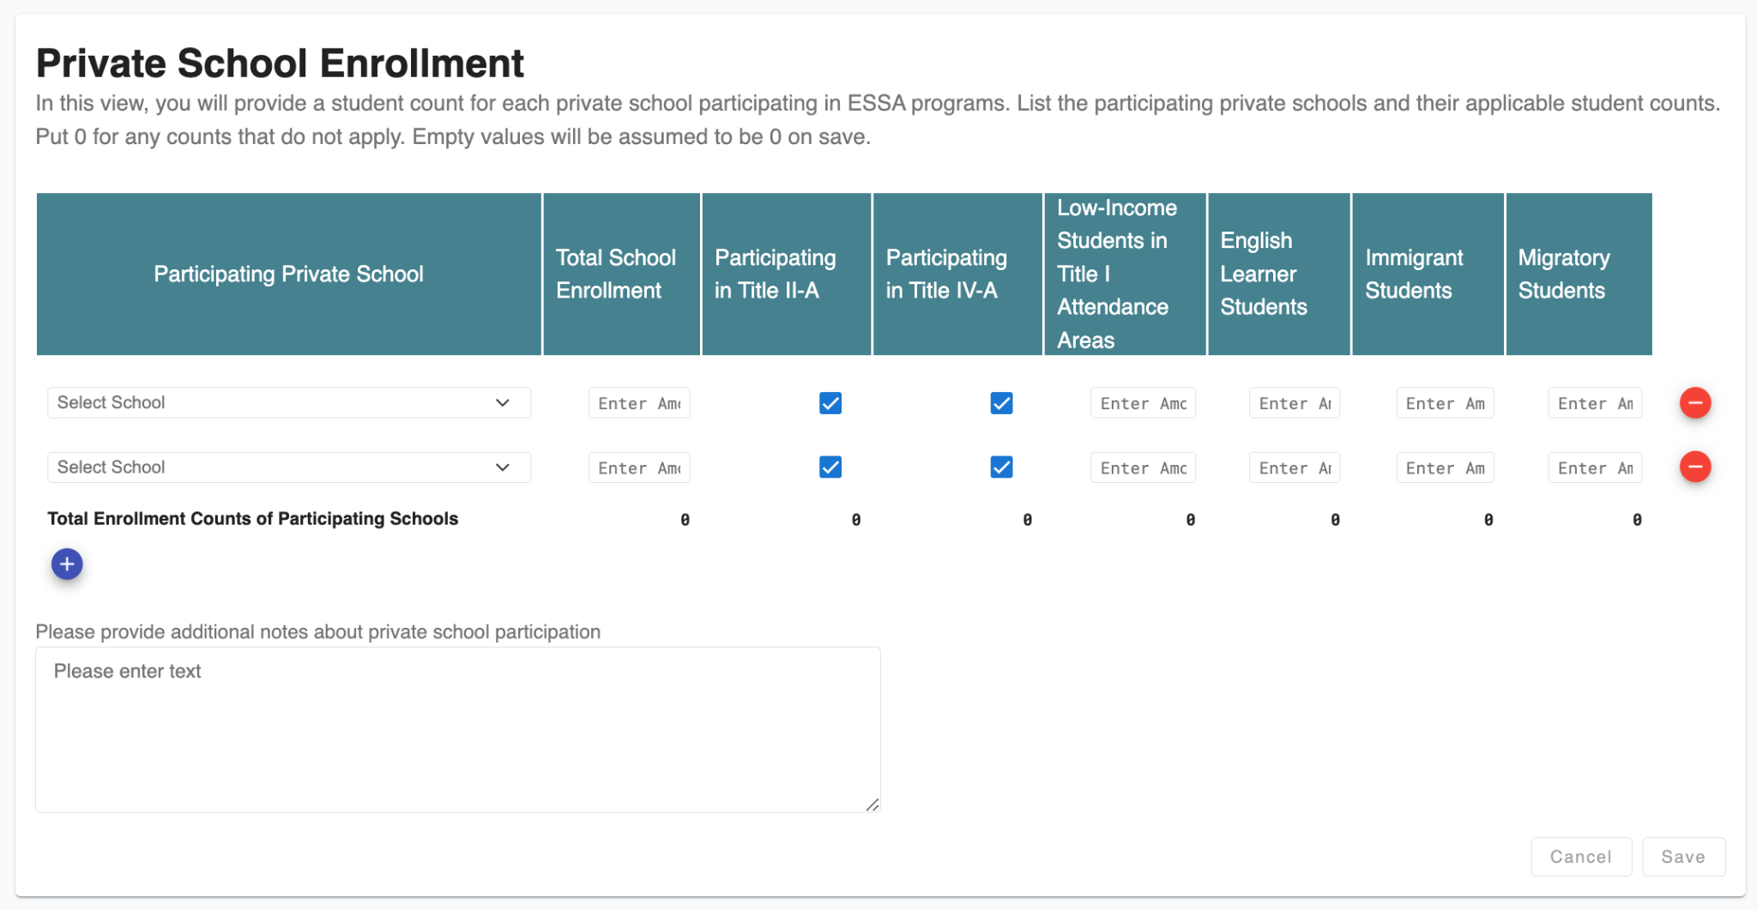
ESEA Equitable Services
To complete the ESEA Equitable Services submodule, LEAs should collect counts for each applicable federal program from every private school as well as confirmation about participation in Title II-A and/or Title IV-A.
The Private School Enrollment
LEAs will enter counts of all students at each private school, as well as counts of students eligible for:
Low-income students (Title I-A);
English learners (Title III-A);
Immigrant students (Title III); and
Migratory students (Title I-C).
LEAs will indicate whether each private school is participating in a schoolwide program for:
TItle II-A; and
Title IV-A.

Slide 8
Consultation
Notes:
Daniela

Slide 9
Consultation Process
Student eligibility (e.g.
data used to determine the number of low-income children who attend the non-public school and who reside in a participating Title I school attendance area)
Amount of funds available for services and how the amount is determined
Timely and meaningful consultation must continue throughout the implementation and assessment of services and shall occur before the local education agency makes any decision that affects the opportunities to participate of eligible private school students, teachers, and other educational personnel.
Size and Scope of Services
How, where, when, and by whom services are provided
Providing Services Directly or via Another Entity
Needs of Private School Students and Teachers
How will the services be evaluated?
How and When Decisions are Made
Notes:
Note: districts transferring funds between federal programs must consult with private schools regarding the transferability
Note – Title VIII (pg 421) here: https://www.ed.gov/sites/ed/files/documents/essa-act-of-1965.pdf

Slide 10
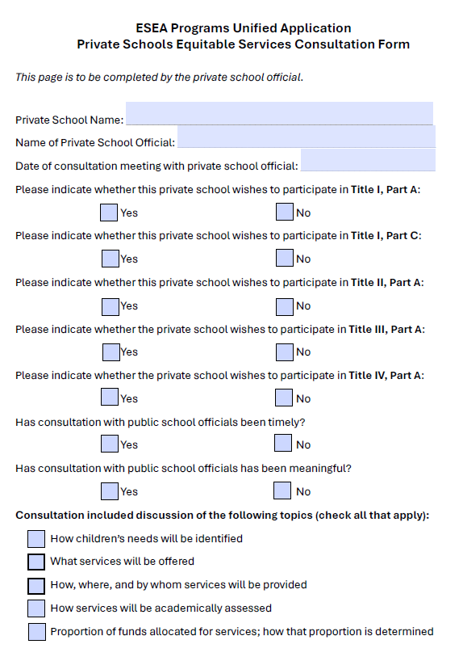
Equitable Services Consultation Form
New consolidated equitable services consultation form for Title Programs is available on the Unified Application Support Page and covers:
Title I, Part A
Title I, Part C
Title II, Part A
Title III
Title IV, Part A
Must be completed by private school official, in conjunction with District Representative
Examples of information needed:
Describe what services will be provided at the private school
How eligible students were identified
How will effectiveness of program be measured

Slide 11
Equitable Services Requirements
Notes:
Daniela

Slide 12
LEA Services to Eligible Private Students
Services to eligible private school children must be secular, neutral, non-ideological, provided in a timely manner, and equitable in comparison to services and benefits for public school children.
Options for private-school services include, but are not limited to:
Instructional services provided by public-school employees or third-party contractors
Extended-day services
Summer school
Family literacy programs
Counseling programs
Tutoring
School district professional development

Slide 13
Control of Funds
Structure of the UA
A public agency must control funds. Private schools do not directly receive funds.
District maintains administrative control over services and materials.
No reimbursement to private schools.
District monitors teachers and providers who deliver services.
Any supplies (except expendables) and equipment purchased by the LEA for use in a private school remains the property of the LEA, and the LEA must maintain an inventory.

Slide 14
ESEA Equitable Services in the UA
Notes:
Watershed

Slide 15
ESEA Equitable Services in the Unified Application
ESEA Equitable Services is a submodule that is part of the Compliance Decisions module of the Unified Application.
Structure of the UA
LEAs will complete ESEA Equitable Services as part of the Compliance module.
Module 1
Module 2
Module 3
LEA Priorities
LEA Compliance Decisions
LEA Expenditure Detail

Slide 16
Calculating Equitable Share
ESEA Equitable Share Formula
A. Number of Eligible Children
A1: LEA Enrollment | 900 | Nova – 80 Day Data
A2: Participating Private Schools’ Enrollment | 100 | Entered by the LEA
A3: Total Enrollment = A1 + A2 | 1,000 | Calculated by the UA
B. LEA program (e.g., Title II, Part A) Allocation
B1: Total LEA Allocation | $1,000,000 | Linked to OBMS
B2: Administrative Costs (for public and private school programs) | $50,000 | Entered by the LEA
B3: LEA Allocation Minus Admin Costs = B1 - B2 | $950,000 | Calculated by the UA
C. Per Pupil Rate
C1: B3 divided by A3 | $950 | Calculated by the UA
D. Equitable Services
Amount LEA must reserve for equitable services for private school children and educators = A2 x C1 | $95,000 | Calculated by the UA
Title VIII, Part F covers equitable services for the following programs included in the UA:
Title I, Part C Migratory
Title II, Part A
Title III EL
Title III Immigrant
Title IV, Part A SSAE
For these programs, LEAs determine equitable share on the basis of relative enrollment of public and private schools or, as applicable, eligible public and private school children.
Before calculating the per pupil rate, LEAs will deduct administrative costs, including direct and indirect admin, for public and private school programs.

Slide 17
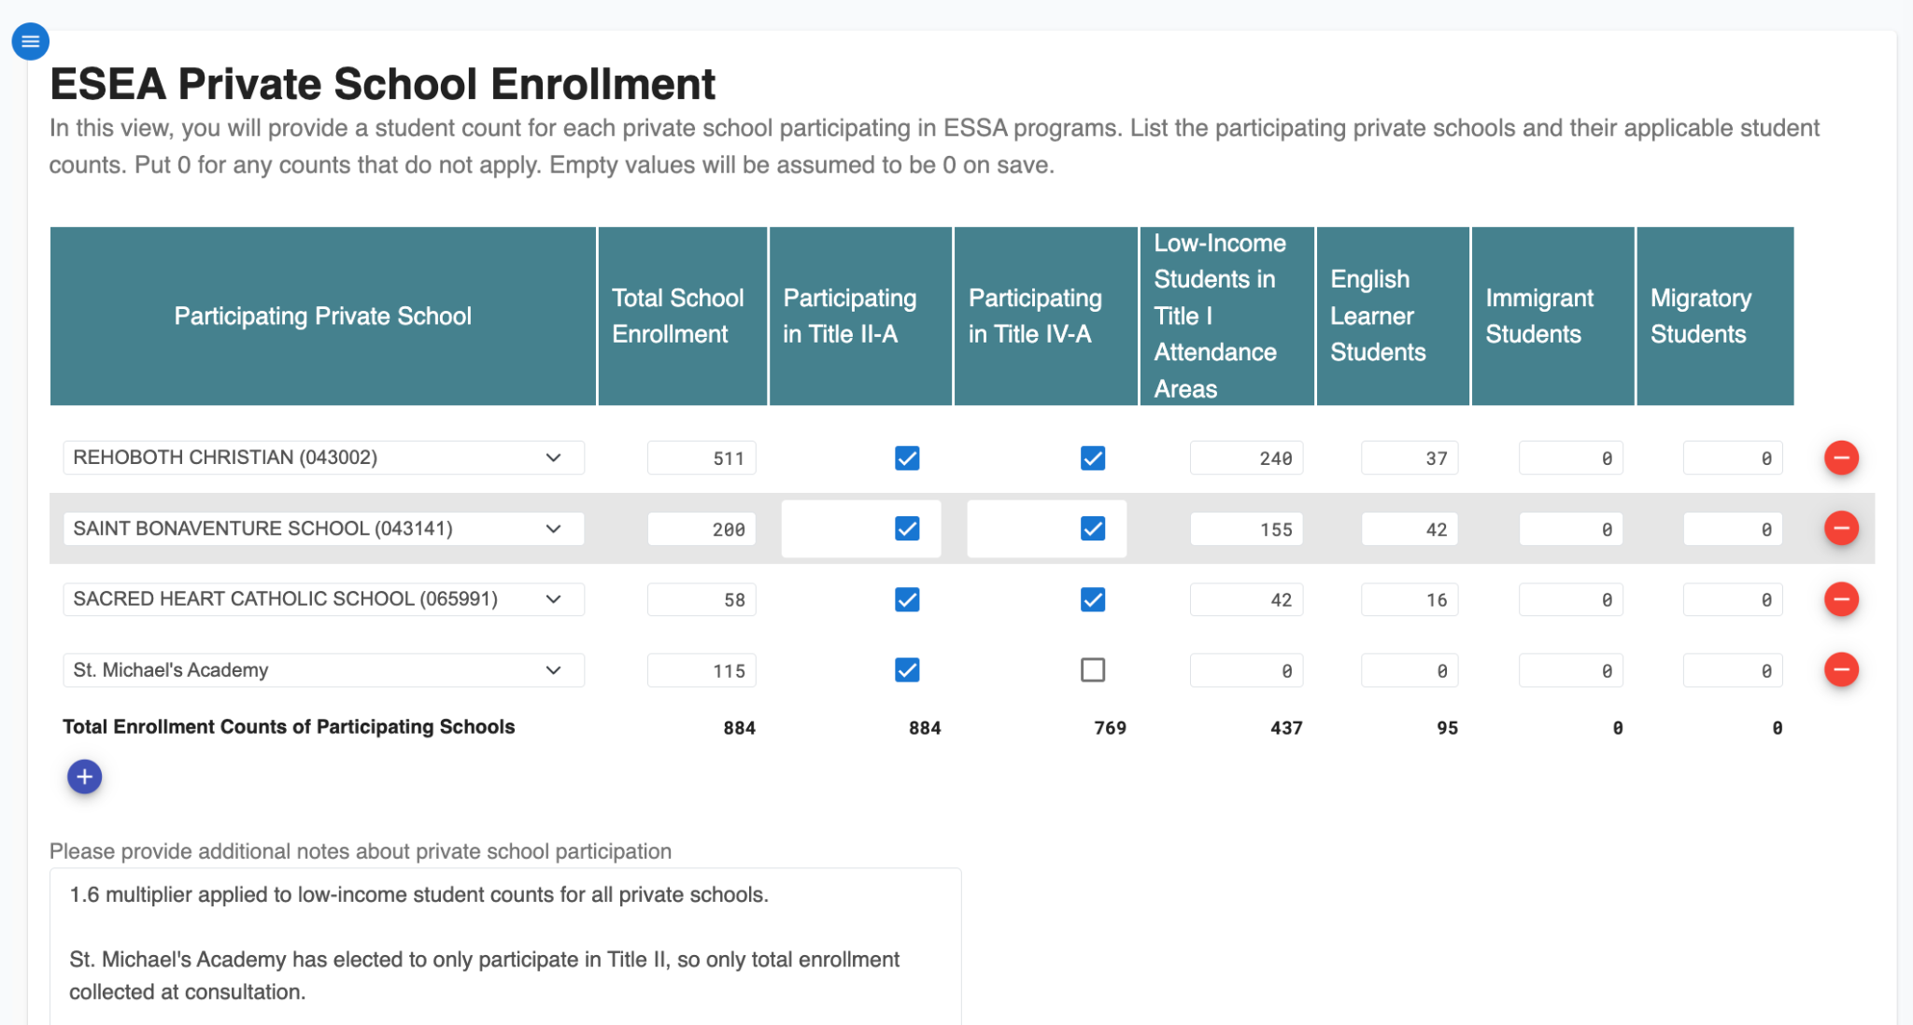
(1/3) OBMS Interface: Enrollment
Structure of the UA
Notes:
Watershed
Note – loom here if needed/remove before sharing widely: (https://www.loom.com/share/6d13d1992c8e46ff8eb99567e1293bdc?sid=d14d2ad9-66e7-4d8d-bb77-8137565bc16f)

Slide 18
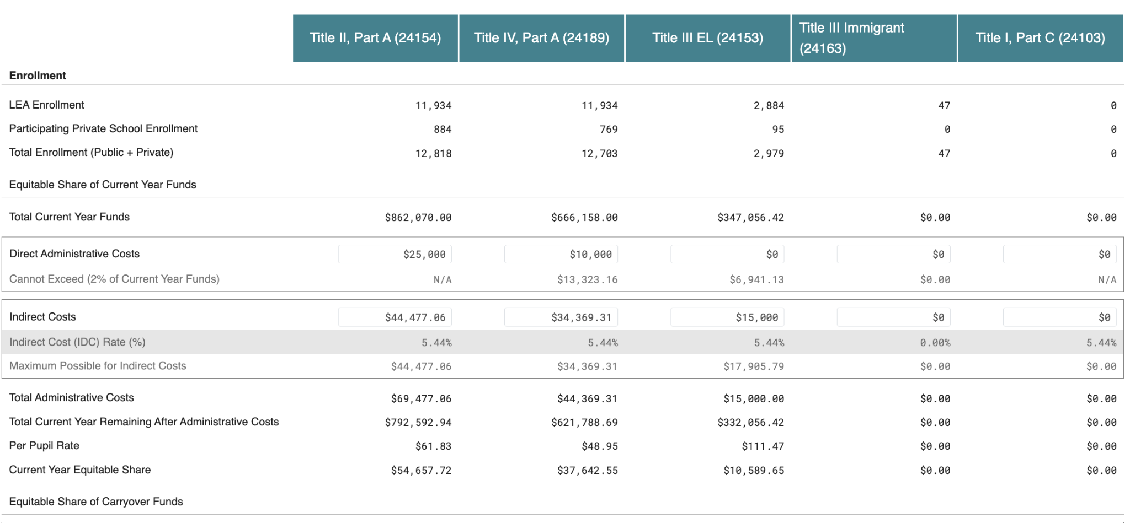
(2/3) OBMS Interface: Administrative Costs
Structure of the UA
Notes:
Note – loom here if needed/remove before sharing widely: https://www.loom.com/share/948b97ec6aea4e4a963af037d1306485?sid=301ad4c9-b1f4-4a99-95cd-2c65b059bbbf

Slide 19
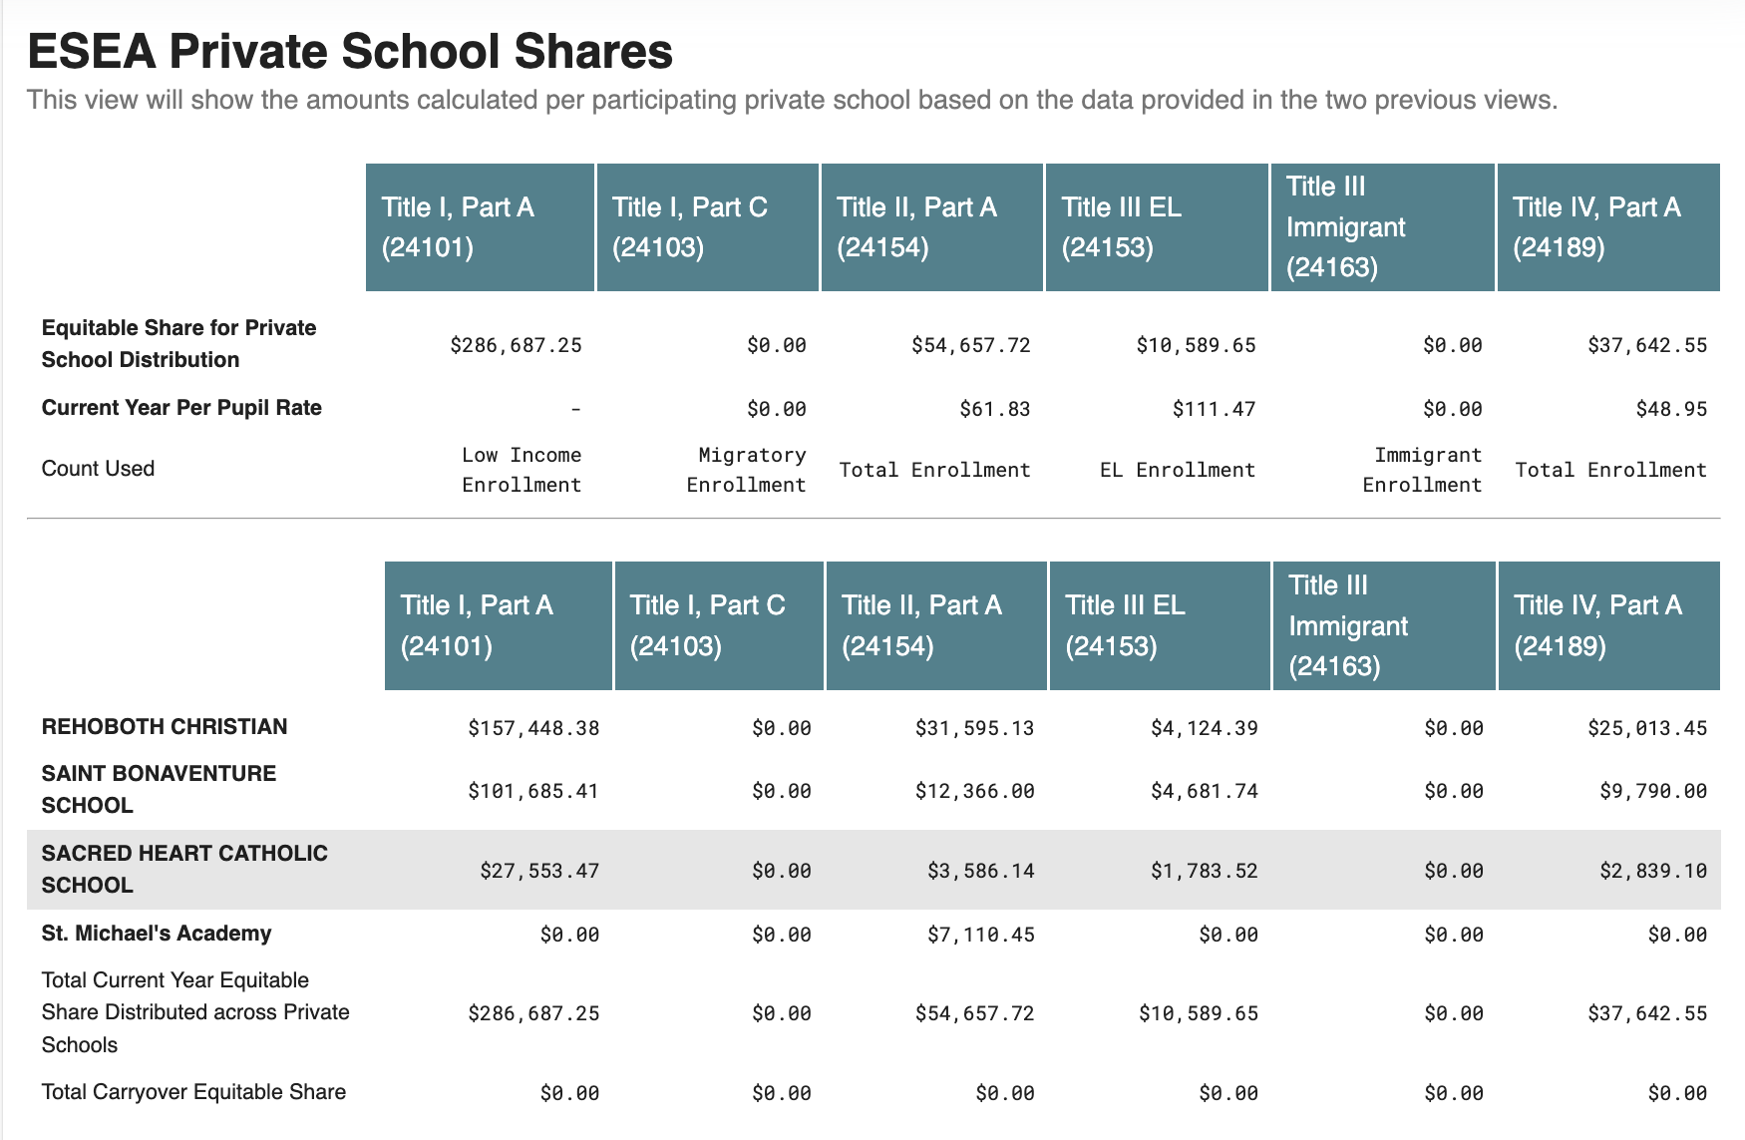
(3/3) OBMS Interface: Equitable Share
Structure of the UA
Notes:
Note – loom here if needed/remove before sharing widely: https://www.loom.com/share/7605b3280f364b09b1b3506873c9122f?sid=0d732d29-c2cc-4f25-a99e-212a92b6ed16

Slide 20
Key Updates
Notes:
Ken

Slide 21
Follow Up
Comprehensive Needs Assessment (CNA) – All LEAs are required to submit a CNA, however if LEAs have already completed a CNA for the relevant time period (e.g. a previously-submitted CNA covers the entirety of the upcoming year) LEAs may submit that CNA as part of the Unified Application.
Notes:
Ken

Slide 22
Moving Forward
Notes:
Ken

Slide 23
Key Milestones for the Unified Application
The Unified Application will launch in three stages: the Pre-Application module, ESEA, and IDEA. Unified Application will be due April 16.
Date | Milestone
February 17th | Pre-Application module opens.
March 3rd | Unified Application opens – all modules (except IDEA submodules) available.
March 17th | IDEA submodules released.
April 16th | Unified Application due.
Notes:
Ken

Slide 24
Weekly Federal Programs Team Calls Schedule (1/2)
Further training on the Unified Application components will take place until applications are due. Planning leads should ensure personnel attend sessions relevant to their LEAs; not all sessions will be applicable to all LEAs.
Date | Phase | Audience *denotes mandatory | Description
January 7 | Pre-Application | Federal Programs Directors* All LEA Roles | Overview of Unified Application Structure (including budget) and pre-application modules (consolidated assurances, district contacts, etc.)
January 14 | Pre-Application | Federal Programs Directors* All LEA Roles | Overview of Pre-Application Activities (Assurances, , NOVA data validation, LEA Access, etc.).
January 21 | Pre-Application | Federal Programs Directors* All LEA Roles | Comprehensive Needs Assessments, Tribal Consultation, Homeless Needs Assessment
January 28 | Pre-Application | Chief Academic Officers* All LEA Roles | Priorities module overview: Academics for All, Priority Student Groups, Educator Workforce
February 4 | Pre-Application | Private School Equitable Services Captains (Geographical LEAs only)* All LEA Roles | ESEA Equitable Services
February 11 | Pre-Application | Geographical LEA Title I Directors* All LEA Roles | Title I-A: Reservations and Rank & Serve
February 17th | Pre-Application Module Opens
February 18 | Pre-Application | Federal Programs Directors* All LEA Roles | TItle IV & Title III
February 25 | Pre-Application | Federal Programs Directors* All LEA Roles | Expenditure Detail Module & Guidance
March 3 | UA Opens (ESEA)
Notes:
Ken

Slide 25
Planned Topics for Weekly Federal Programs Team Calls (2/2)
Further training on the Unified Application components will take place until applications are due. Planning leads should ensure personnel attend sessions relevant to their LEAs; not all sessions will be applicable to all LEAs.
Date | Phase | Audience *denotes mandatory | Description Tentative & Subject to Change
March 4 | Application Completion | Federal Programs Directors* All LEA Roles | Launching and Transferability/AFUA
March 11 | Application Completion | Federal Programs Directors* All LEA Roles | IDEA Compliance & Proportionate Share
March 17th | UA Opens (IDEA)
March 18 | Application Completion | All LEA Roles | Submitting the Application & Overview of approval process
March 25 | Application Completion | Federal Programs Directors* All LEA Roles | Overview of finance processes that will stay the same and any differences
April 1 | Application Completion | Chief Financial Officers/Business Managers* All LEA Roles | Outstanding Questions
April 8 | Application Completion | All LEA Roles | Outstanding Questions
April 15 | Application Completion | Federal Programs Directors* All LEA Roles | Outstanding Questions
April 16 | UA Submissions Due
Notes:
Ken

Slide 26
Key Notes Regarding Upcoming Sessions
Upcoming sessions will be more specific; LEA Planning Leads can invite additional team members as necessary.
February 11 will focus on Title I and the time will be extended. The first 30 minutes will be relevant to all LEAs. The second 60 minutes will cover Title I Rank & Serve and be most relevant to districts with multiple sites and more than 1,000 students (next slide).
Notes:
Ken

Slide 27
Pilot LEAs that will Rank and Serve
NMPED anticipates that 15 LEAs participating in the Unified Application pilot listed below will be required to complete the rank and serve process through the Unified Application for the 2025-2026 Grant Applications .
DRAFT LIST – LEAs that must complete the Rank and Serve Process
Albuquerque Public Schools | Espanola Public School District | Moriarty Public Schools
Aztec Municipal Schools | Gallup-McKinley County Schools | Roswell Independent School District
Belen Consolidated Schools | Grants Cibola County School District | Socorro Consolidated Schools
Central Consolidated Schools | Hatch Valley Public School District | Truth or Consequences Municipal Schools
Deming Public Schools | Lovington Municipal Schools | Zuni Public School District
LEAs not on the list that believe they will need to complete Rank & Serve should email Unified.App@ped.nm.gov.
Notes:
Ken

Slide 28
Next Steps
Notes:
Ken

Slide 29
Next Steps
In order to ensure LEAs successfully complete the Unified Application by April 16, Planning Leads should:
Ensure private school counts are collected accurately;
Submit the required consultation forms; and
Enter required information and save within the OBMS application.
Any questions about the following processes should be directed to Unified.App@nmped.gov.
Notes:
Ken

Slide 30
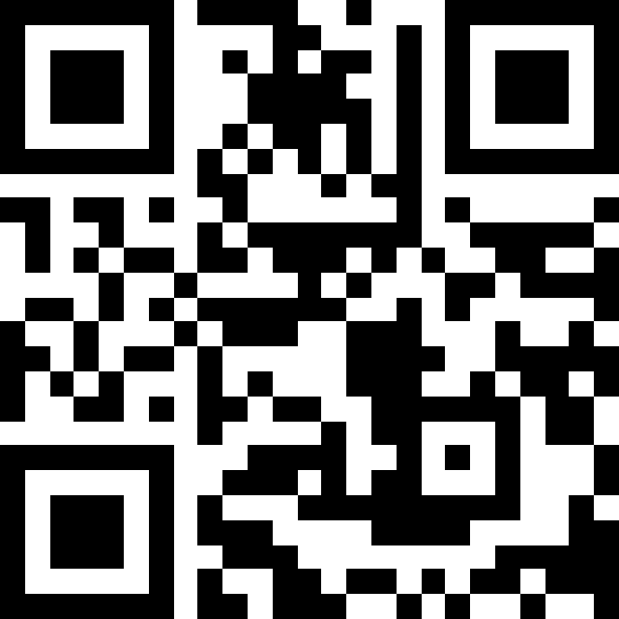
Exit Survey: Questions & Feedback
Link to exit survey
Also available at https://tinyurl.com/NMUAFeb4
Please send any questions regarding the Unified Application to:
Unified.App@ped.nm.gov
Notes:
Ken

