Slide 1


Reminders
Notes:
Please take a minute to ensure you are muted and any AI notetakers are turned off. Thank you!

Slide 2


Office Hour Sessions
Dr. Margaret Cage
Deputy Secretary
The Office of Special Education
February 18, 2025
Notes:
Good afternoon and welcome to February’s Office Hour Session!
Today’s Office Hour Session will be providing updates, technical assistance, and professional development
A few housekeeping notes, we will have 10-15 minutes for questions at the end of the main presentation preceding today’s training portion. Training questions will be answered on The Office of Special Education’s Q& A Booklet. This is a living document, and the link will be in the chat. The Office Hour Sessions Slide deck will be accessible on the PED website, in special education, under resources or may be found in the LEA Managed Booklet, under the resources tab.

Slide 3
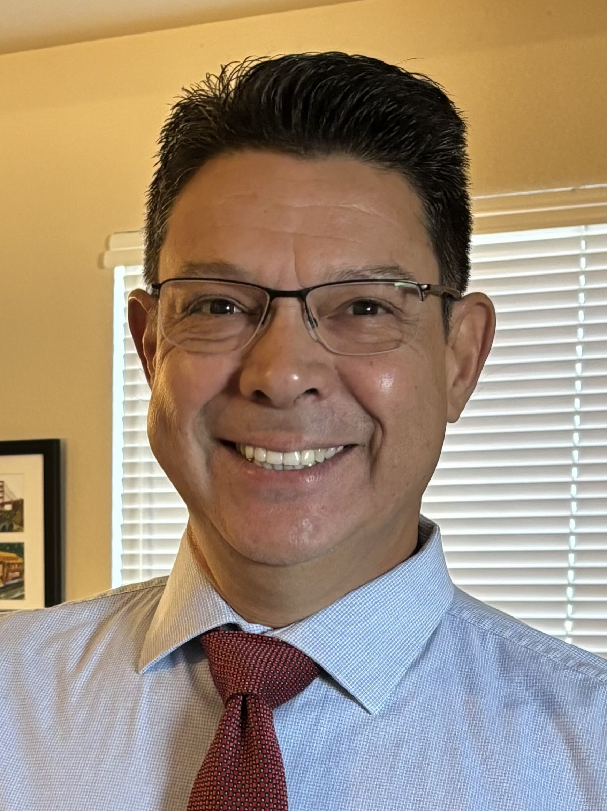

Leadership/Duties of the Office
Dr. Margaret Cage
Deputy Secretary, OSE
Dr. Tyre Jenkins
Deputy Director, OSE
Charlene Marcotte
Deputy Director of Data & Finance
Ria Gill
Assistant Deputy Director, OSE
Randall Rapanut
Assistant Deputy Director of Data & Finance
Develop, review, and propose updates to state special education statutes, rules, policies, and technical assistance
Consult and coordinate with other units of the Department, other state agencies, public post-secondary educational institutions, and key education and community stakeholders on varying special education topics and issues
Coordinate with school districts and public post-secondary education institutions to develop and provide training and professional development to licensed school employees
Provide technical assistance and recommendations to school districts and public schools to implement evidence- and research-based programs and services that are culturally and linguistically responsive
Conduct activities to promote the recruitment and retention of qualified special education practitioners
Solicit input regarding delivery of special education services in the State from various stakeholders
Oversee and enforce the compliance with the IDEA and any state law pertaining to special education
Collect statewide data on varying aspects of special education within the state
Monitor spending of state and federal funds for special education programs
Develop and annually update a state plan for students with disabilities
Notes:
To the right, please find The Office of Special Education priorities that align with the executive order per Governor Lujan-Grisham. To your left, you will find The Office of Special Education Leadership team.

Slide 4
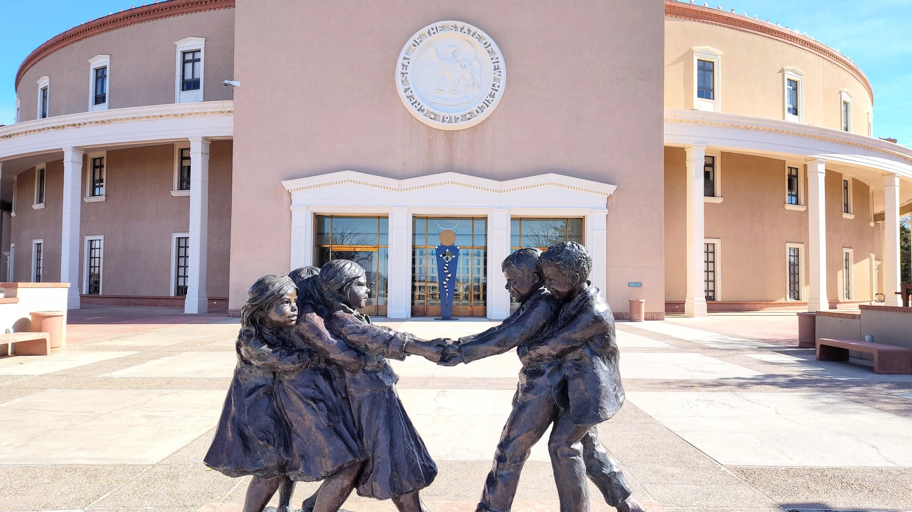

Hiring Updates
https://www.spo.state.nm.us/
Notes:
OSE is steadily increasing capacity and staff to better serve you. Just a reminder, we are hiring! Please check the state personal office website for job openings. It is our pleasure to introduce are three newest employees, Randall Rapanut, Sushmita Ghosh and Leticia Esparza. Randall, Sushmita and Letica do you want to introduce yourself?

Slide 5

HELPING UNLOCK THE POWERFUL TOOL OF COMMUNICATION
BY
GROWING ACCESS TO SPEECH THERAPY
Moises Morgenstern
Co-founder & CEO
moises@empatspeech.com
Notes:
Dr. Ty

Slide 6





Quality Speech therapy services via telehealth
Experienced SLPs available to support your needs
Collaboration and support for your school staff
Streamlined progress tracking for seamless monitoring of progress and compliance
Personalized interactive activities
based on research to help child learn, practice and stay engaged
Services: assessments, treatment, IEP meetings and reports

Slide 7
OVER THE COMING MONTHS OUR TELEHEALTH PLATFORM WILL
INCREMENTALLY HELP GROW ACCESS TO
QUALITY SERVICES

Slide 8


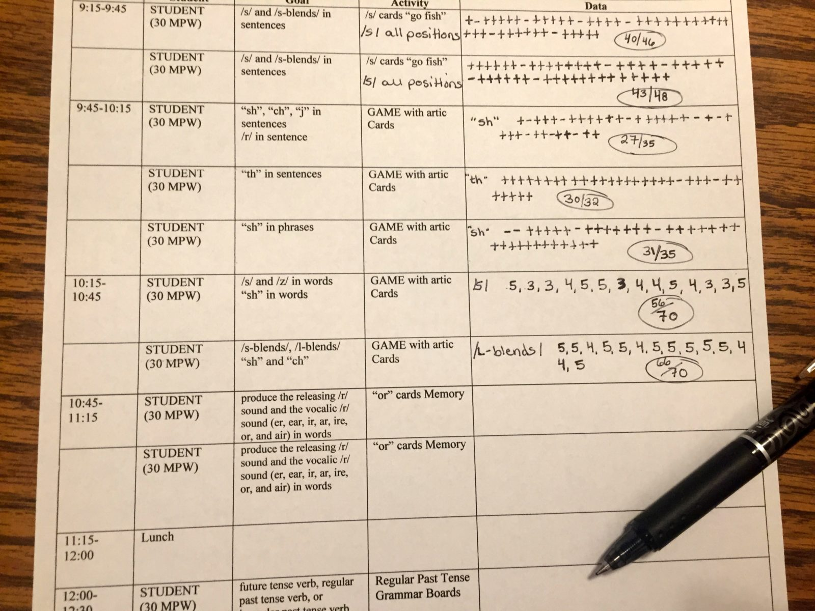

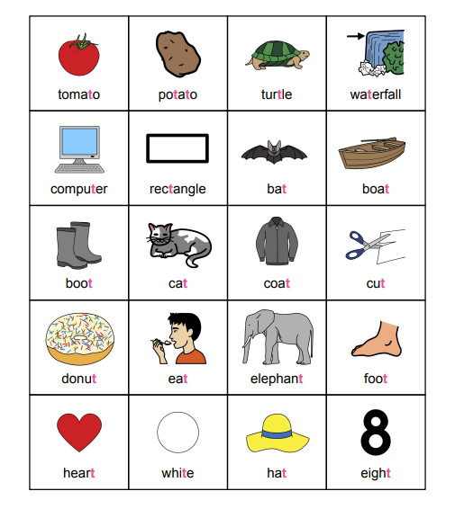



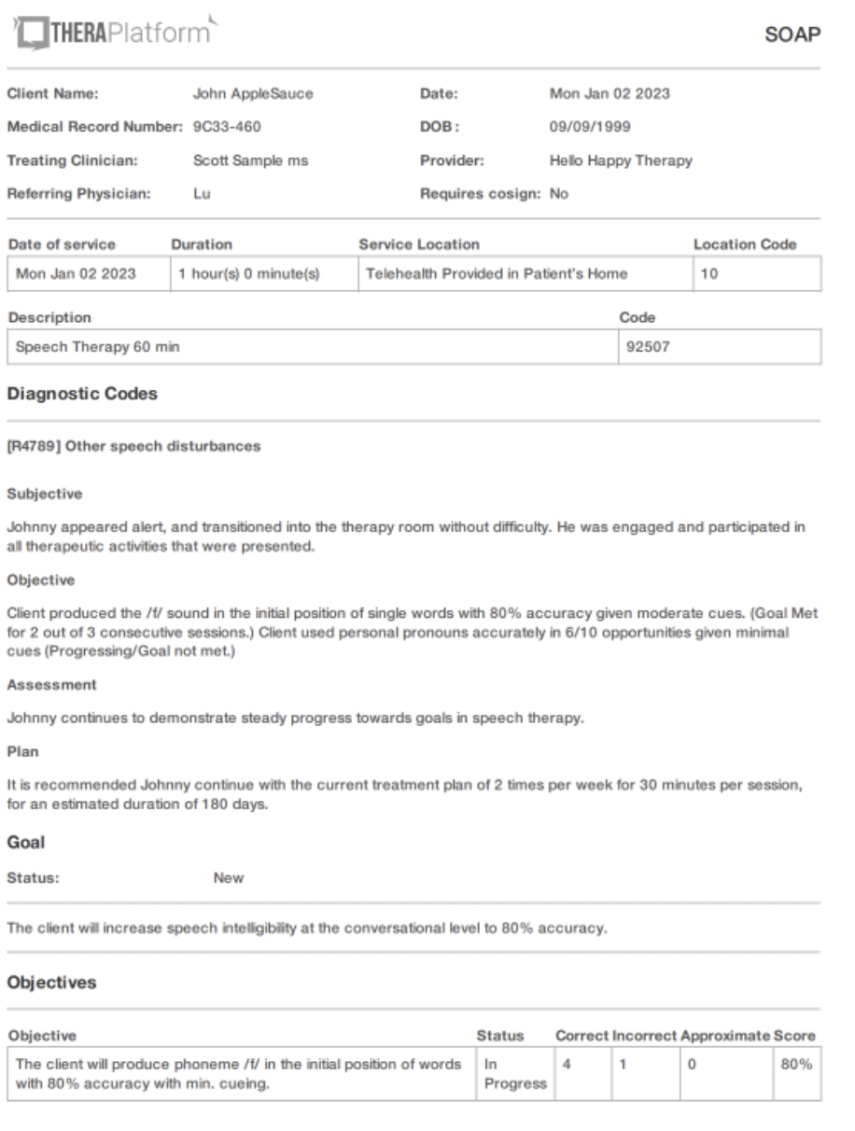
To grow access to quality services we need to help scale SLPs
Streamline progress tracking and personalization of care to reduce workload
Grow practice opportunities
per student via AI led support
Data collection & reports
Plan engaging sessions
Care support
School group therapy session
Outside of therapy
Instead of scanned materials and
games with limited interactivity
Assessments
SLP stimulation
Waiting
(SLP with other child)
Practice @home/classroom
Care scheduling /
meetings
10 min
Waiting
AI opportunity
Child 1
Homework / Caregiver support
10 min
Waiting
AI opportunity
Child 3
10 min
Waiting
AI opportunity
Child 3
30 min

Slide 9
SCHOOLS PARTNER WITH US TO

Slide 10
Grow capacity to help students thrive
1
Fill open positions with experienced licensed therapists
2
Help manage your team caseloads and backlog with support from our SLPs
3
Access bilingual services personalized to each student needs

Slide 11
WE WOULD LOVE
TO LEARN ABOUT
YOUR SCHOOL SPEECH THERAPY NEEDS!
Contact us
info@empatspeech.com
415-735-4022

Slide 12



Spring Special Education
Law Conference
Tentatively Scheduled
  Tuesday April 15, 2025, and Wednesday April 16, 2025
  Times: TBD
  Location: TBD
Save the Date! Registration will be available soon!!!
Conference will cover same topics as 2024 Fall Law Conference, excluding finance training.
LEAs are encouraged to send Superintendents, School and District Administrators, and Teachers that did not attend Fall conference
Notes:
Thank you! Chief Counsel Miguel Lozano is up next. Miguel?

Slide 13


OSE Monthly Newsletter
  Submissions to the OSE Newsletter are due by the second Monday of each month and should be sent to special.ednews@ped.nm.gov.
  Please share great things happening in your LEA to special.ednews@ped.nm.gov.
  The following form can be shared with colleagues who wish to receive the OSE Newsletter: OSE Signup Form.
  Here is a linked newsletter submissions schedule through November 2025, as to when article submissions are due.
  If you have questions about the newsletter email special.ednews@ped.nm.gov.
Notes:
Thank you, Miguel! Next up, Assistant Deputy Director of OSE, Ria Gill. Ria?

Slide 14

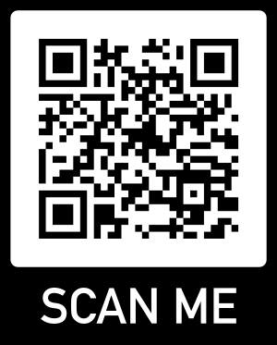
Connections! - OSE Parent Newsletter
Our new monthly OSE parent newsletter, Connections!, released its inaugural issue last week for parents.
Our goal is to continue building strong, supportive, collaborative relationships with families of students with disabilities, school districts, and leaders from our state’s cradle to career initiative set for the by the education Secretaries and our Governor, Michelle Lujan Grisham.
Connections! will play an important role in this effort. Through this newsletter, our goal is to keep parents informed and engaged in the educational journey of their children, while also aligning with specific special education initiatives within the State Plan.
connections.news@ped.nm.gov
Parent Resource Spotlight
Notes:
Thank you, Ria! Dr. Elizabeth Cassel will now introduce a new OSE initiative-Connections. Dr. Cassel?

Slide 15


IDEA B Panel Meetings
Q3: February 20 and 21
(Virtual, with the ICC joining on the 21st)
Day 1
Meeting ID:829 3209 1166
Passcode:929303
Day 2
Meeting ID: 739 963 9388
Passcode: SP722ICC
Contact Kaity Ellis for questions
kaitlin.ellis@ped.nm.gov
505-709-7690
Notes:
Kaity to present

Slide 16



Special Education Ombud Flyers
Please direct all website staff, schools, and school personnel to take down the old flyers and post the new flyers in well trafficked areas.
If you would like information about our intake process, family presentations, or general information about our work, please contact:
Clare Gallegos (505) 841-3885
Jody Myers (682)554-6672
Michelle Tregembo (505)274-3885
Notes:
Thank you, Kaity. Next up, Ombud.

Slide 17


Parent University Virtual Sessions
Parent University Virtual Sessions Registration Form
We’re excited to invite you to a series of 90-minute virtual sessions hosted by the New Mexico Public Education Department (NMPED) Office of Special Education and Public Consulting Group (PCG). These sessions are designed to help you navigate the special education process confidently and advocate for your child’s success!
You’ll learn how to:
Understand Special Education rights
Navigate IEPs
Communicate effectively with schools
Prepare for key transitions in your child’s education
These sessions are packed with practical strategies and tools to empower you as an advocate for your child’s future.
Special Education 101
Knowing your Rights
High Quality IEPs
Strategies for Communication & Collaboration
Transition
Notes:
Jessica to present?

Slide 18

Professional Development Calendar
Month | Professional Development Opportunities
February 2025 | •Virtual FULL DAY Monitoring Workshop – Feb18th •In Person FULL DAY Monitoring Workshop – Feb 19th •Alternate Standards Onsite Sessions -Feb 24- Mar7 •Parent University Virtual Session 1-Sped Ed 101-Feb 27 •Special Education Director Onsite Fellow Session 1-Feb 26 Session Full •IDEA Virtual Panel Meeting-Feb 20-21, 2025
March 2025 | •Alternate Standards Virtual Session 1-Mar 4 •Special Education Director Fellow Virtual Session 1-Mar 5 Session Full •Aspiring Academy Virtual Sessions on 1 & 2-Mar 6 •Parent University Virtual Session 2-Know Your Rights- Mar 25
April 2025 | •Special Education Director Fellow Virtual Session 2- Apr 2 Session Full •Alternate Standards Virtual Session 2 -Apr 3 •Aspiring Academy Virtual Session 3- Apr 9 •Parent University Virtual Session 3-High Quality IEPs - Apr 10 •Spring Special Education Law Conference -Apr 15-16 •Alternate Standards Onsite Sessions 2-Apr 14-25 •Parent University Virtual Session 4-Comm & Collab - Apr 30
May 2025 | •IDEA Panel Meeting- May 1-2 •Aspiring Academy Virtual Session 4 -May 7 •Implementing High-Quality IEPs Virtual Session 1 -May 8 •Implementing High-Quality IEPs Onsite Sessions-May 12-23 •Special Education Director Fellow Virtual Session 3- May 14 Session Full •Implementing High-Quality IEPs Virtual Session 2- May 28 •Parent University Virtual Session 5-Transition- May 29
June 2025 | •Special Education Director Fellow Onsite Sessions 2 &4 -June 10-12 Session Full •Aspiring Academy Virtual Session 5 -June 18
Notes:
Jessica to present.

Slide 19

2024-2025 Program Monitoring
On-Site Monitoring
Involves in-person visits to schools withing each LEA.
Comprehensive reviews include interviews, classroom observations, and documentation analysis.
Desktop Monitoring
Conducted remotely through reviews of documentation and data submitted by LEAs.
Focuses on analyzing IEPs assessment data, and other relevant materials to ensure compliance with federal and state regulations and to identify areas for improvement.
Self-Monitoring
LEAs are responsible for conducting internal monitoring activities and submitting findings to OSE.
Encourages LEAs to take ownership of their special education programs while receiving guidance and support as needed.
Primary Objectives
Identify strengths
Address areas for improvement; identify and correct noncompliance
Enhance outcomes for all students
Identify potential statewide professional development opportunities
Notes:
Catherine to present.
On-Site Monitoring
a. Involves in-person visits to schools within each LEA.
b. Comprehensive reviews include interviews, classroom observations, and documentation analysis related to special education programs, practices, and services.
Desktop Monitoring
Conducted remotely through reviews of documentation and data submitted by LEAs.
Focuses on analyzing IEPs, assessment data, and other relevant materials to ensure compliance with federal and state regulations and to identify areas for improvement.
Self-Monitoring
LEAs are responsible for conducting internal monitoring activities and submitting findings to OSE.
Encourages LEAs to take ownership of their special education programs while receiving guidance and support as needed.

Slide 20

Program Monitor Trainings and
Windows of Execution
Recording link coming! February 5, 2025: Participate in an introductory monitoring webinar. Upcoming! February 18, 2025: Participate in a virtual NMPED-hosted training session for LEAs to review monitoring expectations and receive guidance on required documentation. Registration Link for February 18th – Virtual Session February 19, 2025: Participate in an in-person NMPED-hosted training session for LEAs to review monitoring expectations and receive guidance on required documentation. Registration Link for February 19th – In Person Session | Letters will be sent to Superintendents and Special Education Directors: Onsite Monitor Window: February 24, 2025 – April 18, 2025 Desk-top Monitor Window: March 10th, 2025 – March 31st, 2025 Self-Assessment Monitor Window: March 3rd, 2025 – April 14th, 2025

Slide 21

Program Monitoring Tools
Program Monitoring
The Program Monitoring Tool can be found here:
  OSE Program Monitoring Protocol – Google docs (Updated February 2025)
  OSE Program Monitor Guide - Google docs (Updated February 2025)
LEAs selected for monitoring - start reviewing the tool and preparing documents which will be requested.
LEAs not undergoing monitoring this round should also begin reviewing the protocol to ensure all requirements are being met.
Child Find
Least Restrictive Environment
Early Childhood Special Education
Service Delivery
Discipline
Alternate Assessment

Slide 22


Data & Finance Calendar
Data Training: Purple
Finance Training: Blue
Training Key
October 2024
November 2024
December 2024
January 2025
Indicator 13 Annual Review Training for LEAs
Pre-finding Correction Training for LEAs
40-Day Reporting opens, data review begins
Excess cost compliance completion by LEAs
MOE compliance completion by LEAs
Determination Letters sent to LEAs
80-Day data reporting training
40-Day data review closes
Time and Effort Training for LEAs
High-Cost Fund Training
40-Day Pre-finding letter released
MOE Letters sent to LEAs
Indicator 13 Review sample provided to LEAs
80-Day data reporting opens, data review begins
Quarterly spending reports sent to LEAs
Puente Para Los Ninos High-Cost Fund applications released
120-Day data Reporting Training
80-Day data review closes
Indicator 13 Pre-finding notices sent to LEAs
80-Day Pre-finding letters released to LEAs
Time & Effort due from LEAs
Puente Para Los Ninos High-Cost Fund application submission deadline
February 2025
March 2025
April 2025
May 2025
120-Day data review opens, data review begins
Indicator 13-Prong 2 review completion
BOLO for NMASBO Spring Budget Conference Announcements
Advertisements for SPP/APR Stakeholder Meetings
SPP/APR Due to OSEP
MOE Eligibility Training for LEAs
Excess Cost Base trainings for LEAs
IDEA B Application Training
120-Day data review closes
120-Day Prefinding letter released
NMASBO School Budget Conference
SPP/APR Stakeholder Engagement meetings
Quarterly Spending Reports sent to LEAs
State IDEA B Application posted for public review
Puente Para Los Ninos High-Cost Fund awards issued
Indicator 8-Parent Surveys sent out to sampled parents.
MOE eligibility completion by LEAs
Excess Cost Base completion by LEAs
SPP/APR Stakeholder meetings
State Application-Public Comment opens
End of Year (EOY) data reporting training
DPR Training
Indicator 14-Post School Outcomes survey data collections begin
EOY reporting opens, reviews begin
IDEA B application open for LEA completion
SPP/APR Stakeholder engagement meeting
District Profile Report (DPR) data posted on DPR site
State Application-Public Comment closes
1 month to the end of state fiscal year
June 2025
July 2025
August 2025
September 2025
Budgets in OBMS due
Quarterly spending report sent to LEAs
IDEA B applications due from LEAs
Submit RfRs prior to end of Fiscal Year
All LEA IDEA B applications in “Approved by State” or “Substantially Approved” status
State Fiscal Year ends (6/30)
Start of New Fiscal Year (7/1)
Nova Conference
OBMS Deadlines-Reimbursement requests, accounts and payable invoices
Time & Effort for LEAs due
Encumber Funds expiring September 30
EOY Pre-finding letters released to LEAs
Federal Child Count DUE to USDE
Complete and submit Indicator 14 Data Collection
EOY Pre-finding notices sent to LEAs
Nova Conference
IDEA B applications must be fully approved
Board meeting agendas and minutes must be submitted on or before (8/30)
Encumber funds expiring in September
Complete Inventory of Supplies and Materials
40-Day data reporting training
Annual determination training
Excess cost compliance training
MOE Compliance training
Indicator 14 data due from LEAs
Quarterly spending reports sent to LEAs
OSE Law Conference
Federal Funding expires (9/30)
Notes:
Thanks Catherine. Deputy Director of Data & Finance, Charlene Marcotte will kick us off today. Charlene?

Slide 23

Data & Finance
February 2025
120-Day data review opens, data review begins
Annual review I 13
NMASBO Spring Budget Conference-
4/9-4/11/25
SPP/APR Stakeholder Meetings Upcoming
Notes:
Charlene

Slide 24
Welcomes and Good-Byes
Welcome to the Data and Finance Team!
Randall Rapanut – Assistant Deputy Director of Data and Finance
Sushmita Ghosh – Financial Coordinator
Thank you for your service on the Finance Team!
Kaylock Sellers
Jessie Jiang
Good Luck on your next endeavors.

Slide 25

American Rescue Plan Act (ARPA) Funds
OSE is seeking a late liquidation request for ARPA funds
LEAs with unspent ARPA funds will need to complete the following forms.
  24346: ARPA Funds - Late Liquidation - Basic (24346) - Google Forms
  24349: ARPA Funds - Late Liquidation - Preschool (24346) - Google Forms
The following documents will be required:
  Purchase orders
  Contracts
  Dated invoices, bills of lading or other billing documents
Descriptions and clear explanations will be needed

Slide 26

Finance Monitoring
LEAs selected for monitoring will upload documents to the Special Education Monitoring site
    Folders:
      Finance Folder
        Finance Monitoring Folder
          2024-2025 Folder
            Upload monitoring documents in this folder
For access to the SE Monitoring site, contact Mahesh Reddy-Erri at mahesh.reddy-erri@ped.nm.gov
All LEAs will be monitored within a 5-Year cycle.

Slide 27

LEA Time and Effort Submission
To meet federal requirements, LEAs will be required to begin submitting Time and Effort Documentation.
  LEAs may use their own forms so long as it contains all information required.
Time and Effort form due dates:
  February 28, 2025: Period of July 1, 2024, to December 31, 2024
  July 31, 2025: Period of January 1, 2025, to June 30, 2025

Slide 28

LEA Time and Effort Submission
Time and effort (T&E) forms will be uploaded to the Special Education Monitoring site.
  Folders:
    Finance Folder
      Time and Effort Folder
        2024-2025 Folder
          Upload T&E forms in this folder.
For access to the SE Monitoring site, contact Mahesh Reddy-Erri at mahesh.reddy-erri@ped.nm.gov

Slide 29

Excess Costs reminders
Excess Costs Compliance calculation submissions are currently overdue.​
New deadline for submission will be Monday, February 24th
Forward any questions to kaylock.sellers@ped.nm.gov and randall.rapanut@ped.nm.gov​
The excel instruction sheet can be found here:
General Instructions I-Excess Costs (Fund numbers list).xls - Google Sheets
Notes:
Kaylock to present

Slide 30









Data/Finance Team Contact List
Office of Special Education Data Team:
liz.schweiger@ped.nm.gov
tamara.burkett@ped.nm.gov
trudy.cordova@ped.nm.gov
Office of Special Education Finance Team:
kaylock.sellers@ped.nm.gov
jingchao.jiang@ped.nm.gov
sushmita.ghosh@ped.nm.gov
Data & Finance Leadership
charlene.marcotte@ped.nm.gov
randall.rapanut@ped.nm.gov
Notes:
Thank you, Kaylock! Trudy

Slide 31

RfR Tips
To avoid the need for info requests and delays in approval, please ensure that:
  Backup documentation is provided for all expenses
    For example:
      Purchase orders
      Invoices
      Administrative Staff Consideration Form
  All expenses are:
    An Excess Cost of providing special education and related services
    Allocable – only correct share of cost is charged
    Reasonable – costs meet the prudent person test
    Necessary – needed to provide special education and related services
Notes:
Kaylock to present.

Slide 32
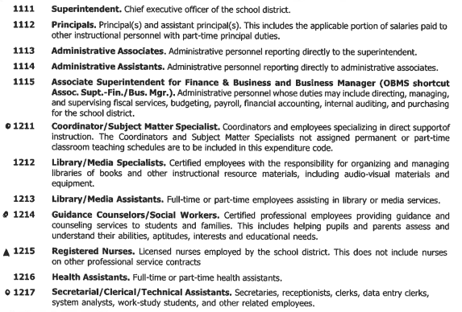
Special Education Job Class-Direct & Indirect I
?
?
Notes:
Kaylock

Slide 33
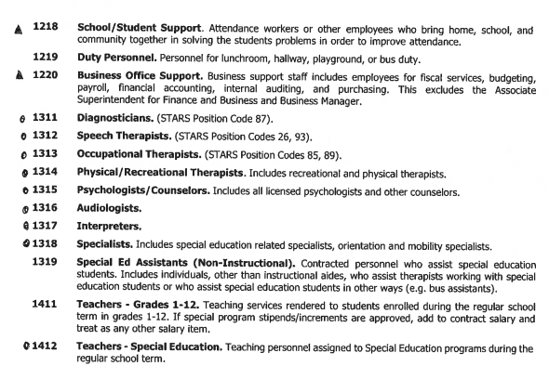
Special Education Job Class-Direct & Indirect II
?
Notes:
Kaylock

Slide 34
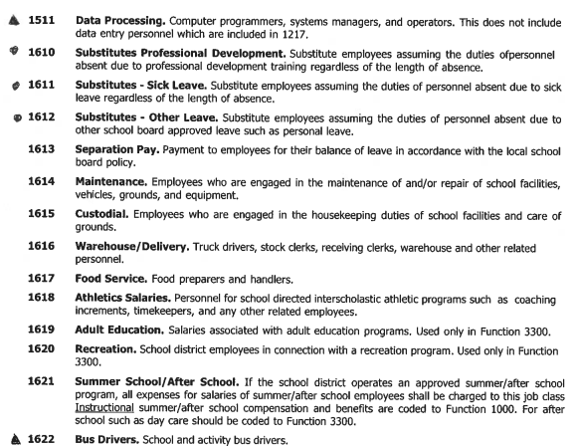
Special Education Job Class-Direct & Indirect III
?
?
Notes:
Kaylock

Slide 35
Special Education Job Class-Direct & Indirect IV
Job Class Codes that can be charged directly to the grant (Direct Costs).
Job Class Codes that may be charged directly to the grant (Direct Costs) but additional information will be requested to make a determination.
?
Job Class Codes that cannot be charged directly to the grant (Indirect Costs).*
Notes:
Kaylock

Slide 36

Special Education
Job Class-Direct & Indirect IV
For Job Classes "Normally"* an Indirect Cost:​
Complete the Administrative Staff Consideration form and submit it to the Office of Special Education (OSE) for review and approval.​
OSE finance team staff will review and make the determination if the costs can be charged directly to the grant or are deemed indirect costs.​
Form can be found on the OSE Resources Page: https://webnew.ped.state.nm.us/bureaus/special-education/resources/​
If OSE approves the costs to be charged directly the grant, the signed form must be included with each RfR.
Notes:
Kaylock

Slide 37

Questions???

Slide 38

TRAINING
Notes:
Switching gears into the training portion of Office Hour Sessions. Please ensure all questions are asked in the Q& A Training booklet. The link will be in the chat. Just a reminder, today’s presentation and slide deck will be on Ped’s website under, OSE, on the resources link to your right. (place Q&A link in chat).

Slide 39

120 Day Reminders 2-12-2025
Subs and Caseloads
  Substitute Teachers are not allowed to carry a caseload for students with disabilities.
  See allowable case managers, student levels and codes.
Teachers’ Position Codes | Description of Position
95 | Special Education Speech Language Pathologist Acting as a Caseload Manager (6–21 year olds)
95S | Special Education Speech Language Pathologist Acting as a Caseload Manager (3–5 year olds)
96 | Special Education Preschool Teacher
97 | General Special Education Teacher (K–12)
Level of Student | Student Category | Nova Category Level | Amount of Special Education Services | Teacher Category | FTE
A or minimum level | Student with Disabilities | 1 | 10% or less of the school day | 96 / 97 | 1/35 or .029
A or minimum level | “Speech-Only” Student | 1 | 10% or less of the school day | 95 / 95S | 1/60 or .017
B or moderate level | Student with Disabilities | 2 | 11%–49% of the school day | 96 / 97 | 1/24 or .042
B or moderate level | “Speech-Only” Student | 2 | 11%–49% of the school day | 95 / 95S | 1/35 or .029
C or extensive level | Student with Disabilities | 3 | 50% or more of the school day | 96 / 97 | 1/15 or .067
D or maximum level | Student with Disabilities | 4 | Approaching 100% of the school day | 96 / 97 | 1/8 or .125
Notes:
Trudy

Slide 40

120 Day Reminders
Modified and Ability Graduation Options
  Students who graduated on the modified and ability option but returned for a Free and Appropriate Public Education (FAPE) are still students of the LEA and must be reported as such for federal reporting purposes.
    This includes students who are enrolled in Project Search or other postsecondary transition programs.
What is a FAPE?
  The coursework necessary to earn a Standard Diploma.
  Special education and related services.
Students are eligible for a FAPE until they:
  Age out at 21 (or 22 if turn 22 after the school year has already started)
  Earn a diploma through the Standard program of study.
Notes:
Trudy

Slide 41

120 Day Reminders
Indicator 8 Parent Information
  The following data points are required for students:
    Parent mailing address to send a paper survey mailing to the parent.
    Parent email address to send an email with the link to the parent survey.
    Parent cell phone number to send a text with the link to the parent survey.
  This data will be collected manually for LEAs having SIS difficulties.
Notes:
Tammy

Slide 42
Ancillary FTE Variance
At 120 day, OSE will be checking for variances in Ancillary (Related Service) FTE between 80 day and 120 day.
  For variances +/- 10%, a justification for the decrease/increase will be required in the Document Transfer Station (DTS).
An average of 80 and 120 Day Reported Ancillary FTE is used to determine state funding for LEAs and is imperative it is correct.
Notes:
Tammy

Slide 43
Overdue IEPs and Tri-Annual Evaluations Delay Reasons
If the available delay reason code options in Nova do not explain reason for the delay of an Annual IEP or Tri-Annual Evaluation, LEAs may leave the delay reason blank and submit an explanation via the DTS.
If LEAs supply a delay reason code to Nova, LEAs do NOT need to submit a delay reason to the DTS.
A submission to the DTS is only required if LEAs leave the delay reason code blank.
Notes:
Tammy

Slide 44

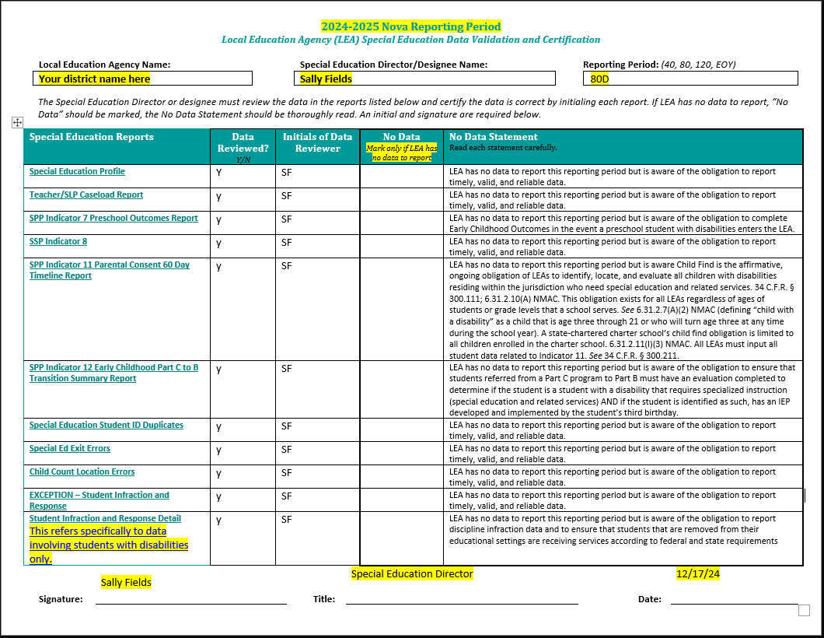
Data Validation Form
This form must be filled out once data in the Nova reports is completely accurate.
By signing, Special Education Director/Designee is indicating they have reviewed each report and confirm accuracy.
    - This is done by marking yes/no in the "Data Reviewed"
    box and initialing in the box next to it.
"No Data" should be marked with an "X" when an LEA does not have any of data to report for the specific reporting period.
- "No Data" is not the same as "No Errors."
The infraction reports referenced on this page are specific to the data involving students with disabilities only. If have no infraction data for students with disabilities, indicate no data on this form.
Membership count must either be included on this form or as a comment in the DTS.
Notes:
Tammy

Slide 45

FAQ’S 120
Submit a ticket : Nova Support Portal
LEAs own data
Nova is a different department within PED, separate from OSE​
Begin submitting SIS tickets early on, at the start of 120​
Validation and Certification forms filled out and submitted are a part of 120-day cycle​
- Indicate Student count somewhere on validation form​
​
Email OSE Data Reviewer when changes are made to your data or uploaded to the DTS
Notes:
Liz

Slide 46
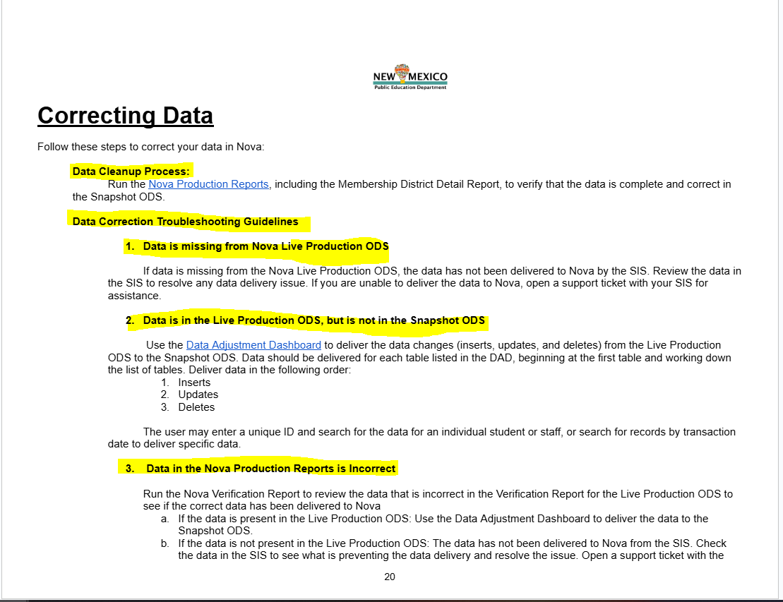
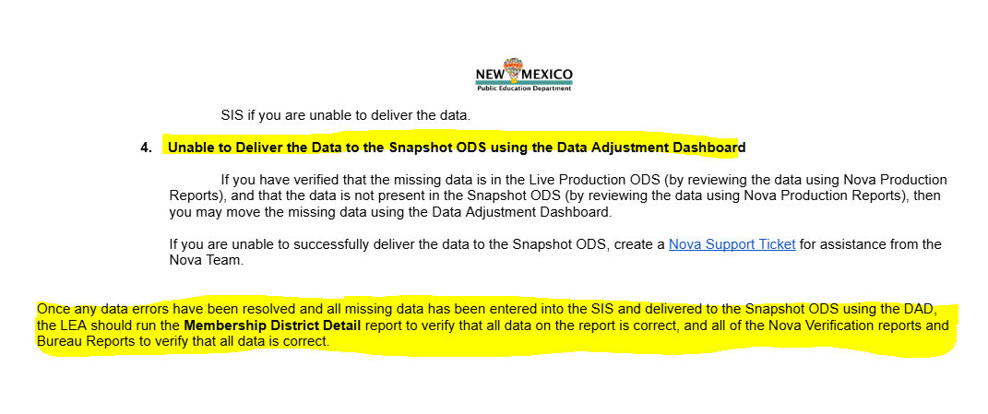
Data Corrections
Nova Manual- Page 20
Notes:
Liz

Slide 47

Indicator 13 Secondary Transition Update
Reviews of Indictor 13 Secondary Transition IEPs has started and is on going we hope to be finished by mid March.
If you want to see your score, check the SE Monitoring site
Information Technology Applications – New Mexico Public Education Department
Notes:
Liz

Slide 48
Significant Discrepancy & Disproportionate Representation
LEAs found to have Significant Discrepancy (Indicators 4A & 4B) and Disproportionate Representation (Indicators 9 & 10) will be notified soon via a memorandum to be sent to the Superintendent. The Special Education Director will be copied.
LEAs receiving this letter have met the criteria for Significant Discrepancy and Disproportionate Representation.
Next Steps are to determine if the LEAs Policies Procedures and Practices contributed to the LEAs non-compliance.
LEAs will be asked to submit Policies, Procedures and Practices to the OSE.
If letter is received, read carefully and follow all steps outlined.
Notes:
Randy

Slide 49
Significant Discrepancy & Disproportionate Representation
Disproportionate representation (4A) defined:
- No minimum cell size
- Minimum N size of 10: LEAs must have at least 10 students with disabilities enrolled
- Threshold of significance: 3 times of the state rate.
Disproportionate representation by Race/Ethnicity (4B) defined:
- No minimum cell size
- Minimum N size of 10: number of students with disabilities of a particular race/ethnicity enrolled in the LEA
- Threshold of significance: 3 times of the state rate.
Disproportionate representation (10) defined:
1. Calculation method: Risk Ratio and Alternate Risk Ratio
2. Threshold at which disproportionate representation is identified: Risk Ratio (RR) and Alternate Risk Ratio (ARR) of 3.0 or above (over-representation) for students ages 5 in Kindergarten – 21
3. Number of years of data used in calculation: One year
4. Minimum cell size: Greater than 10 students or more in racial/ethnic group category and disability category
Notes:
Randy

Slide 50

Data & Finance Shoutouts
Rachel Rael is RETIRING!!!!!!!!!!!!!
Thank you for all you have done for the New Mexico School of the Deaf!
Puente para los Ninos Review Committee Members​
Notes:
Randy

Slide 51

Resources
February 2025 OSE Newsletter
OSE Parent Portal
OSE Resources
Have Questions for OSE?
ose.support@ped.nm.gov
LEA Managed Booklet
Notes:
Thanks Liz! Please find links to the OSE Parent portal, Newsletter, Resources, LEA Managed Booklet or if you have questions for OSE. Just a reminder, you can find Office Hours recordings and slide decks on the PED website, navigate to special education, under the resources tab.

Slide 52
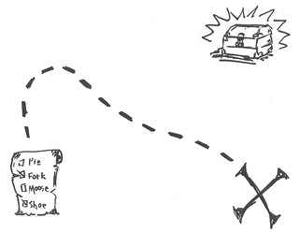
Scavenger Hunt

Slide 53
Contact List
Rapanut, Randall | randall.rapanut@ped.nm.gov | Assistant Deputy Director of Data & Finance
Cordova, Trudy | trudy.cordova@ped.nm.gov | Education Administrator, Professional Development
Dinsmore, Jessica | jessica.dinsmore@ped.nm.gov | Education Administrator, Program and Support Specialist
Burkett, Tammy | tamara.burkett@ped.nm.gov | Education Administrator Data Analyst
Hedrick, Yaling | yaling.hedrick@ped.nm.gov | Education Administrator Program & Support monitor
Gonzales, Kim | kimberly.gonzales1@ped.nm.gov | Education Administrator Program & Support Specialist
Ellis, Kaity | kaitlin.ellis@ped.nm.gov | Social & Community Coordinator
Campbell, Natalie | natalie.campbell@ped.nm.gov | Assistant General Counsel
Esparza, Leticia | leticia.esparza@ped.nm.gov | Administrative Assistant
Ghosh, Sushmita | sushmita.ghosh@ped.nm.gov | Financial Coordinator III
Notes:
This is our continued list.

Slide 54
Contact List
Cage, Margaret | margaret.cage@ped.nm.gov | Deputy Cabinet Secretary
Jenkins, Tyre’ | tyre.jenkins@ped.nm.gov | Deputy Director, Office of Special Education
Marcotte, Charlene | charlene.marcotte@ped.nm.gov | Deputy Director of Data & Finance
Gill, Ria | ria.gill@ped.nm.gov | Assistant Deputy Director, OSE
Santistevan, Monica | monica.santistevan@ped.nm.gov | Program Support Specialist
Perea, Sharyn | sharyn.perea@ped.nm.gov | Dispute Resolution Coordinator
Cassel, Elizabeth | elizabeth.cassel@ped.nm.gov | Parent and Community Liaison, Complaints and CAPS
Pacheco, Lorie | lorie.pacheco@ped.nm.gov | General Supervision, Low Incidence, NIMAS/NIMAC
Schweiger, Liz | liz.schweiger@ped.nm.gov | Education Administrator, Data Analyst, Indicator 13
Sellers, Kaylock | kaylock.sellers@ped.nm.gov | Financial Coordinator
Quick, Catherine | catherine.Quick@ped.nm.gov | General Supervision

Slide 55

Mark Your Calendars!
March 18, 2025
Time: 9:00 a.m. – TBD
Location: Virtual, Microsoft Teams Click here to join the meeting
Click here to join the meeting
Meeting ID: 252 341 847 618
Passcode: 7tVTBm
Or call in (audio only)
+1 505-312-4308,,779020632#
Phone Conference ID: 779 020 632#
Notes:
Next OHS is February 18, 2025 @ 3:30. Using feedback and analytics, Office Hour Sessions will change time from 3:30 to 9:00 am, every third Tuesday of the month beginning March 2025!!!!

