Slide 1
FY24 FINANCIAL AUDIT RESULTS STATE CHARTER SCHOOLS MARCH 21, 2025

Slide 2
FINDINGS DEFINITIONS
MATERIAL WEAKNESS
SIGNIFICANT DEFICIENCY
A material weakness is a deficiency, or a combination of deficiencies, in internal control such that there is a reasonable possibility that a material misstatement of the entity’s financial statements will not be prevented, or detected and corrected on a timely basis. (Material non-compliance just as severe).
A significant deficiency is a deficiency or a combination of deficiencies in internal control that is less severe than a material weakness, yet important enough to merit attention by those charged with governance.

Slide 3
MORE DEFINITIONS
COMPLIANCE AND OTHER MATTERS
RESPONSE TO FINDINGS
Instances of noncompliance or other matters that are required to be reported under Government Auditing Standards issued by the Comptroller General of the United States, the financial statements of the governmental activities (GASB).
Management’s response to the findings identified in the audit and described in the accompanying schedule of findings and questioned costs.

Slide 4
10 schools had 0 Findings!
Albuquerque Aviation Academy
AIMS
La Academia Dolores Huerta
McCurdy Charter School
New Mexico School for the Arts
Pecos Cyber Academy
Sandoval Academy for Bilingual Education
Southwest Preparatory Learning Academy (Renaissance Academy Charter School)
Taos Academy Charter School
Vista Grande High School

Slide 5
The downside ☹
3 schools received a disclaimed audit opinion
Estancia Valley Classical Academy
Monte Del Sol Charter School
South Valley Preparatory Academy
What is a Disclaimed Opinion?
The worst and most alarming opinion. The auditor was unable to obtain sufficient audit evidence on which to base an opinion. This could be due to many factors, including the school not cooperating with the auditor, a material doubt about the schools “going concern,” missing documents, errors, or uncertainties within the school itself. The issues are presented in the opinion letter contained in the audit document (see pp. 10-12).

Slide 6
FIVE SCHOOLS HAD A “GOING CONCERN” PP. 87-88
Alma d’Arte Charter High
Explore Academy Albuquerque
Explore Academy Las Cruces
Explore Academy Rio Rancho
Hózhó Academy
A going concern disclosure is accompanied with economic conditions that may include liquidity issues, or concerns about sufficient funds needed to maintain operations and meet obligations within a year of the financial statements.

Slide 7
Audit Findings By Category
Category New FY24 Repeat FY24 Repeat %
Non-compliance/Other Matters 113 32 28%
Significant Deficiency 23 7 30%
Material Weakness 48 21 43%
Material Non-compliance 1 0
TOTAL FINDINGS 185 60 32%

Slide 8
Audit Findings By Category
FY24 vs FY23
Category FY23 FY24 Change % Increase
Non-compliance/Other Matters 96 113 +17 18.0%
Significant Deficiency 14 23 + 9 64.0%
Material Weakness 38 48 + 10 26.0%
Material Non-compliance 0 1 +1 100%
TOTAL FINDINGS 148 185 +37 25.0%
Increase in audit findings in all categories.

Slide 9
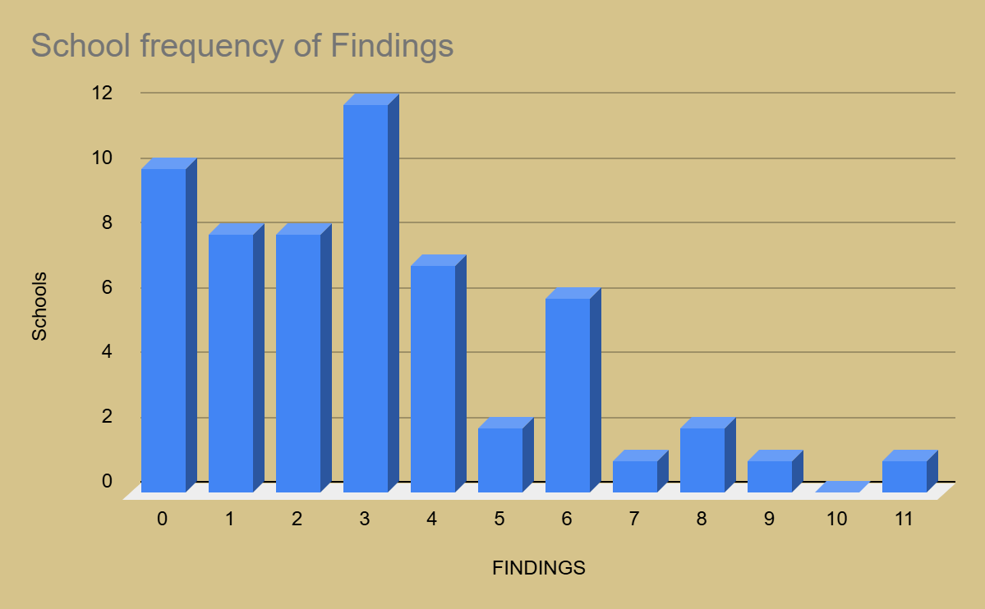

Slide 10
CATEGORIES OF FINDING
Finding Type # Schools Finding Type #Schools Finding Type #Schools
Accrual Issues 22 Background check missing 5 CPO Reg issues 2
Revenue Miscoded 22 Cash Disbursement issues 5 Prepaid Expend issues 2
RFP’s not done 17 Payroll issues 5 ACH misclassed 1
Travel & Per Diem Issues 17 Audit issues 4 BARs not approved 1
Capital Assets & Depreciation 16 Budget issues 4 Lease issues 1
Journal Entry Issues 15 Expenditures miscoded 4 MOE issues 1
BARs not completed 14 F/R Lunch issues 4 Purchasing issues 1
Deposit issues 13 IT issues 4 Segregation of duties 1
Fund Balance Rollover issues 10 RFR issues 4
Bank Recs don’t balance to G/L 8 Stale dated checks not voided 4
Cash Report/OBMS Report issues 8 Grant revenue exceeds expends 3
Payroll Liability issues 8 P-Card issues 3 HR Forms missing 7 Property Tax Receipt miscoded 3
Pledged Collateral insufficient 6 Board Reporting issues 2
PO Missing/done after the fact 6 Cash Balance issues 2
# of findings noted in categories exceed # of finding in the audit. This is due to some findings in the audit had multiple categorical findings

Slide 11
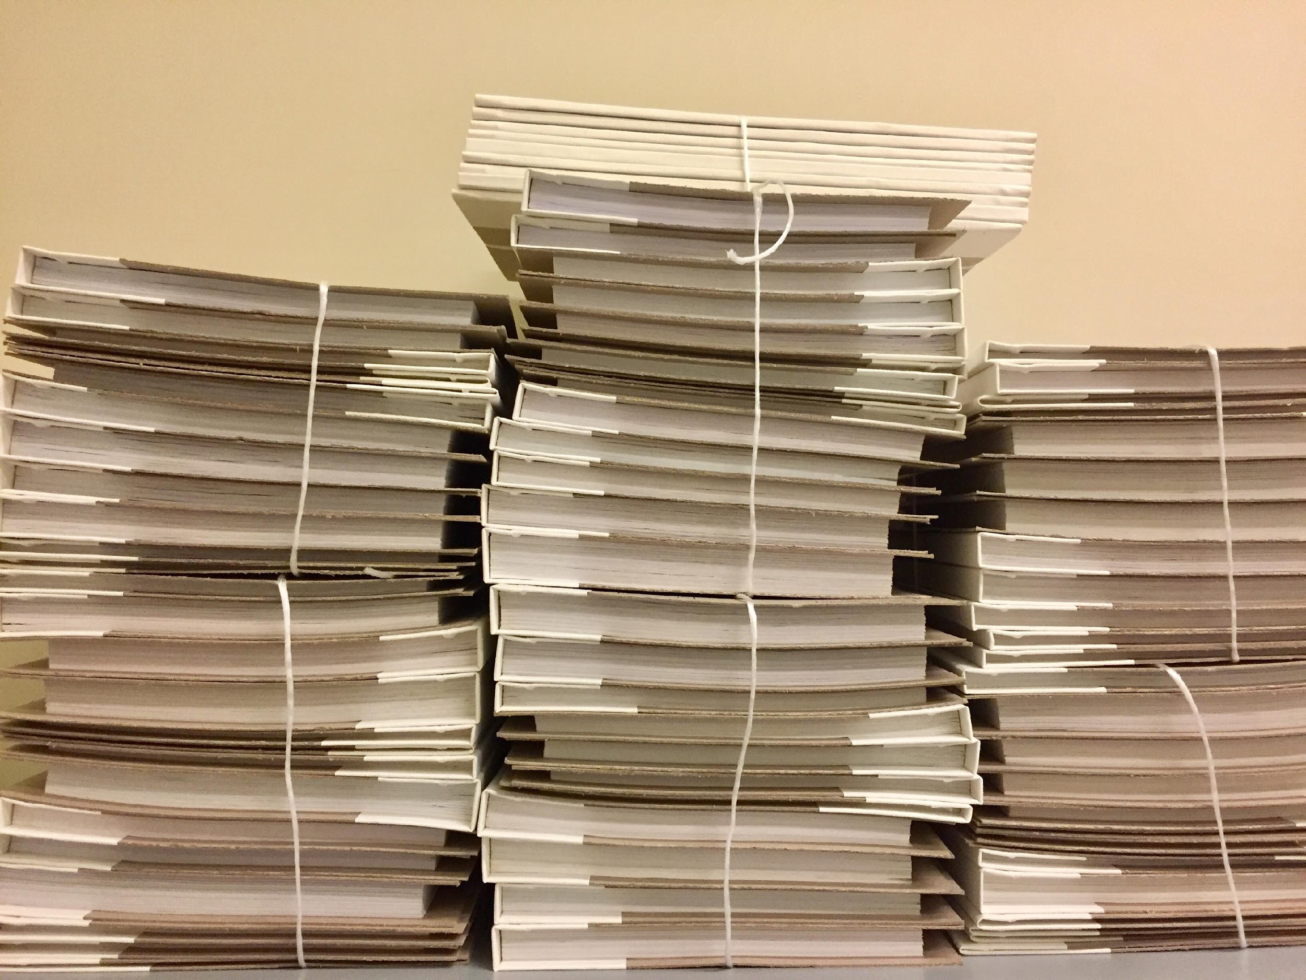
MOST FREQUENT REPEAT FINDINGS
End of Year BARs not completed
Internal Controls over cash disbursements
Financial Close and Reporting: numerous issues

Slide 12
School + Foundation Findings (detail breakdown)
182 Findings FY24 PEC portfolio
+ 3 Findings from Transfer schools
+ 7 Foundation Findings
Total combined = 192

Slide 13
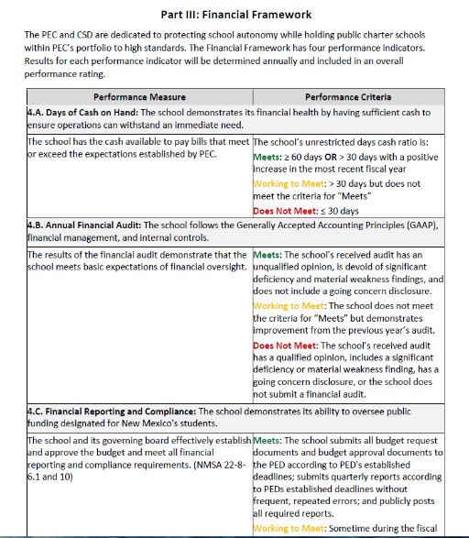
PERFORMANCE FRAMEWORK
VS
CAP RECOMMENDATIONS

Slide 14
CAP RECOMMENDATIONS BY TIER LEVEL
Tier 1 = 7 | Disclaimed Audit and/or Between 3-6 Material Weakness Findings, and Between 1-5 Repeat Findings, and Between 11-5 Total Findings. Financial Performance Framework ratings of “Does Not Meet” for at least one PF indicator
Tier 2 = 6 | 1-2 Material Weakness Findings, and At least one Significant Deficiency, and At least one, and up to 4 Repeat Findings Financial PF of “Does Not Meet” for at least one indicator
Tier 3 = 16 | At least one “Does Not Meet” PF indicator May have one MW and/or 1-2 SD and may have 1 -2 repeat findings
Tier 4= 31 | Has no MV or SD May have a “Working to Meet” in the older PF but NOT recommended for CAP

Slide 15
CORRECTIVE ACTION RECOMMENDATIONS
Alma d’Arte Charter High School +
Estancia Valley Classical Academy +
Hozho Academy
J Paul Taylor Academy
Monte del Sol Charter School *
Raices Del Saber Xinachtli Community School
South Valley Preparatory School
These schools have
A Disclaimed Audit (bold), and/or
Between 3-6 Material Weakness Findings, and
Between 1-5 Repeat Findings, and
Between 11-5 Total Findings.
Financial Performance Framework ratings of “Does Not Meet” for at least one PF indicators
* currently on a Financial Condition of Renewal
+ currently on a Financial CAP

Slide 16
Corrective
Action Plan Recommendations
CSD quarterly check-in with Head Administrator and Business Manager
Monitor actions in Management Response (or expansion of that response)
Monitor Board/Finance & Audit Committee work
Assess need for technical assistance/support
Quarterly or Twice/yearly Test of Internal Controls
Less frequent than current Financial CAP
Feedback each time to schools during check-ins

Slide 17
QUESTIONS?

