Slide 1


Reminders
Notes:
Please take a minute to ensure you are muted and any AI notetakers are turned off. Thank you!

Slide 2


Office Hour Sessions
Dr. Margaret Cage
Deputy Secretary
The Office of Special Education
March 18, 2025
Notes:
Good afternoon and welcome to the March Office Hour Session!
Today will be providing updates, technical assistance, and professional development
A few housekeeping notes, The Office Hour Sessions Slide deck will be accessible on the PED website, in special education, under resources or may be found in the LEA Managed Booklet, under the resources tab.

Slide 3
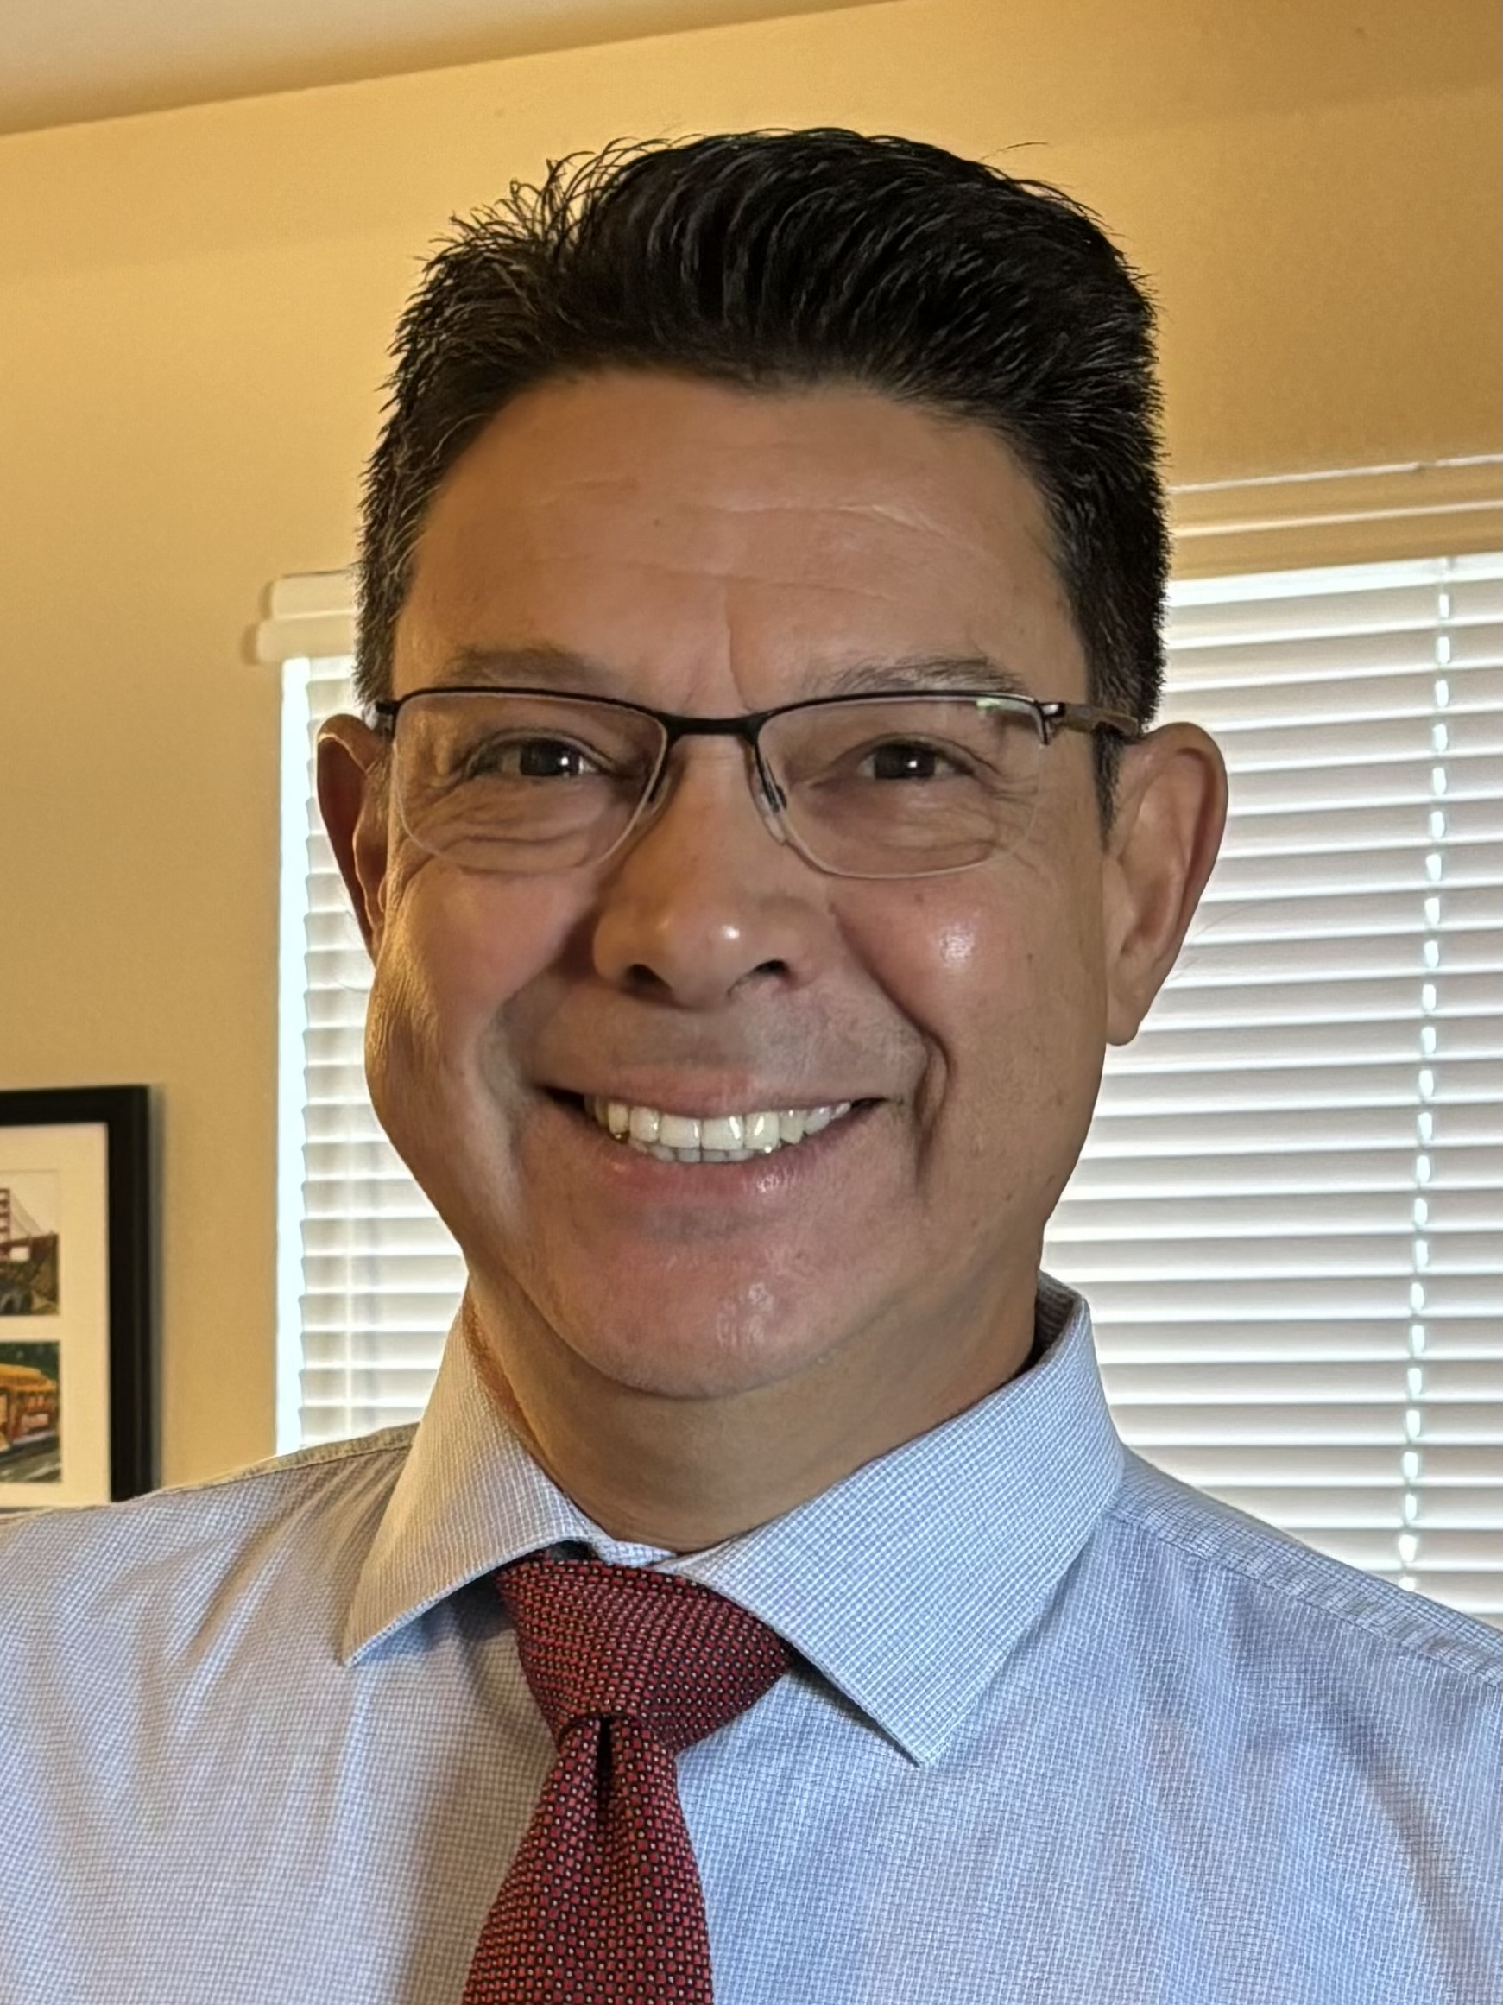
Leadership/Duties of the Office
Develop, review, and propose updates to state special education statutes, rules, policies, and technical assistance
Consult and coordinate with other units of the Department, other state agencies, public post-secondary educational institutions, and key education and community stakeholders on varying special education topics and issues
Coordinate with school districts and public post-secondary education institutions to develop and provide training and professional development to licensed school employees
Provide technical assistance and recommendations to school districts and public schools to implement evidence- and research-based programs and services that are culturally and linguistically responsive
Conduct activities to promote the recruitment and retention of qualified special education practitioners
Solicit input regarding delivery of special education services in the State from various stakeholders
Oversee and enforce the compliance with the IDEA and any state law pertaining to special education
Collect statewide data on varying aspects of special education within the state
Monitor spending of state and federal funds for special education programs
Develop and annually update a state plan for students with disabilities
Dr. Margaret Cage
Deputy Secretary, OSE
Dr. Tyre Jenkins
Deputy Director, OSE
Assistant Deputy Director of Data
Ria Gill
Assistant Deputy Director, OSE
Randall Rapanut
Assistant Deputy Director of Finance
Notes:
To the right, please find The Office of Special Education priorities that align with the executive order per Governor Lujan-Grisham. To your left, you will find The Office of Special Education Leadership team.

Slide 4

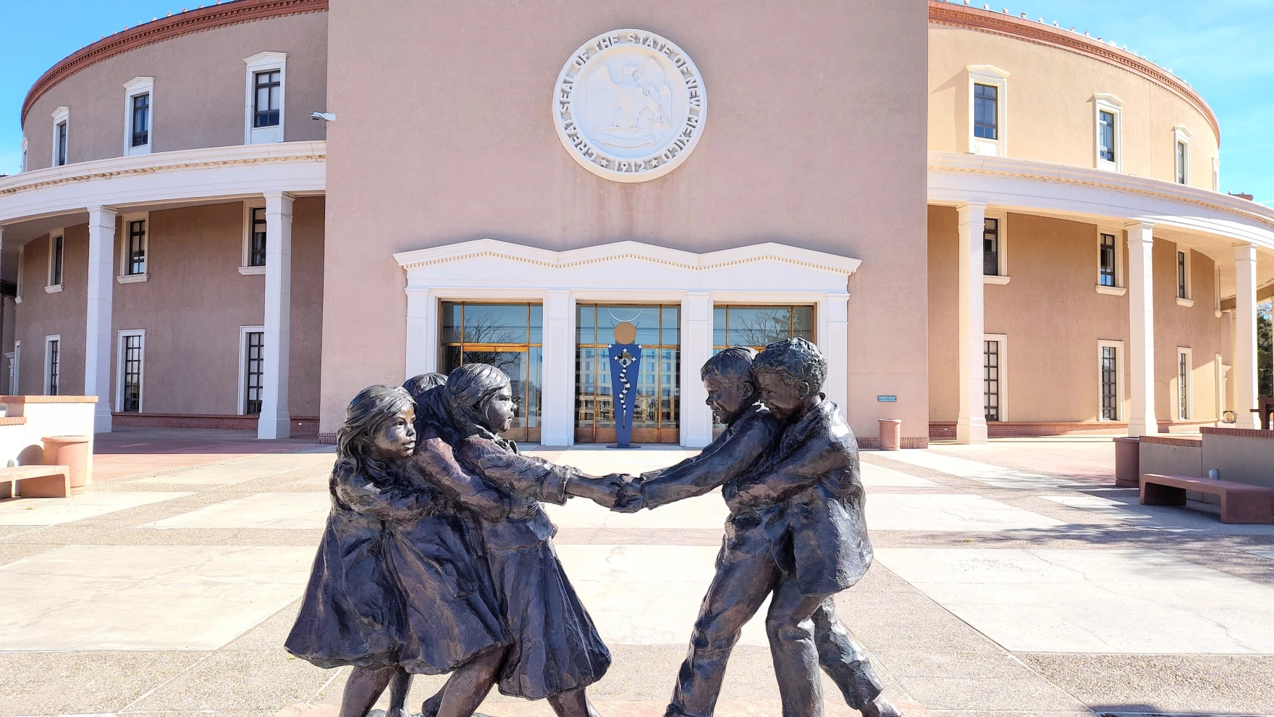
Hiring Updates
https://www.spo.state.nm.us/
Notes:
OSE is steadily increasing capacity and staff to better serve you. Just a reminder, we are hiring! Please check the state personal office website for job openings. It is our pleasure to introduce our newest employee, Samia Swarnali, do you want to introduce yourself?

Slide 5

Indicator 13 Secondary Transition School to Adult Life
Annual Reviews are complete for Secondary Transition I-13 please check the SE Monitoring site for your score
If you did not score 100% Compliance You will go to Prong 1 giving you
10 business days to correct the noncompliant IEPs,
Prong 1 Non-Compliant IEP Letters will go out next week
Upload the corrected IEPs, SE Monitoring site labeled (1234_Revised)
Questions, please email me Liz.Schweiger@ped.nm.gov

Slide 6


Partners for Employment
New Mexico Transition Programs
March 2025

Slide 7

AGENDA
  Introductions
  School-to-Work Transition Teams
  Training Portal
  Project SEARCH
  Partners for Employment Annual Conference
  Collaboration

Slide 8

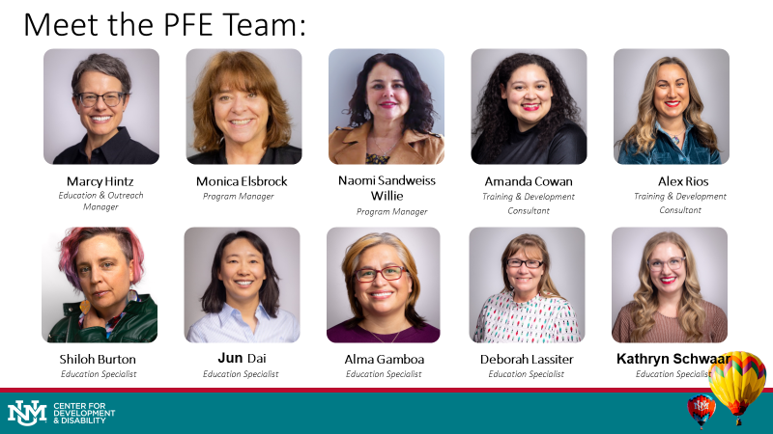

Slide 9
Statewide
School-to-Work
Transition Teams

Slide 10


Slide 11
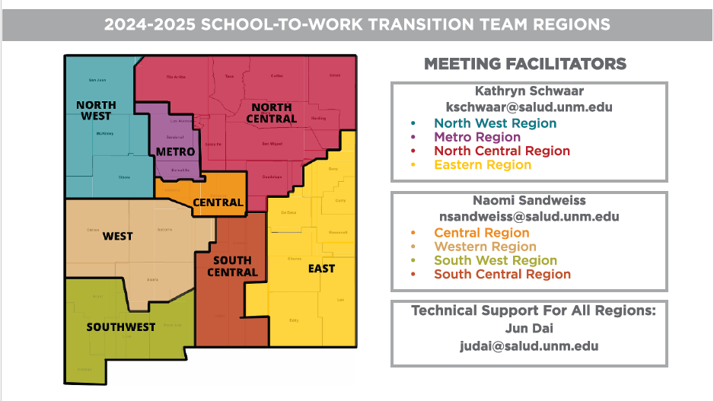
New Mexico
School-to-Work Regions

Slide 12
PFE TRAINING PORTAL
with New School-to-Work Transition Micro Trainings!
Notes:
Jun

Slide 13
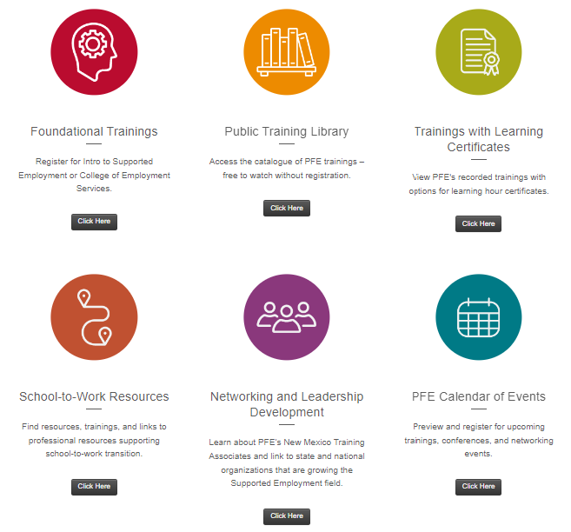
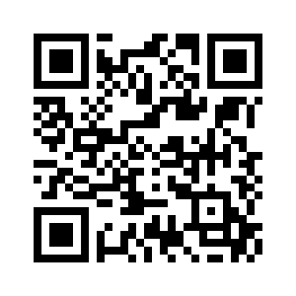
Accessing To PFE Training Portal
Direct URL:
https://cdd.health.unm.edu/pfe/
Notes:
Jun

Slide 14
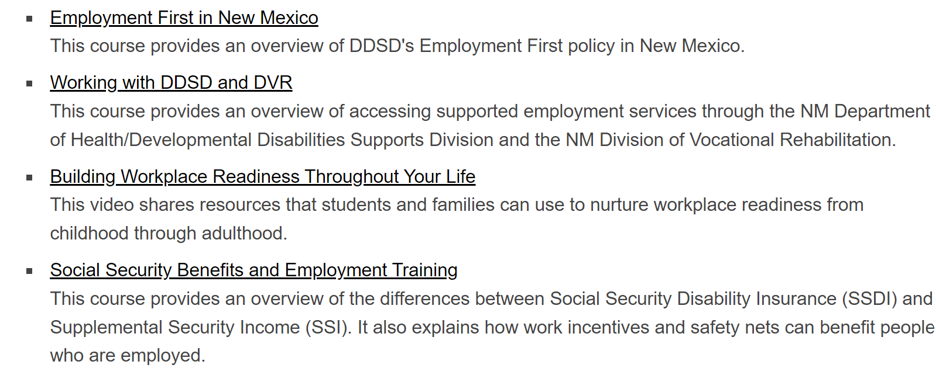

PUBLIC TRAINING LIBRARY
Use these trainings in:
Employment planning meetings
Job development discussions
Classroom Lessons
Notes:
Jun

Slide 15
Notes:
Kathryn

Slide 16
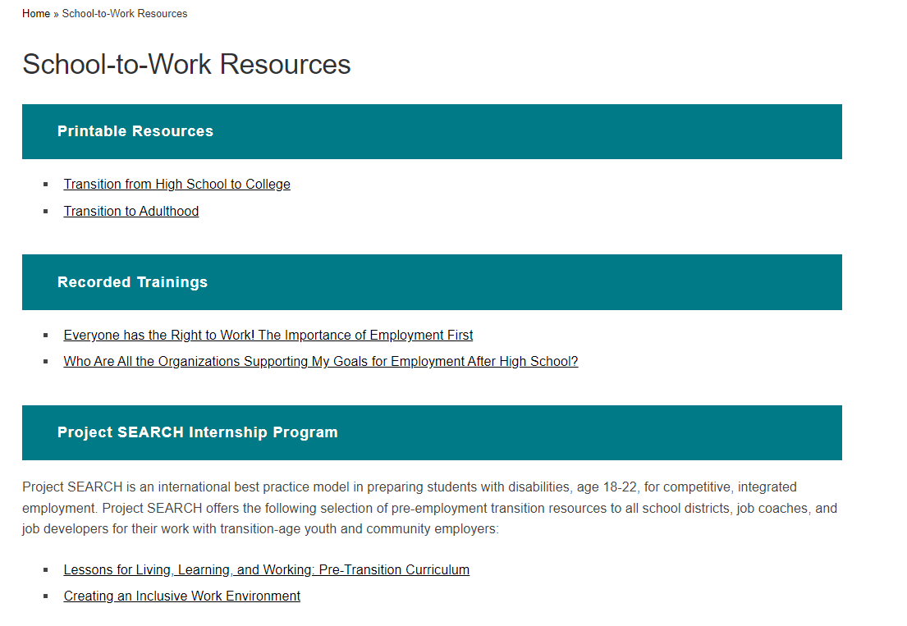

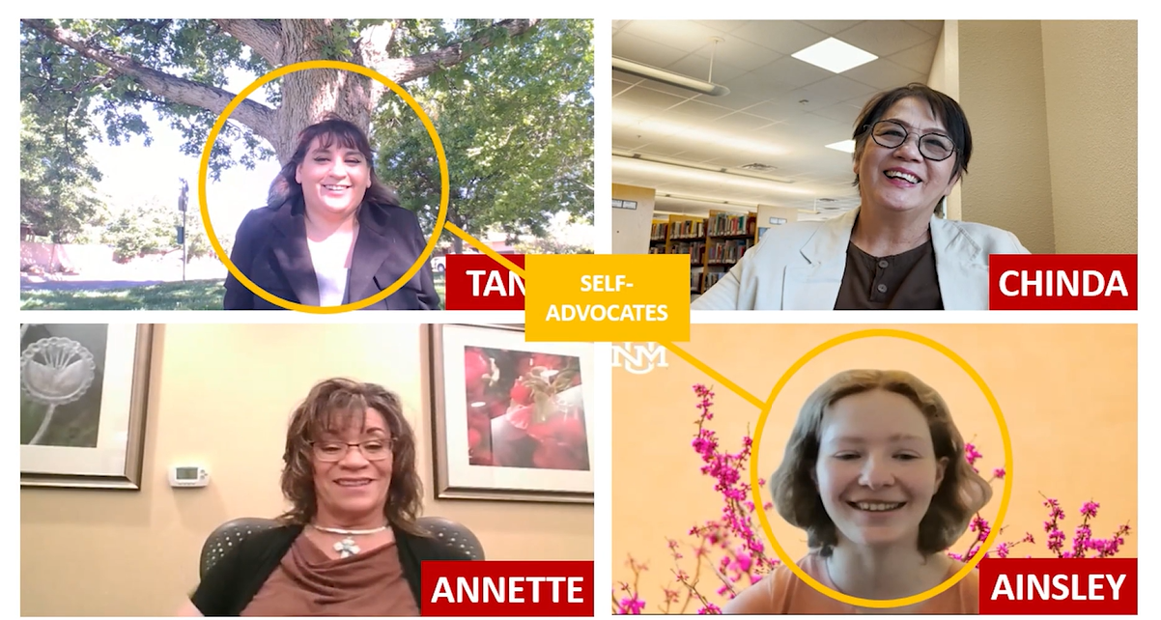

SCHOOL-TO-WORK RESOURCES
Notes:
Kathryn

Slide 17
Everyone Has The Right To Work!
The Importance of Employment First
https://vimeo.com/982820605/85aa5d2011
14:44
Notes:
Kathryn

Slide 18
Project SEARCH in New Mexico
Notes:
Jun

Slide 19
New Mexico Project SEARCH Sites and Sponors
14:44

Slide 20

Notes:
https://unmhealth.org/services/development-disabilities/programs/other-disability-programs/partners-for-employment/school-to-work-transition.html

Slide 21

Dates:
Thursday, April 10, 2025, and Friday, April 11, 2025
Location:
Santa Ana Star Hotel
54 Jemez Canyon Dam Rd, Bernalillo, NM 87004

Slide 22
THANK YOU!
Notes:
Naomi

Slide 23




Spring Special Education
Law Conference
LEAs are encouraged to send Superintendents,
School, and District Administrators, and Teachers that did not attend Fall conference
Scheduled
  Tuesday April 15, 2025, and Wednesday April 16, 2025
  Embassy Suite, Albuquerque
  Law Conference Registration
Priority will be given to individuals who did not attend the Fall Conference
Notes:
Thank you transition team! Chief Counsel Natalie Campbell has some exiting news to share. Natalie?

Slide 24


OSE Monthly Newsletter
  Depending upon the month, submissions are due to the OSE Newsletter by either the second Monday or Friday and should be sent to special.ednews@ped.nm.gov.
  Please share great things happening in your LEA to special.ednews@ped.nm.gov.
  The following form can be shared with colleagues who wish to receive the OSE Newsletter: OSE Signup Form.
  Here is a linked newsletter submissions schedule through December 2026, as to when article submissions are due.
  If you have questions about the newsletter email special.ednews@ped.nm.gov.
Notes:
Thank you, Natalie! Next up, Assistant Deputy Director of OSE, Ria Gill. Ria?

Slide 25


IDEA B Panel Meetings
Final meeting of the 2024-2025 school year.
IDEA B Panel Virtual Meeting
Dates: Thursday, May 1, and Friday, May 2, 2025
Time: 9:00 a.m.
Location: TBD (IDEA)
Summary:
According to the Individuals with Disabilities Education Act (IDEA), the State of New Mexico must establish and maintain an advisory panel to provide policy guidance for special education and related services for children with disabilities in the state. The IDEA Advisory Panel’s role is to advise the New Mexico Public Education Department regarding serving students with disabilities through Part B of IDEA.
Contact Kaity Ellis for questions
kaitlin.ellis@ped.nm.gov
505-709-7690
Notes:
Kaity to present.

Slide 26



Special Education Ombud Flyers
Please direct all website staff, schools, and school personnel to take down the old flyers and post the new flyers in well trafficked areas.
If you would like information about our intake process, family presentations, or general information about our work, please contact:
Clare Gallegos (505) 841-3885
Jody Myers (682)554-6672
Michelle Tregembo (505)274-3885
Notes:
Thank you, Kaity. Next up, Ombud.

Slide 27

Professional Development Calendar
Month | Professional Development Opportunities
March 2025 | Alternate Standards Virtual Session 1 Special Education Director Fellow Virtual Session 1 Aspiring Academy Virtual Session 1 & 2 Parent University Virtual Session 2-Know Your Rights
April 2025 | Special Education Director Fellow Virtual Session 2 Alternate Standards Virtual Session 2 Aspiring Academy Virtual Session 3 Parent University Virtual Session 3-High Quality IEPs Spring Special Education Law Conference Alternate Standards Onsite Sessions 2 Parent University Virtual Session 4-Comm & Collab
May 2025 | Aspiring Academy Virtual Session 4 Implementing High-Quality IEPs Virtual Session 1 & 2 + Onsite Sessions Special Education Director Fellow Virtual Session 3 Parent University Virtual Session 5-Transition IDEA Panel Meeting
June 2025 | Special Education Director Fellow Onsite Sessions 2 &4 Aspiring Academy Virtual Session 5
Notes:
Next up is the PD team. PD team come on up!

Slide 28
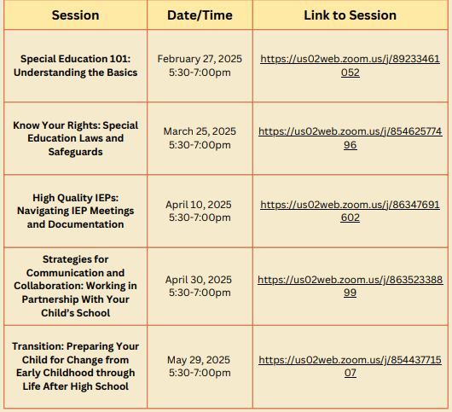
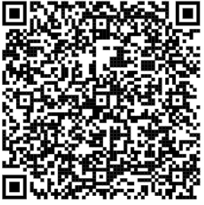

Parent University: Virtual Sessions!
These 90-minute sessions offer valuable insights into the special education process, advocacy skills, communication techniques & SO MUCH MORE!
Scan here to Register!
Zoom Links will be emailed to you!
Want to host a screening?
Email Kaity Ellis at kaitlin.ellis@ped.nm.gov for more details!

Slide 29


2025 Spring Special Education Academy

Slide 30

2025 Spring Special Education Academy
Conference Themes!
Behavior Support & Intervention – Strategies for managing diverse behavioral needs, including FBAs, BIPs, and legal compliance.
Data Collection & Progress Monitoring – Using data and technology to track student progress and improve special education services.
Collaboration & Stakeholder Engagement – Strengthening teamwork, parent involvement, and inclusive practices.
Leadership & Professional Growth – Enhancing special education leadership, PLCs, and professional development.
Date: April 28-30, 2025
Location: Albuquerque Embassy Suites
SAVE THE DATE!!
Registration Coming Soon!!

Slide 31

2024-2025 Program Monitoring
On-Site Monitoring
Involves in-person visits to schools withing each LEA.
Comprehensive reviews include interviews, classroom observations, and documentation analysis.
Desktop Monitoring
Conducted remotely through reviews of documentation and data submitted by LEAs.
Focuses on analyzing IEPs assessment data, and other relevant materials to ensure compliance with federal and state regulations and to identify areas for improvement.
Self-Monitoring
LEAs are responsible for conducting internal monitoring activities and submitting findings to OSE.
Encourages LEAs to take ownership of their special education programs while receiving guidance and support as needed.
Primary Objectives
Identify strengths
Address areas for improvement; identify and correct noncompliance
Enhance outcomes for all students
Identify potential statewide professional development opportunities
Notes:
On-Site Monitoring
a. Involves in-person visits to schools within each LEA.
b. Comprehensive reviews include interviews, classroom observations, and documentation analysis related to special education programs, practices, and services.
Desktop Monitoring
Conducted remotely through reviews of documentation and data submitted by LEAs.
Focuses on analyzing IEPs, assessment data, and other relevant materials to ensure compliance with federal and state regulations and to identify areas for improvement.
Self-Monitoring
LEAs are responsible for conducting internal monitoring activities and submitting findings to OSE.
Encourages LEAs to take ownership of their special education programs while receiving guidance and support as needed.

Slide 32

Program Monitor Trainings and Windows of Execution
February 5, 2025: Participate in an introductory monitoring webinar. Special Education Monitoring: An Overview of IDEA and NMAC Requirements. February 18, 2025: Participate in a virtual NMPED-hosted training session for LEAs to review monitoring expectations and receive guidance on required documentation. Registration Link for February 18th – Virtual Session February 19, 2025: Participate in an in-person NMPED-hosted training session for LEAs to review monitoring expectations and receive guidance on required documentation. Registration Link for February 19th – In Person Session | Letters will be sent to Superintendents and Special Education Directors: Onsite Monitor Window: March 24, 2025 – April 18, 2025 Desk-top Monitor Window: March 17, 2025 – March 31st, 2025 Self-Assessment Monitor Window: March 5, 2025 – April 14th, 2025

Slide 33

Program Monitoring Tools
Program Monitoring
The Program Monitoring Tool can be found here:
  OSE Program Monitoring Protocol – Google docs (Updated February 2025)
  OSE Program Monitor Guide - Google docs (Updated February 2025)
LEAs selected for monitoring - start reviewing the tool and preparing documents which will be requested.
LEAs not undergoing monitoring this round should also begin reviewing the protocol to ensure all requirements are being met.
Child Find
Least Restrictive Environment
Early Childhood Special Education
Service Delivery
Discipline
Alternate Assessment

Slide 34


Data & Finance Calendar
Data Training: Purple
Finance Training: Blue
Training Key
October 2024
November 2024
December 2024
January 2025
Indicator 13 Annual Review Training for LEAs
Pre-finding Correction Training for LEAs
40-Day Reporting opens, data review begins
Excess cost compliance completion by LEAs
MOE compliance completion by LEAs
Determination Letters sent to LEAs
80-Day data reporting training
40-Day data review closes
Time and Effort Training for LEAs
High-Cost Fund Training
40-Day Pre-finding letter released
MOE Letters sent to LEAs
Indicator 13 Review sample provided to LEAs
80-Day data reporting opens, data review begins
Quarterly spending reports sent to LEAs
Puente Para Los Ninos High-Cost Fund applications released
120-Day data Reporting Training
80-Day data review closes
Indicator 13 Pre-finding notices sent to LEAs
80-Day Pre-finding letters released to LEAs
Time & Effort due from LEAs
Puente Para Los Ninos High-Cost Fund application submission deadline
February 2025
March 2025
April 2025
May 2025
SPP/APR Stakeholder Engagement meetings
120-Day data review opens, data review begins
Indicator 13-Prong 2 review completion
BOLO for NMASBO Spring Budget Conference Announcements
Advertisements for SPP/APR Stakeholder Meetings
SPP/APR Due to OSEP
120-Day data review closes
NMASBO School Budget Conference
Quarterly Spending Reports sent to LEAs
State IDEA B Application posted for public review
Puente Para Los Ninos High-Cost Fund awards issued
Indicator 8-Parent Surveys sent out to sampled parents.
MOE eligibility completion by LEAs
Excess Cost Base completion by LEAs
SPP/APR Stakeholder meetings
State Application-Public Comment opens
End of Year (EOY) data reporting training
DPR Training
Indicator 14-Post School Outcomes survey data collections begin
EOY reporting opens, reviews begin
IDEA B application open for LEA completion
SPP/APR Stakeholder engagement meeting
District Profile Report (DPR) data posted on DPR site
State Application-Public Comment closes
1 month to the end of state fiscal year
June 2025
July 2025
August 2025
September 2025
Budgets in OBMS due
Quarterly spending report sent to LEAs
IDEA B applications due from LEAs
Submit RfRs prior to end of Fiscal Year
All LEA IDEA B applications in “Approved by State” or “Substantially Approved” status
State Fiscal Year ends (6/30)
Start of New Fiscal Year (7/1)
Nova Conference
OBMS Deadlines-Reimbursement requests, accounts and payable invoices
Time & Effort for LEAs due
Encumber Funds expiring September 30
EOY Pre-finding letters released to LEAs
Federal Child Count DUE to USDE
Complete and submit Indicator 14 Data Collection
EOY Pre-finding notices sent to LEAs
Nova Conference
IDEA B applications must be fully approved
Board meeting agendas and minutes must be submitted on or before (8/30)
Encumber funds expiring in September
Complete Inventory of Supplies and Materials
40-Day data reporting training
Annual determination training
Excess cost compliance training
MOE Compliance training
Indicator 14 data due from LEAs
Quarterly spending reports sent to LEAs
OSE Law Conference
Federal Funding expires (9/30)
Notes:
Assistant Deputy of Finance Randy will kick us off today. Randy?

Slide 35

Data & Finance
March 2025
120-Day data review closes
NMASBO School Budget Conference
Quarterly Spending Reports sent to LEAs
State IDEA B Application posted for public review
Puente Para Los Ninos High-Cost Fund awards issued
Notes:
Randy

Slide 36

LEA Time and Effort Submission
To meet federal requirements, LEAs will be required to begin submitting Time and Effort Documentation.
  LEAs may use their own forms so long as it contains all information required.
Time and Effort form due dates:
  March 31, 2025: Period of July 1, 2024, to December 31, 2024
  July 31, 2025: Period of January 1, 2025, to June 30, 2025

Slide 37

LEA Time and Effort Submission
Time and effort (T&E) forms will be uploaded to the Special Education Monitoring site.
  Folders:
    Finance Folder
      Time and Effort Folder
        2024-2025 Folder
          Upload T&E forms in this folder.
For access to the SE Monitoring site, contact Mahesh Reddy-Erri at mahesh.reddy-erri@ped.nm.gov

Slide 38

Excess Costs Reminders
Excess Costs Compliance calculation submissions are currently overdue.
  New deadline for submission will be Monday, March 31st
Forward any questions to kaylock.sellers@ped.nm.gov and randall.rapanut@ped.nm.gov
The excel instruction sheet can be found here:
LEA Managed Booklet under Finance Reviewer Assignments

Slide 39

RfR Tips
To avoid the need for info requests and delays in approval, please ensure that:
  Backup documentation is provided for all expenses
    For example:
      Purchase orders
      Invoices
      Administrative Staff Consideration Form
      OBMS Documentation is uploaded as a landscape
  All expenses are:
    An Excess Cost of providing special education and related services
    Allocable – only correct share of cost is charged
    Reasonable – costs meet the prudent person test
    Necessary – needed to provide special education and related services

Slide 40








Data/Finance Team Contact List
Office of Special Education Data Team:
liz.schweiger@ped.nm.gov
tamara.burkett@ped.nm.gov
trudy.cordova@ped.nm.gov
Office of Special Education Finance Team:
kaylock.sellers@ped.nm.gov
samia.swarnali@ped.nm.gov
sushmita.ghosh@ped.nm.gov
randall.rapanut@ped.nm.gov

Slide 41
Contact List
Cage, Margaret | margaret.cage@ped.nm.gov | Deputy Cabinet Secretary
Jenkins, Tyre’ | tyre.jenkins@ped.nm.gov | Deputy Director, Office of Special Education
Swarnali, Samia | samia.swarnali@ped.nm.gov | Financial Coordinator
Gill, Ria | ria.gill@ped.nm.gov | Assistant Deputy Director, OSE
Santistevan, Monica | monica.santistevan@ped.nm.gov | Program Support Specialist
Perea, Sharyn | sharyn.perea@ped.nm.gov | Dispute Resolution Coordinator
Cassel, Elizabeth | elizabeth.cassel@ped.nm.gov | Parent and Community Liaison, Complaints and CAPS
Pacheco, Lorie | lorie.pacheco@ped.nm.gov | General Supervision, Low Incidence, NIMAS/NIMAC
Schweiger, Liz | liz.schweiger@ped.nm.gov | Education Administrator, Data Analyst, Indicator 13
Sellers, Kaylock | kaylock.sellers@ped.nm.gov | Financial Coordinator
Quick, Catherine | catherine.Quick@ped.nm.gov | General Supervision

Slide 42
Contact List
Rapanut, Randall | randall.rapanut@ped.nm.gov | Assistant Deputy Director of Data & Finance
Cordova, Trudy | trudy.cordova@ped.nm.gov | Education Administrator, Professional Development
Dinsmore, Jessica | jessica.dinsmore@ped.nm.gov | Education Administrator, Program and Support Specialist
Burkett, Tammy | tamara.burkett@ped.nm.gov | Education Administrator Data Analyst
Hedrick, Yaling | yaling.hedrick@ped.nm.gov | Education Administrator Program & Support monitor
Gonzales, Kim | kimberly.gonzales1@ped.nm.gov | Education Administrator Program & Support Specialist
Ellis, Kaity | kaitlin.ellis@ped.nm.gov | Social & Community Coordinator
Campbell, Natalie | natalie.campbell@ped.nm.gov | Assistant General Counsel
Esparza, Leticia | letica.esparza@ped.nm.gov | Administrative Assistant
Ghosh, Sushmita | sushmita.ghosh@ped.nm.gov | Financial Coordinator III
Notes:
This is our continued list.

Slide 43

Resources
March 2025 OSE Newsletter
Have Questions for OSE?
ose.support@ped.nm.gov
LEA Managed Booklet
OSE Parent Portal
OSE Resources
Notes:
Please find links to the OSE Parent portal, Newsletter, Resources, LEA Managed Booklet or if you have questions for OSE. Just a reminder, you can find Office Hours recordings and slide decks on the PED website, navigate to special education, under the resources tab.

Slide 44




Mark Your Calendars!
April 15, 2025
Time: 9:00 a.m. – TBD
Location: Virtual, Microsoft Teams Click here to join the meeting
Meeting ID: 252 341 847 618
Passcode: 7tVTBm
Or call in (audio only)
+1 505-312-4308,,779020632#
Phone Conference ID: 779 020 632#
Notes:
Next OHS is April 15, 2025 @ 9:00 a.m.

Slide 45

Questions???
Notes:
Questions? Please enter in the chat or raise your hand. Also, I will put in the chat the OSE Q&A (please look at the tab with todays date).

