Slide 1


Job Incentive Training Program (JTIP)
Work-Based Learning Community of Practice
Scott Groginsky, Deputy Cabinet Secretary NMDWS
Breezy Gutierrez, Director, CCRB NMPED
Marc Duske, Special Projects Manager, CCRB NMPED
Judith Cruz, Education Administrator CCRB NMPED
Jennifer DeRedin Youth WBL Program Coordinator NMDWS & CCRB NMPED
Denise Ojeda, Education Administrator CCRB NMPED
March 19th 2025 (3:00 pm)
Investing for tomorrow, delivering today.
Notes:
Judy

Slide 2

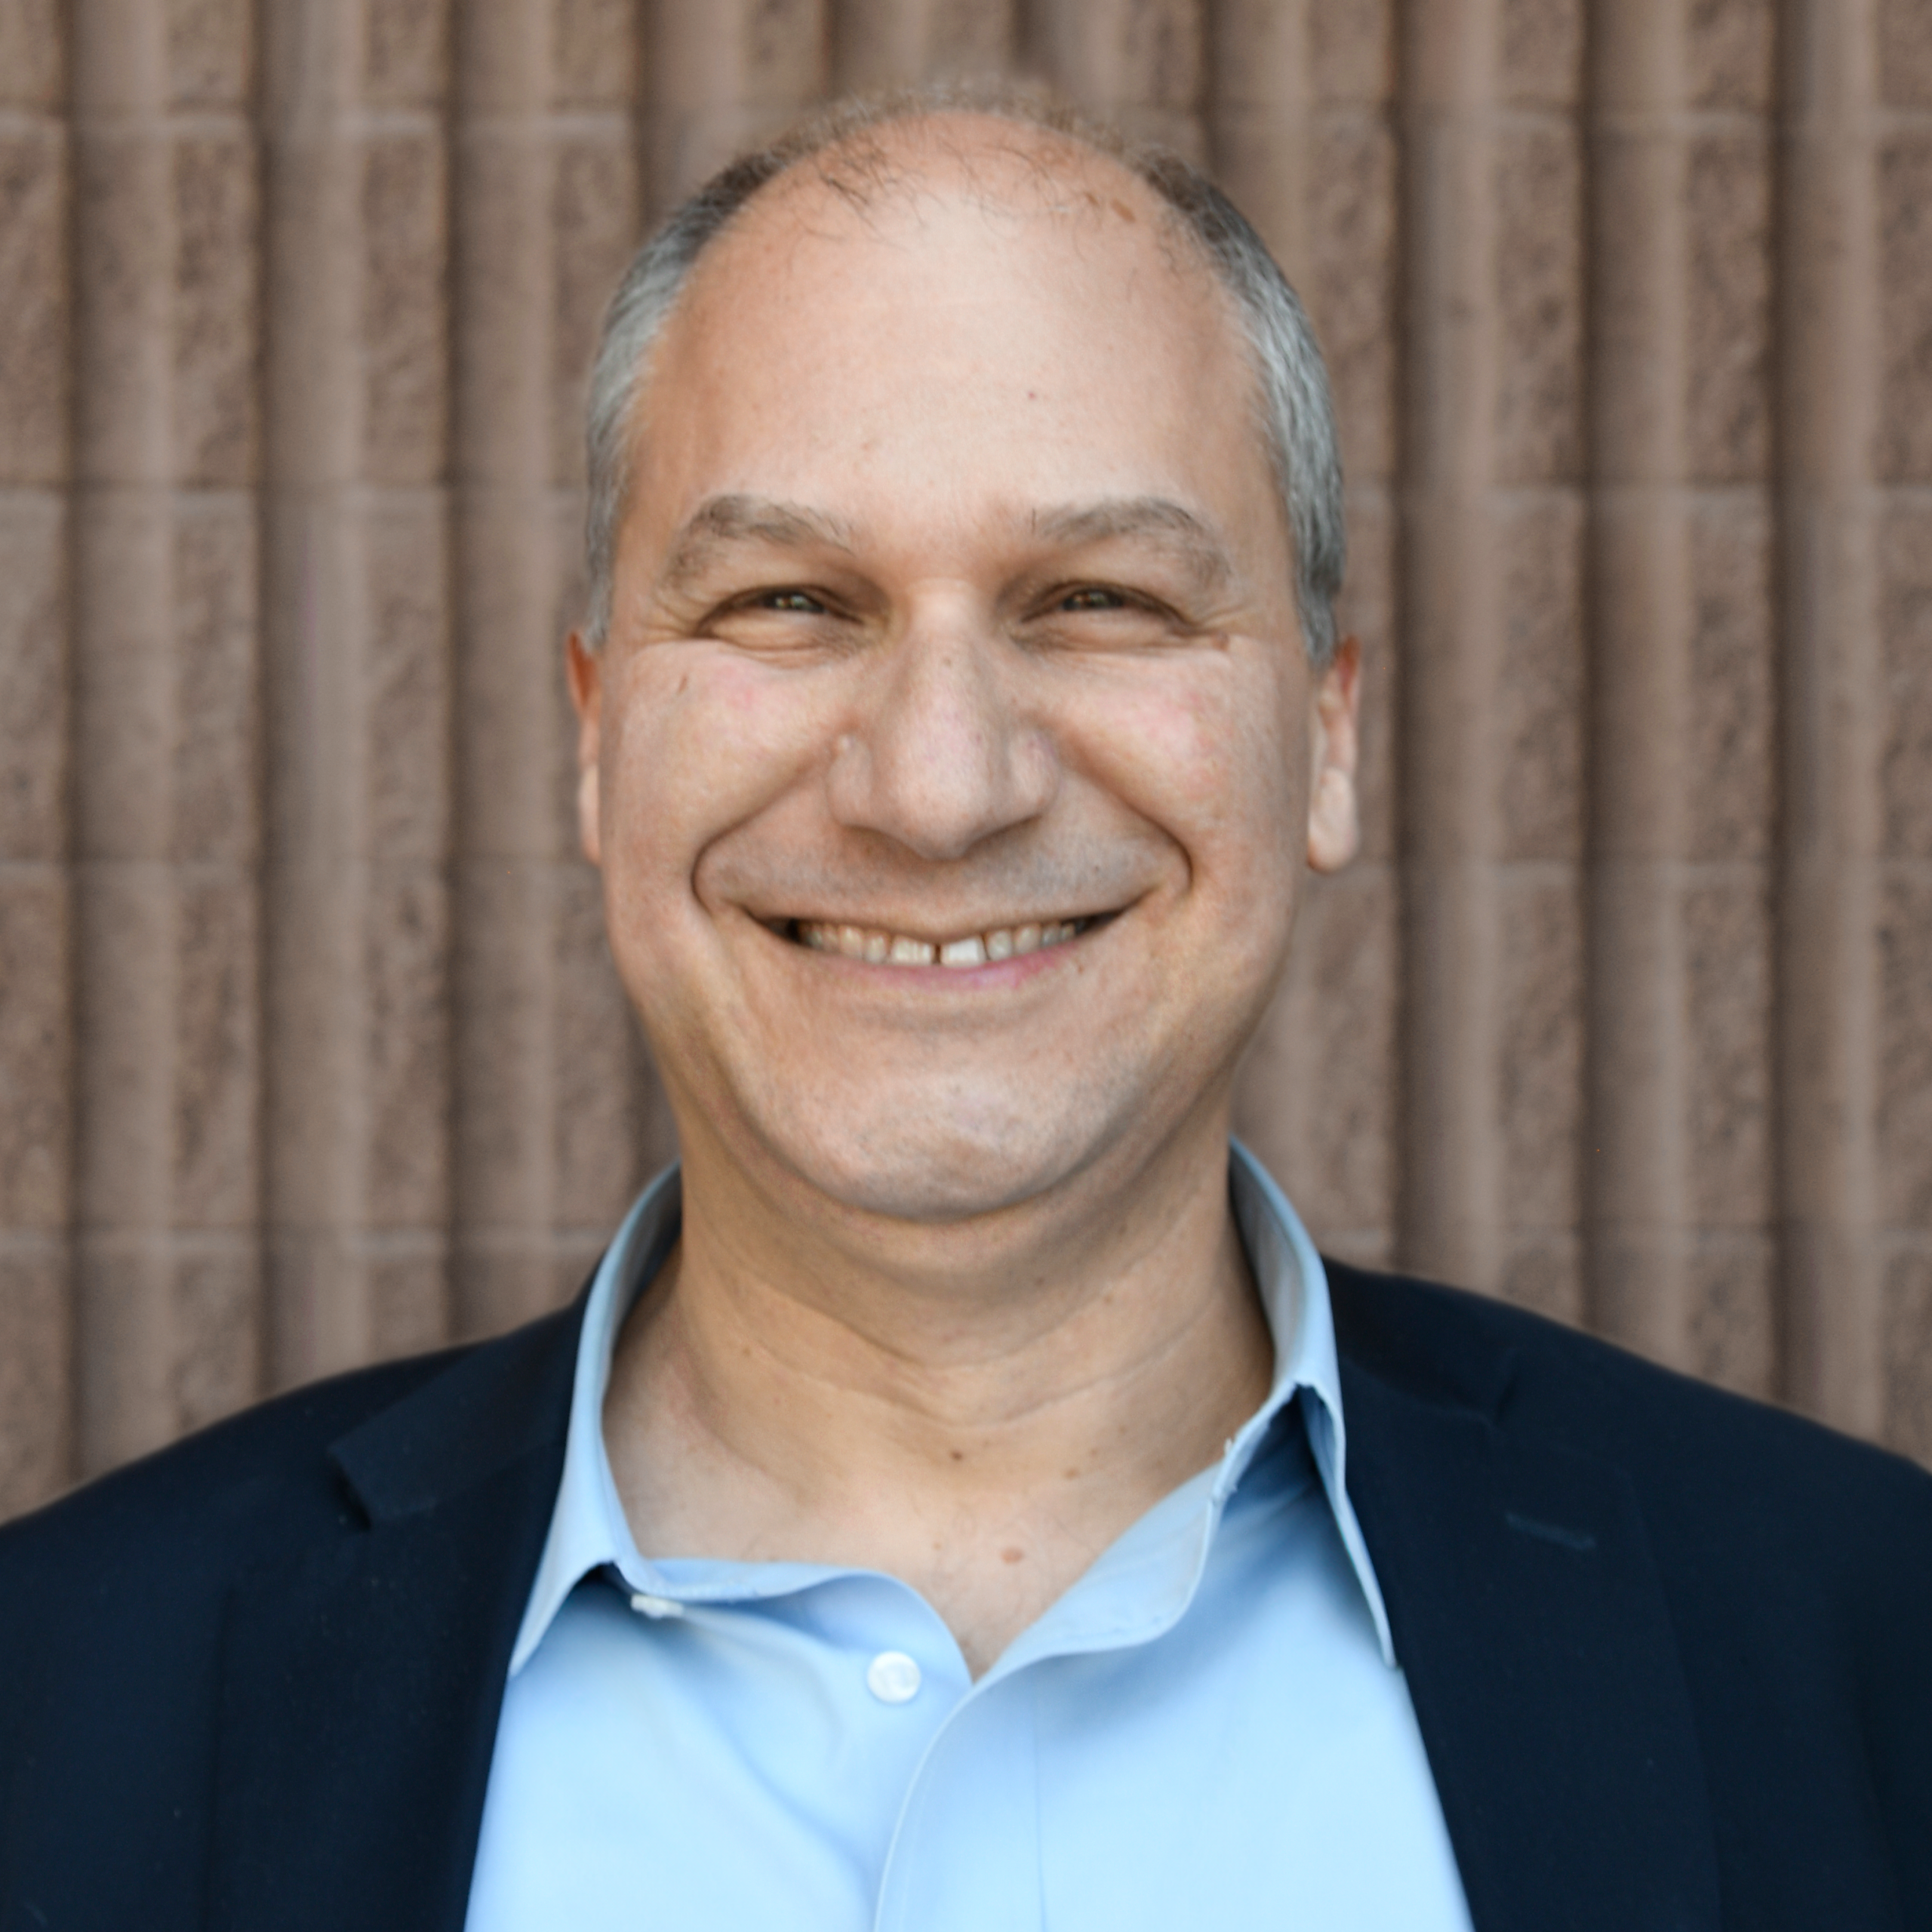

Who We Are?
College and Career Readiness Contacts
New Mexico Department of Workforce Solutions Contacts
Scott Groginsky
Deputy Cabinet Secretary
Scott.Groginsky@dws.nm.gov
Jennifer DeRedin
Youth WBL Program Coordinator
Jennifer.DeRedin@dws.nm.gov
Notes:
Karla (DWS)

Slide 3
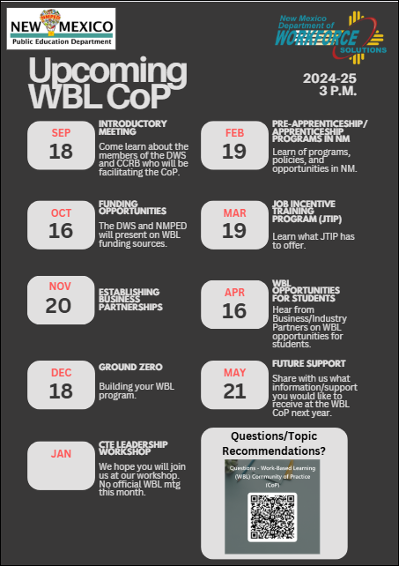
Work-Based Learning – New Mexico Public Education Department
Notes:
Judy

Slide 4
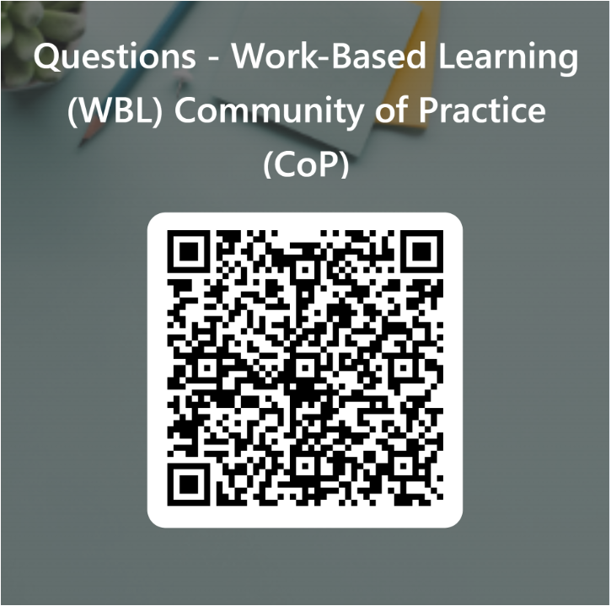
Questions QR Code & Next Steps
Next Meeting – April 16, 2025 (3:00 pm)
Agenda- WBL Opportunities for Students
Notes:
CoP #2 Topics for discussion-

